Slide 1
NEWHAM Healthy Living Needs Assessment
Informing 50 steps to a healthier Newham

Slide 2
CONTENTS
SECTIONS SLIDES
Background, methods & summary findings Slides 3 – 4
SECTION 1: Life Expectancy and Causes of Death Slides 5 – 12
SECTION 2: Determinants of Health Slides 13 – 19
SECTION 3: Risk Factors Slides 20 – 34
SECTION 4: Gap analysis - Needs vs Services Slides 34 – 52

Slide 3
BACKGROUND AND METHODOLOGY
What is the Healthy Living Needs Assessment?
The assessment is a review of the some of the factors that affect healthy living in Newham. Importantly, this includes some of the wider determinants of health, such as income and poverty, housing and air quality. These overarching determinants can lead to risk factors that prevent healthy living, such as smoking, physical inactivity, unhealthy diet and alcohol consumption. In turn, these risk factors contribute to people developing conditions such as obesity, high blood pressure, diabetes, cardiovascular diseases, chronic respiratory diseases and cancer. These conditions and their risk factors are the major drivers of the low healthy life expectancy in Newham. This Needs Assessment provides an overview of the determinants and risk factors in Newham, leading to a Gap Analysis to inform some of the strategies and interventions needed to make the borough healthier.
Where does the data come from?
The data in the needs assessment has been pulled together from a variety of sources, including numerical (quantitative data) such as the percentage of men who smoke, and perceptions (qualitative data) such as the barriers Newham residents face to healthy living. Service data is also provided in the gap analysis.
  The quantitative data comes from a variety of sources including GP practices, Public Health England, Sport England, National Child Measurement programme, and the Office for National Statistics. Quantitative service data includes the number of residents referred into, and successfully completing, relevant interventions such as Stop Smoking Services, NHS Health Checks, exercise on prescription (150 club) and the NHS Diabetes Prevention Programme.
  The quantitative data comes from the 2019 Newham Show and a series of nine focus groups conducted with 56 Newham residents between May and August 2019.

Slide 4
SUMMARY FINDINGS
A baby boy in Newham in 2018 can expect to live in good health until age 58 and 5 months and a baby girl to age 61 and 5 months. Six and three years fewer in good health, respectively, than the London average.
The disease conditions leading to this loss of population vitality are the most common causes of premature death and long term illness: heart disease, mental illness, lung and breathing diseases, cancers.
The causes of these diseases are a range of other long term illnesses (such as diabetes and hypertension), risk factors (such as obesity and low physical activity) and exposures to harmful agents (such as tobacco, alcohol, air pollutants and infectious diseases.)
Some risk factors are hard wired (age, genetics), while some (such as physical activity, healthy diet and tobacco consumption) can be modified.
Newham has the 3rd highest smoking rate out of 33 London boroughs (1 in 4 men are smokers), high levels of childhood and adult obesity, and significantly lower physical activity levels than London and England rates.
The COVID-19 pandemic has been devastating in Newham – one of the worst affected boroughs. National data has shown that some BAME ethnic groups, people affected by deprivation, and those in specific occupations have suffered worse outcomes from the virus. It also evidenced a significantly increased risk among people with preventable conditions such as obesity and diabetes.
More needs to be done to tackle the main causes of poor health and deaths in Newham:
  at a policy level – e.g. improving access and affordability of healthy foods and reducing marketing of unhealthy foods
  at a system level – improving health and social care systems to ensure early diagnosis of health conditions
  at a service level – such as provision of accessible and culturally appropriate smoking cessation and weight management services

Slide 5
life expectancy and Causes of death
Section 1

Slide 6




Life expectancy (2016-18)
Effects of deprivation
Males
Females
Average life expectancy (LE)
Difference in LE at birth between most and least deprived deciles
(Slope index of inequality)
80.2 | 83.3
6.6 | 5.5
Life expectancy at birth:
80.2 | 80.7 | 79.6
83.3 | 84.5 | 83.2
Life expectancy is the average number of years a person can expect to live, if he or she experiences the typical health and mortality rates of their area
Newham females have the 5th lowest Life Expectancy (LE) at birth out of all London boroughs. Males are the 13th lowest
Newham females are the 4th lowest and males the lowest out of all London boroughs for healthy LE at birth
Newham females are the 7th lowest and males the lowest out of all London boroughs for healthy LE at 65
Newham females have the 2nd lowest and males have the lowest disability-free LE at 65 compared to all London boroughs
Healthy life expectancy at birth:
58.4 | 64.2 | 63.4
61.4 | 64.4 | 63.9
Healthy life expectancy at 65:
6.4 | 10.3 | 10.6
9.2 | 10.7 | 11.1
Disability-free life expectancy at 65:
7.1 | 10.3 | 9.9
7.7 | 9.7 | 9.8
Men in Newham living in the most deprived areas live an average of 6.6 years less than men living in the least deprived areas.
For women, the difference is 5.5 years.
Source: Office for National Statistics and IMD, via Fingertips, PHE

Slide 7
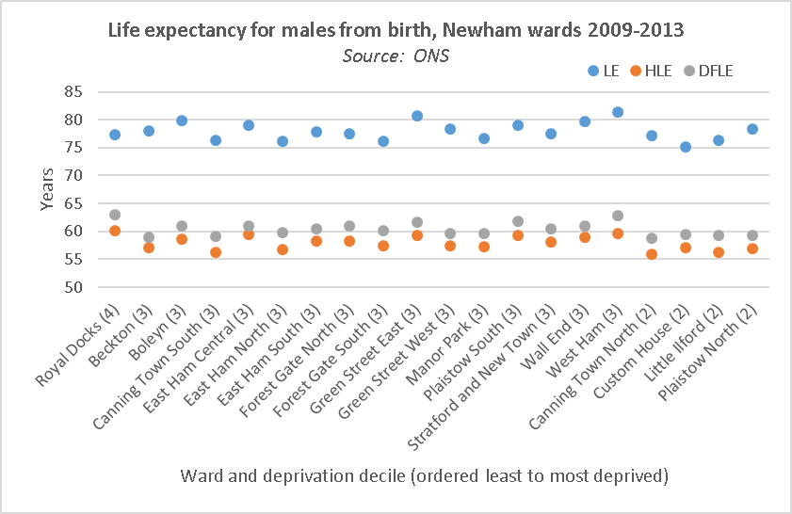
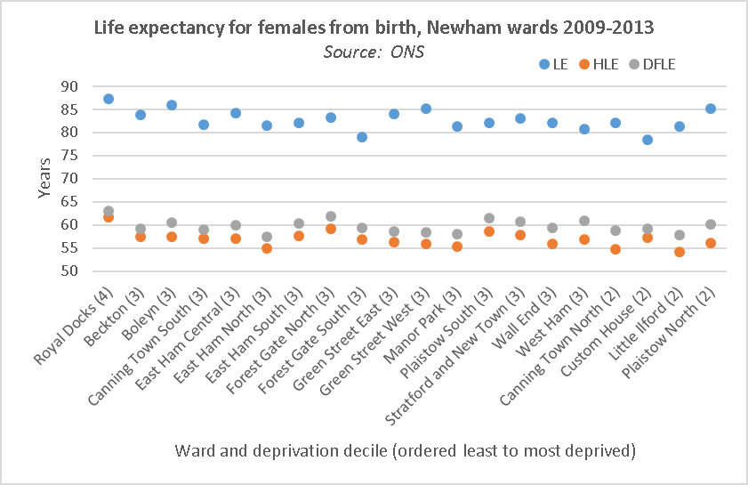
Life expectancy and healthy life expectancy by ward
Life expectancy (LE), healthy LE and disability free LE for males is shown above by ward. The deprivation decile is in brackets and is shown from least to most deprived.
There is 6.2 year difference between Custom House (ward with lowest life expectancy for males) and West Ham (ward with highest life expectancy for males). Interestingly the least deprived ward (Royal Docks) does not have the longest life expectancy for men but does for women.
The same graph for females, showing women living longer, but in poor health. There is a 9 year difference in life expectancy between Custom House (ward with lowest life expectancy for females) and Royal Docks (ward with the highest life expectancy for females).
While the lowest LE is in a more deprived ward and the highest in a least deprived ward there is no obvious linear relationship between IMD score and Life expectancy, suggesting other factors in addition to deprivation should be considered.
LE = Life expectancy, HLE = Healthy Life Expectancy, DFLE = Disability Free Life Expectancy

Slide 8
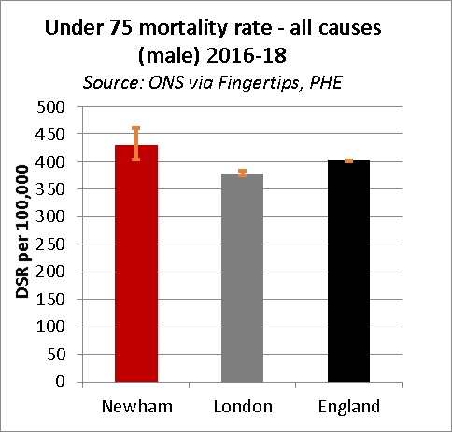
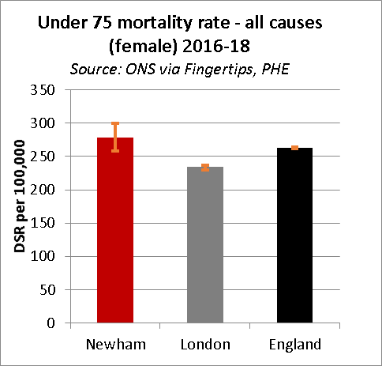
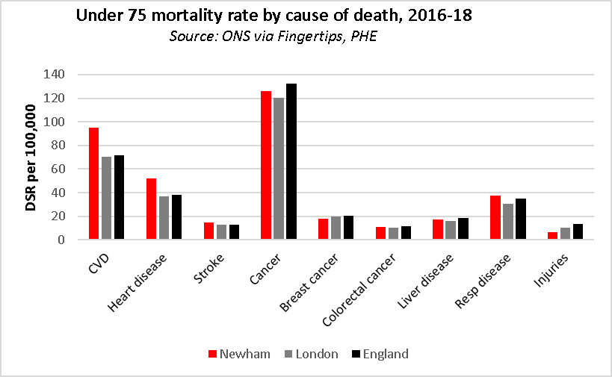
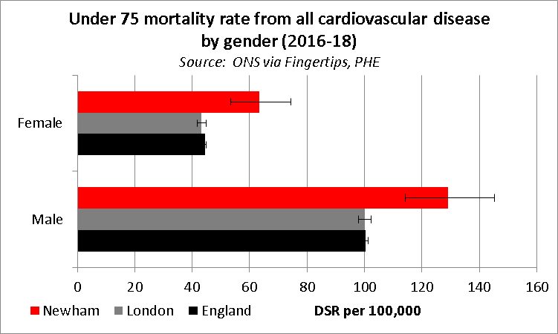
Premature mortality compared with London and England
Women in Newham live on average 3.1 years longer than men in Newham
Women also have a longer healthy life expectancy predicted at birth than men in Newham, by 3 years
Healthy life expectancy at birth is lower in Newham for both men and women than the England average by 5 years (men) and 2.5 years (women)
The impact of the difference in healthy life expectancy is most marked in the over 65s with women having 1.9 fewer healthy years than England counterparts and men 4.2 fewer healthy years
Deprivation has an effect upon life expectancy. In Newham, men living in the least deprived areas are expected to live on average an extra 6.6 years than those in the most deprived areas. For women, the figure is 5.5 years
The rate of premature deaths in Newham males is significantly higher than London
The rate of premature deaths in Newham females is significantly higher than London
The biggest cause of premature mortality is cancer, followed by cardiovascular disease and heart disease
The rate of mortality due to cardiovascular disease in Newham is particularly high compared to London and England

Slide 9

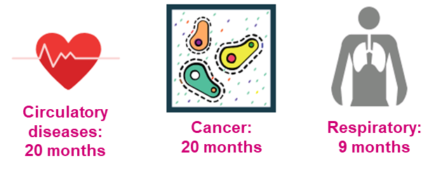
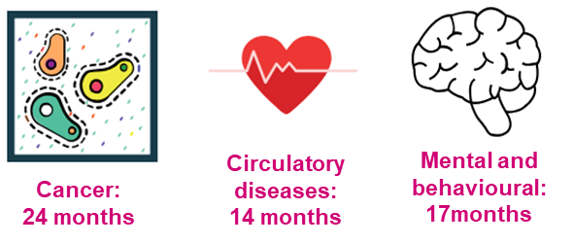





What causes people to die early?
DEPRIVATION:
Top 3 causes of death and difference in months of life lost between most and least deprived areas:
SPECIFIC DISEASES:
Heart disease is the 2nd highest cause of death in Newham residents.
1.
2.
3.
Years of life lost (YLL) per 100,000 population due to disease (2016) (Global burden of disease study 2017)
Heart disease | Lung cancer | Stroke | COPD | Lower respiratory | Dementia
1259* | 703 | 420 | 522 | 396* | 340
*Significantly worse than national average
For men, circulatory disease (including heart disease and stroke) (28.3%) and cancers (28.2%) cause the highest difference in number of deaths between those living in the most and those living in the least deprived areas in Newham. For women, it is cancers (30.2%) and mental/behavioural (21.8%)
Note, mental & behavioural includes dementia.
Suicide is also a cause of premature loss of life. In 2016-18, overall suicide rates in Newham were lower than London and England. The gender split shows deaths among Newham females (rate of 5.3 per 100,000) are higher than London (4) and England (4.7), whereas deaths among males (8.7) lower than London (12.5) and England (14.9)
Source: PHE covering 2016-18

Slide 10
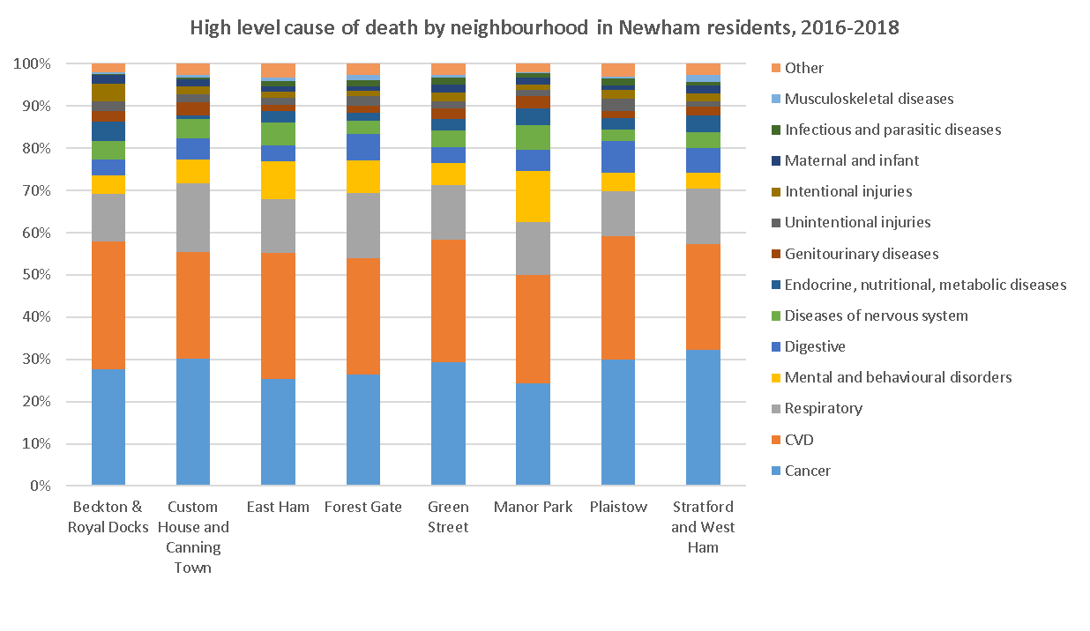


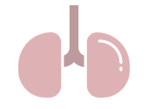

Causes of death by neighbourhood
Over half of all deaths in the 3 year time period (2016-2018) are from:
Cancer (28%, n=1107) or
Cardiovascular disease (27%, n=1085)
Followed by:
Respiratory diseases (13%, n=526)
The highest percentage of deaths during this 3 year period was in the Custom House and Canning Town neighbourhood (17%)
The lowest percentage (7%) was in the Beckton and Royal Docks Neighbourhood. This is probably due to this area attracting the younger population.
Though drawn from the Primary Care Mortality data, this echoes the Global Burden of Disease data in both causes of death and difference between neighbourhoods.
Source: Primary Care Mortality Data
Notably, the death profile across the wards in Newham is fairly similar, with cancer and cardiovascular diseases as the two leading causes of death in all areas, followed by respiratory diseases

Slide 11
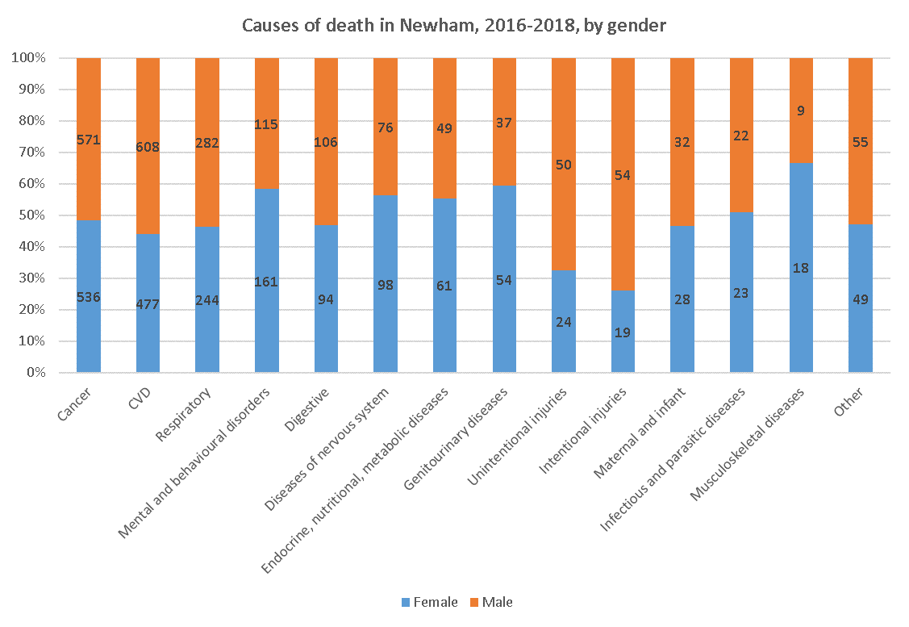


Causes of death by gender
Gender
The chart shows 3 years of Primary Care Mortality Data (2016-2018) for residents of Newham.
The total number of deaths was 3952.
The numbers in the bar chart represent counts.
There are distinct gender differences in the most common causes of death, the most notable being:
  Cardiovascular disease - 56% male (477,608)
  Respiratory - 54% male (244,282)
  Mental and behavioural disorders (including Dementia, Alzheimer’s) – 58% female (161,115)

Slide 12
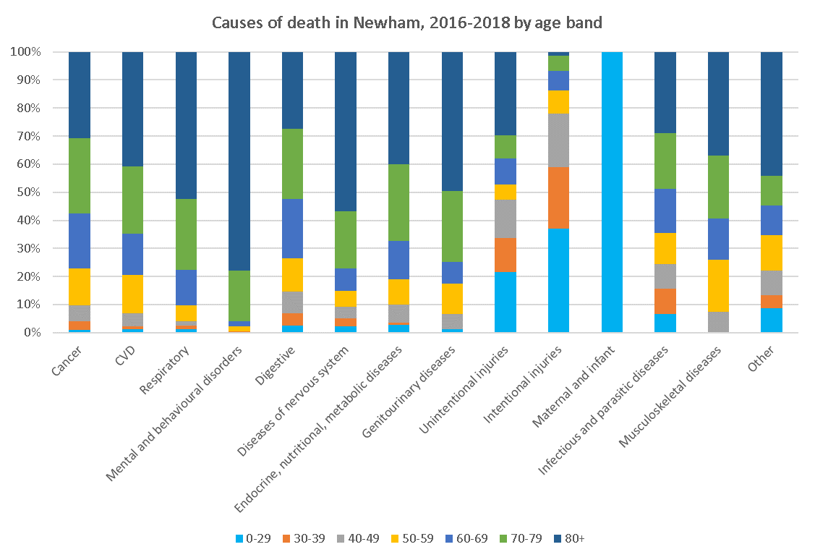
Causes of death by age band
Age band
The highest number of deaths are in older age bands (80+) and from common causes (CVD, respiratory, urosepsis, dementia)
27% deaths (n=1085) were caused by cardiovascular disease; of these, 93% were over 50 years of age
Of note are a small but of concern proportion of deaths in the 30-50 age range from CVD , Digestive (liver) Drug use, respiratory and cancer.
Cause of death by ethnicity is not available in the Primary Care Mortality Data received from NHS Digital.
Note that Mental and Behavioural disorders includes Dementia, which is why it’s the leading cause of death in the 80+ age band.

Slide 13
Determinants of health
Section 2

Slide 14



















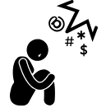










Determinants of Health
Environmental determinants
Social determinants
Commercial determinants
Safety/crime/ASB
Air quality
Transport
Employment opportunity
Housing – type/quality
Built environment
Green space, play areas
Finance - poverty/income
Community
Connectedness/ relationships/Norms
Education
Homelessness
Adverse Childhood Experiences
Food costs & availability
Tobacco prevalence, including Shisha, & cost
Alcohol cost & prevalence
Marketing and messaging
Housing cost and type
Wider and social determinants strongly influence health and wellbeing whilst commercial determinants strongly influence health behaviours.

Slide 15






Some of the root causes of poor health
Poverty
Poor mental wellbeing
Stress
Over-eating
Tends to result in disadvantageous health choices:
Pressure and anxiety in daily life
Mental wellbeing
Poor diet
Over-drinking
Lack of physical activity
Type II diabetes
Air quality
Urban environment
Cost of healthy living
Stress/anxiety related to poverty
Poor quality housing and homelessness
Cost of stress alleviation
Substance misuse
Physical Inactivity / sedentary lifestyle
Smoking

Slide 16
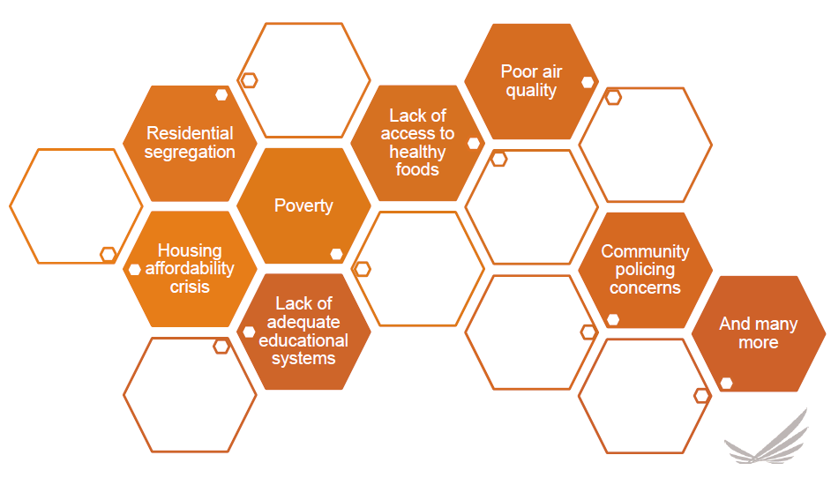
Barriers to Health and Wellbeing
Taken from “The Complex and Dynamic Nature of Helping Cities Thrive” presentation
(Alonzo L. Plough, Robert Wood Johnson Foundation)

Slide 17
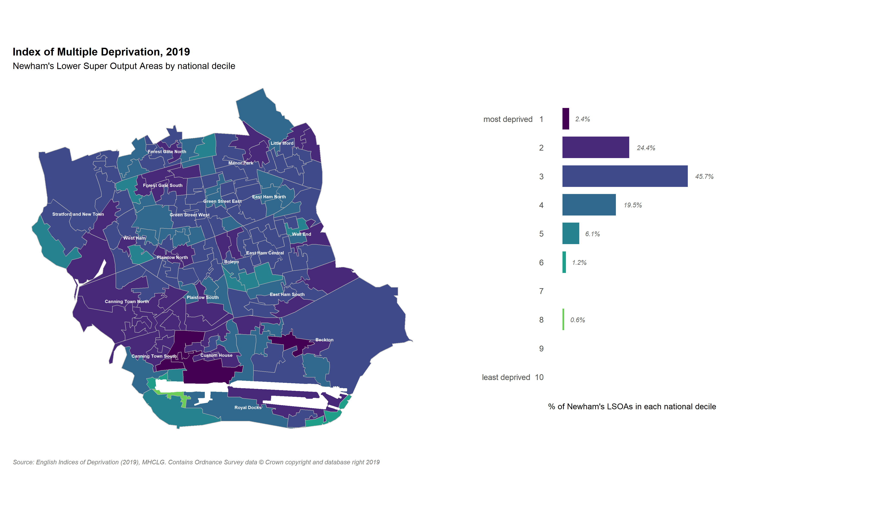
IMD map 2019 – deprivation quintiles in Newham
The Index of Multiple deprivation IMD is a composite measure describing area level deprivation. It includes scores for income, employment, education, skills and training, housing (size, occupancy rates and quality), living environment and crime.
Good health outcomes are linked not only with levels of income , but with lower area levels of deprivation.
Structural inequalities like poor transport, air pollution and a higher density of health-harming environmental features like overcrowding in houses contribute to poorer health outcomes.
Three out every four Newham residents live in the 30% most deprived neighbourhoods, nationally.
The 20% most deprived areas in Newham (deciles 1 and 2) are found mainly in Canning Town and Custom House wards, with pockets in a majority of other wards.

Slide 18
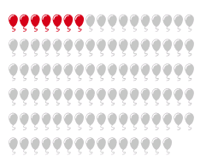

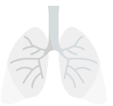




Factors contributing to premature mortality: Air quality
The importance of clean air for healthy living is a priority in Newham and also across England. The statistics show that air pollution contributes to a high number of diseases which ultimately cause premature mortality in Newham’s residents.
In 2017, seven out of every 100 deaths in Newham residents aged 30+ were linked to long-term exposure to air pollution
Source: Public Health England
Long term exposure to Particulate Matter (PM) 2.5 are a causal factor in long term conditions like asthma, bronchitis and heart disease and in increased risk of type 2 diabetes.
Road traffic and some industrial activities are major sources of PM2.5 emissions

Slide 19
Life course – influential factors
 | Life expectancy at birth | Low birth weight of term babies | Education | Deprived childhood | Unemployment
Newham | Males 79.7 Females 82.9 Healthy life expectancy: Males 60.6 Females 61.3 | 3.6% Poor long-term health and educational outcomes | Bullying:14% of 15 year-olds Impact on health, educational attainment and can pose a suicide risk | 20% of children under 16 in low income households Leads to premature mortality and poor health outcomes in adulthood | 4.8% (July 2018- June 2019) Associated with increased risk of ill-health and mortality, poor mental health, suicide, risky health behaviours
Comparison with London average | Males 80.5, Females 84.3 Healthy life expectancy: Males 63.9, Females 64.6 | 3% | 11% - significantly lower than Newham | 18.8% | 4.7%
Trend | Life expectancy rising steadily but levelled recently Healthy life expectancy fallen slightly for males and improved slightly for females | Variable but has dropped slightly over last 3 years | Not available | Falling | Falling
 | Homelessness young people aged 16-24 | Statutory homelessness | Social isolation | Average healthy life expectancy at 65 | Disability free life expectancy at 65
Newham | 1.03 per 1000 (n=116) 2017/18 More likely not to be in education, training or employment. Turn to crime or become victims of crime. Poor physical and mental health common as well as substance misuse | 9.4 per 1000 2017/18 Associated with severe poverty and a social determinant of mental health. Vulnerable. | 42.3% 2017/18adult social care users who had as much social contact as they would like (18+) Link to poor mental and physical health | 2015-17 6.5 years males 8.8 years females | 2015-17 5.2 years males 7.1 years females
Comparison with London average | 0.73 per 1000 Significantly lower than Newham | 4.2 per 1000 – significantly lower than Newham | 41.4% | 10.1 years males 10.8 years females | 10.3 years males 10.3 years females
Trend | Peaked in 2013/14 (290 recorded). Levelled out in 2016/17-2017-18 | Variable, peaked in 2015/16 but falling slightly since | Rising steadily | No trend available | No trend available

Slide 20
Risk factors
Section 3

Slide 21


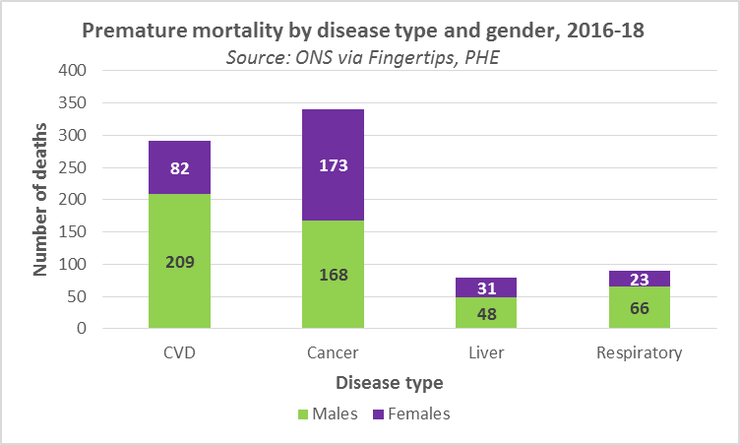







Factors affecting premature loss of life
There are two types of factors, modifiable (risk factors which can be changed) and non-modifiable (which cannot be changed).
Modifiable factors include air quality, smoking, poor diet, alcohol consumption, quality of health and social care services, social capital, racism and deprivation. These factors can lead to risk conditions, such as poor mental wellbeing, reduced social capital, unhealthy weight, unhealthy blood pressure and diabetes.
Factors that we cannot substantially change and may influence our health are genetics, ethnicity and ageing.
Modifiable factors underlie many premature deaths under 75 years of age.
Newham has a higher premature mortality rate (all causes) per 100,000 (362) than the regional value (310) and the national value (332) for deaths from causes considered preventable.
Source: Fingertips, PHE, 2015-17
Between 2016-18, the following premature deaths in Newham were considered preventable:
  291 from cardiovascular disease (209 males, 82 females)
  341 from cancer (168 males, 173 females)
  79 from liver disease (48 males, 31 females)
  89 from respiratory disease (66 males, 23 females)
Premature mortality: deaths that are considered preventable if they could potentially have been avoided by living healthier lives.
Cardiovascular disease:
Can be genetic or due to high blood pressure or diabetes. Smoking, poor diet, substance misuse, excessive alcohol or caffeine and stress all impact.
Cancer:
Can be associated with inherited genetic defects, age, gender or ethnicity. Occupational risk factors such as radon, radiation and fine particulate matter. Also alcohol, diet, exercise, smoking.
Liver disease:
Can be genetic, caused by poor diet and obesity, alcohol use or viruses.
Respiratory disease: Exacerbated by smoking tobacco, poor air quality, infections.
Notes:
Modifiable risk factors may be changed by individual action, but in many instances need coordinated system wide action to achieve healthy modifications.
Some research is ongoing to modify the processes in aging.
The science of epigenetics demonstrates that genes can be modified a little during life
The health impacts of ethnicity can be due to genetics, impact of birth in geographical areas with specific risk or disease profiles and the impacts of migration or racism.

Slide 22
Life reducing conditions & their determinants
Modifiable factors
Non-modifiable factors
Cancer
Familial/genetic/
hereditary
Risk factors:
Air quality
Smoking
Poor diet
Excess alcohol
Low physical activity
Genetics
Ageing
Cardiovascular disease
Smoking
Air quality
Risk conditions
Respiratory (incl. Lower)
Excessive alcohol consumption
Poor mental wellbeing
Overweight/obesity
High blood pressure
Diabetes
Mental health
Substance misuse
While some risk factors are modifiable, the degree of individual behavioural control is strongly influenced by both non-modifiable factors, like genetics or the impact of age, and by modifiable factors (smoking, poor diet) and also determinants that are largely out of individual control, such as air quality and deprivation. Deprivation includes housing, job security, access to employment, and density of health inhibiting factors like poor access to healthy food or outdoor space. Risk conditions such as poor mental wellbeing may be modifiable but are largely out of the individuals control and can be linked to other non-modifiable risk factors such as genetics. Most of the “modifications” required to reduce the modifiable risk factors need to happen at a structural/policy level to see population-level change.
Obesity
Insufficient exercise
Diabetes
Poor diet

Slide 23


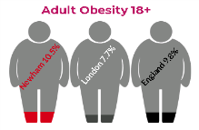
Risk factors
 | Smoking | Physical activity >150 min/week | Healthy Eating – 5 a day | Obesity | Obesity in children^{[1]}
Proportion in Newham | 19% of adults smoke^{[2]} | 53.1% are active ^{[3]} | 1. 42% of adults on a ‘usual’ day^{[4]} | 70% of adults (ethnically adjusted)^{[5]} | Reception 12.8% (595 children ) Year 6 27.4% (1222 children)
Comparison with London average | Significantly worse (London 14.6%) | Significantly worse (London 64.5%) | Significantly worse (ranked last in London) | Significantly worse (London 56%)^{[6]} | Significantly worse, London: Reception - 10.1% Year 6 – 23.1%
Trend | Stable when decreasing nationally | Lowest decile and Worsening | Worsening | Rising year on year | Rising for year 6, slowing increase for reception
The impact to health of overweight and obesity occurs at a lower level of BMI for non white people –(S Asian, SE Asian, African descent, Middle Eastern and mixed race). Given Newham is 72.5% non white, the impact of overweight is considerable
There are almost 28,000 people with Type 2 diabetes, the youngest cohort of type 2 diabetics in London and a further 8,000 people are at risk of developing diabetes in Newham.
^{[1]} Data from National Childhood Measurement Programme (NCMP) 2017/18
^{[2]} Public Health England Fingertips data from the 2017 Annual Population Survey (APS)
^{[3]} Sport England Active Lives survey (2017/18)
^{[4]} Sport England Active Lives survey (2017/18)
^{[5]} Based on ethnically-adjusted BMI data from all adult GP patient records (2018-19) provided by the Clinical Effectiveness Group (CEG). The non-ethnically adjusted estimate for overweight/obesity is 61% in Newham (and 56% in London).
^{[6]} Public Health England Local Authority Health Profile for Newham (2019) – Note this 56% figure is not ethnically adjusted. See footnote number 5 above.

Slide 24
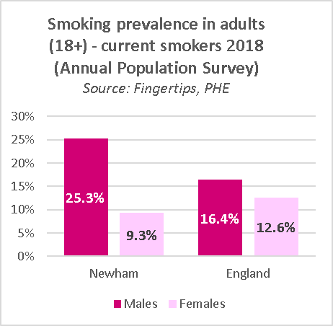


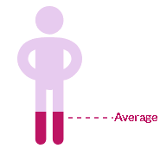

Risk factor - smoking
Smoking prevalence in adults aged 18+ (2018)
Newham has the 3rd highest prevalence out of 33 London boroughs, and ranks 23rd out of 151 areas in England
The gender split for smokers in Newham is significant – with over a quarter of men admitting to smoking (25.3%), compared to just over 9% of women
This likely reflects the ethnic and cultural diversity of Newham. Globally, 35% of men smoke, while only 6% of women do.
Ward and neighbourhood level data
Newham has a significantly lower smoking quit rate than England and London
The number of quits has declined substantially over the last 5 years from 910 in 2014/15 to just 337 in 2018/19
Nearly 1 in 4 residents aged 17+ smoke in the wards of Canning Town South, Custom House and West Ham.
Custom House and Canning Town neighbourhood shows the highest % of smokers at 23.6% (at 1st April 2018).
These areas are the most deprived in Newham.
23.6%
18.2%

Slide 25


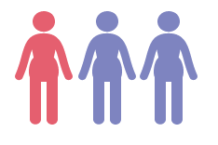
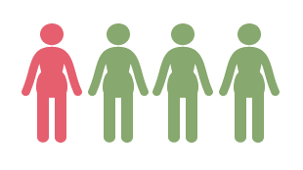
Smoking – key inequalities
Key inequalities:
There is a strong link between smoking and socio-economic status. It has been identified as the biggest cause of inequality in death rates between rich and poor in the UK.
In those households working in routine and manual job roles, nearly half will have started smoking before the age of 16. This compares to one third in managerial and professional households.
Newham has a greater socioeconomic gap between current smokers compared to London (odds of being a smoker in a routine and manual occupation vs being a non smoker in other occupations).
Newham has the 4th highest deprivation score in London at 32.9 and ranks as the 21st most deprived borough in England.
Employment:
Mental Health:
National data (source: ONS) | Cigarette smoker | Ex-smoker | Never smoked
Owns outright | 15.8% | 41.7% | 34.1%
Owns with mortgage | 27.4% | 29.3% | 39.2%
Rents: local authority or housing association | 29.5% | 14.0% | 10.0%
Rents: privately | 27.3% | 15.0% | 16.6%
1 in 4 people (25.4%) working in routine and manual occupations in
Newham smoke
Smoking prevalence in adults with a severe mental illness in Newham is 35.5%
Smoking prevalence in adults with anxiety or depression in Newham is 25.8%
Smoking prevalence in adults with a long term mental health condition in Newham is 28.4%

Slide 26
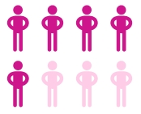


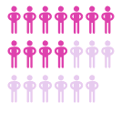
Risk factor – physical activity
People who have a physically active lifestyle have a 20-35% lower risk of cardiovascular disease, coronary heart disease and stroke compared to those who lead a sedentary lifestyle
Regular activity is also associated with a reduced risk of diabetes, obesity, osteoporosis and colon and breast cancer. It also helps to improve mental health. Source: PHE
Ward level data
Over half of the residents in 5 out of 8 neighbourhoods (Green Street, East Ham, Manor Park, Plaistow and Stratford & West Ham) all consider themselves inactive or moderately inactive*. Source: CEG
150 minutes a week
The Active Lives Survey asks people aged 19 and over if they are doing at least 150 minutes of exercise a week
The percentage of physically active adults in Newham (51%) is significantly lower than London (64%) and England (63%) based on 2018/19 data.
Newham also has a significantly higher proportion of inactive adults compared to London and England.
Over half of the residents in 11 out of 20 wards consider themselves inactive or moderately inactive*.
*Definitions:
Inactive - Sedentary job and no physical exercise or cycling
Moderately inactive Sedentary job and some but < 1 hour physical exercise and / or cycling per week OR Standing job and no physical exercise or cycling
Moderately active Sedentary job and 1-2.9 hours physical exercise and / or cycling per week OR Standing job and some but < 1 hour physical exercise and / or cycling per week OR Physical job and no physical exercise or cycling
Active Sedentary job and ≥ 3 hours physical exercise and / or cycling per week OR Standing job and 1-2.9 hours physical exercise and / or cycling per week OR Physical job and some but < 1 hour physical exercise and / or cycling per week OR Heavy manual job

Slide 27
Risk factor – physical activity
At the Newham Show in 2019, residents were asked about barriers and enablers to being physically active…
Barriers
Enablers
I find it harder to get moving/exercise because………
I find it easier to get moving/exercise when………
Exercising is hard
Don’t have time for exercise
Note: Green identify highest, amber medium and red least reason to exercising. The numbers of stickers
received for key
themes are
Identified
next to
each barrier
Because I have disability
I can’t do sports without my friends
I don’t have the confidence
It hard being a mum with children
It’s difficult because of pollution
Health problems
Key barrier themes that came up were: time, health problems, motivation
Key enabler themes: more activities, motivation, time, fitness, health benefit, mood

Slide 28
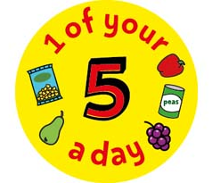
Risk factor – unhealthy diet
Five-a-day:
Less than half of adults in Newham are meeting the 5-a-day recommendation for fruit and vegetable consumption.
The number of adults consuming 5-a-day has declined between 2015 and 2018.
The proportion of adults in Newham getting 5-a-day is significantly lower than London and England.

Slide 29


Barriers to healthy living
Barriers: When asked “what stops you from living a healthy life?” the top theme mentioned by Newham residents (in 9 focus groups) was the availability of unhealthy foods, such as fried chicken, chips and junk food. Money, price and affordability were also mentioned 11 times, highlighting money as a barrier to a healthy life, and the price of health food specifically came up on 7 occasions. Lack of knowledge or information on healthy eating, cooking skills, and alcohol consumption were also mentioned.
Source: Focus Groups conducted by Newham Public Health team, 2019

Slide 30
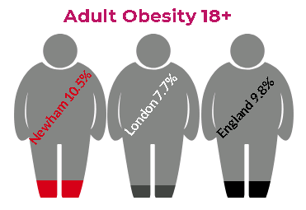
Adult obesity
Overweight or obese:
63.0% of adults in Newham are classified as overweight or obese. Newham ranks, 2nd worst out of CIFA neighbours and 4th worst of all London boroughs. (survey data)
Obesity:
10.5% of adults registered with a GP are in Newham are obese. This is higher than the England (9.8%) and London (7.7%) average and is the third highest out of all the London boroughs and 2nd highest out of its CIFA neighbours.(QoF register)
Key inequalities
More women than men are at high risk or very high risk (obese and severely obese) in Newham.
The prevalence of obesity varies between ethnic groups as does the risk of harm associated with a given BMI level. As a result, ‘Black’ and ‘Asian’ communities are at greater risk of obesity related harm.
People with physical disabilities, long term health problems and learning disabilities are more likely to be overweight or obese.
Adults, particularly women, living in disadvantaged communities are more likely to be obese than peers living in more advantaged communities.
Geography:
East Ham North ward has the highest proportion of adults with high BMI with 75.7% of adults having an increased risk, high or very high risk BMI.
Stratford and new town has the lowest proportion of Increased, high or very high risk BMI still, 58.8% of the residents are at higher risk BMI
Little Ilford has the highest proportion of residents with a very high risk of BMI (6.6%)

Slide 31
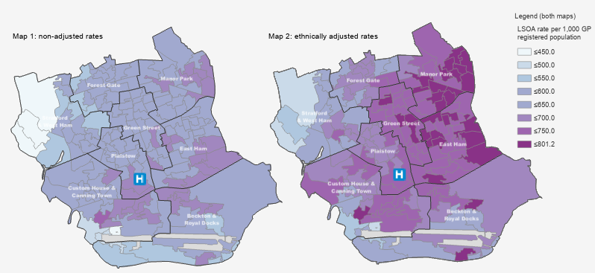
Adult obesity and ethnicity
Standard and ethnically adjusted BMI in adults 17+
BMI and ethnicity
People of Asian ethnicity have higher weight-related disease risks at lower BMIs
A higher percentage of body fat can be found in Asians with the same BMI as someone with white ethnicity
This increase means Asians with a lower BMI can have a higher risk of Type II diabetes and cardiovascular disease
Therefore it is necessary to adjust the BMI levels to reflect this and recognise the true risk in different ethnic groups
Evidence of similar effects is seen in Black African, Middle-Eastern, Black Caribbean, and mixed-race ethnic groups to an extent (Diabetes UK).
Prevalence of increased risk, high or very high obesity as rate per 1000 by LSOA
BMI | Normal | Increased | High | Very high
Standard (S) | <25 | ≥25, <30 | ≥30, <40 | ≥40
Adjusted (A) | <23 | ≥23, <27.5 | ≥27.5, <35 | ≥35

Slide 32





Childhood obesity
Excess weight
Of particular concern in Year 6 (ages 10-11)
At a significant, vulnerable time of life
Consequences
Mental health issues
Physical illness
Physical activity
Helps with weight loss (with changed diet) and increases confidence
Cardiovascular and musculoskeletal benefits
Encourages socialising
Mental health benefits
Lack of self confidence and self esteem
Bullying
Isolation

Slide 33

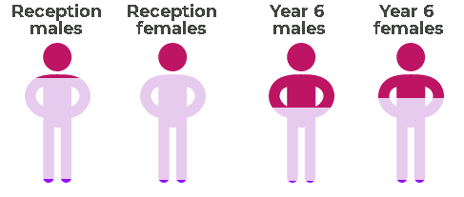
National Child Measurement Programme (NCMP) – 2018-19 data
Participation in Newham – 2018/19
Underweight
(≤2 centile)
Healthy weight
(>2 - <85th centile)
Overweight or obese (≥85th or ≥95th centile)
96% of Reception (R) and 95.2% of Year 6 (Y6) children were measured, an overall score of 95.6%.
1.8% of females (R)
2.6% of males (R)
2.3% females (Y6)
1.7% males (Y6)
76.8% of females (R)
72.3% of males (R)
58.3% of females (Y6)
51.9% of males (Y6)
21.4% of females (R)
25.1% of males (R)
39.3% of females (Y6)
46.4% of males (Y6)
2018-19: Newham compared to London and England
Reception:
Newham 23.3%
London 21.8%
England 22.6%
Key:
Overweight/obese
Healthy weight
Underweight
Year 6:
Newham 42.9%
London 37.9%
England 34.3%
About NCMP
NCMP data is collected over the year from Reception (aged 4/5) and Year 6 (aged 10/11) school pupils
Data includes all pupils who attend Newham Primary Schools, whether they live within the borough or outside
Newham resident pupils who attend schools outside the borough will not be included in the data
These figures are based on a Population BMI rather than a Clinical BMI (there is a slight difference in the range of the measurements)

Slide 34
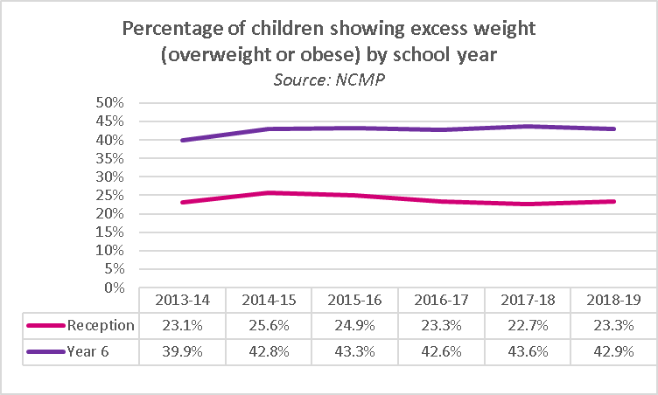
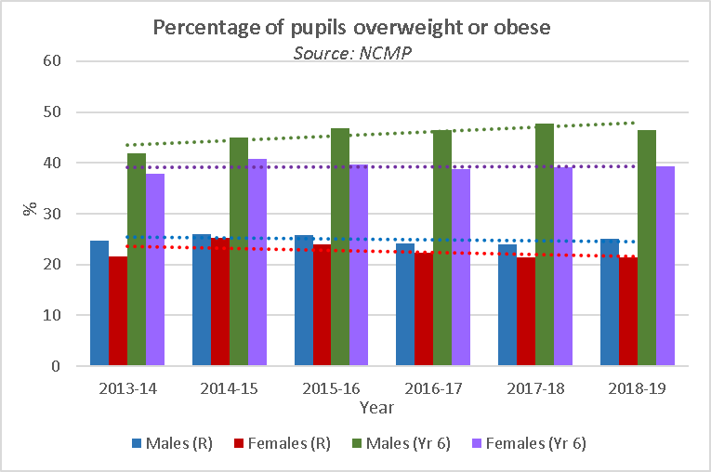
National Child Measurement Programme - trends
School year breakdown:
2018-19 data shows an increase in Reception in the percentage of children who are overweight or obese (0.6 percentage points) and a slight reduction in Year 6 (0.7 percentage points).
Gender breakdown:
Males in reception and females in Year 6 show a relatively level trend
The trend for females in Reception has fallen slightly
The trend for Males in Year 6 continues to rise in 2018-19
Key inequalities
In both reception year and Year 6, children, black and other ethnicities have higher percentages of children who are overweight or very overweight
Children with a limiting illness are more likely to be obese or overweight, particularly if they also have a learning disability – children with both conditions were almost twice more likely to be overweight or obese than children with neither.
Children’s obesity prevalence is higher in more deprived groups

Slide 35
Gap analysis - Greatest Healthy living needs vs Services in NEWHAM
Section 4

Slide 36

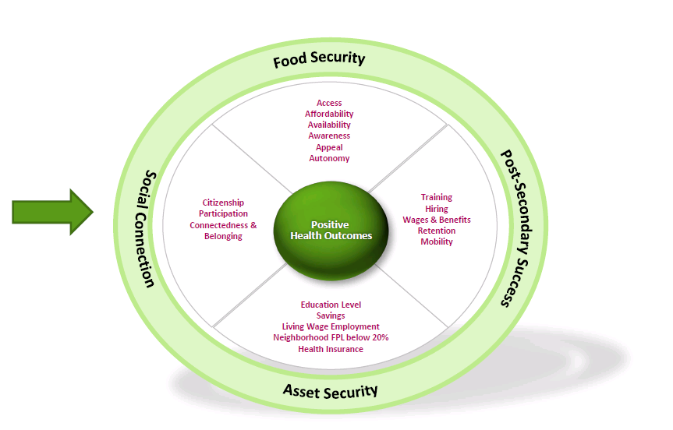
Working together to improve health outcomes: Where are the gaps?
Taken from “Place-making and the Investment in Hope” presentation
(Brandy N Kelly Pryor, Humana Foundation, June 2019)

Slide 37
A framework for intervention on public health issues by target group
The majority of health interventions are aimed here - at individuals
Individuals and Families - Goals: evidence based, integrated, person centered, co-produced strength and independence oriented
Individuals
Schools, Workplaces, anchor institutions
Families
Settings and Environments Goals: evidence based, prevention oriented, making being healthy- both mentally and physically, easier for all.
Settings
Neighbourhoods borough level, built environment,
Communications
Wider Environment

Slide 38
Life course and interventions in Newham
Physical activity
Smoking
Mental Health
Newham Rise (Young people 11-18)
Newham Rise – change, grow live (adults)
Pharmacies Stop smoking service (age 12+)
Healthy
diet/weight
Alcohol/ drugs
Community
Pharmacies- Contraception, Needle Exchange
HeadStart (CASA*)
10-16
In Autumn 2019, prevention services commissioned by the council or NHS cover most ages, and offer support on a range of mental and physical health issues. These however are not formally integrated into a prevention system. For example, the NHS Diabetes Prevention Programme offers advice on diabetes and it’s prevention, and West Ham foundation delivers an exercise on referral programme. However Newham lacks a dedicated weight loss and weight management provision or integration with mental health support services (such as IAPT) or other social support.
WHFU – 150 club (NDH, CVD risk GDM)
Newham School Sport Partnership
Council
Intervention
Active Newham
Newham Young People’s Service (11-18)
NHS health check
NHS
NHS Diabetes Prevention Programme
(NHS DPP) 18+
CAMHS – 0-18 specialist service
Improving Access to Psychological Therapies (IAPT)
-9m
Birth
10
20
30
40
50
60
70
80
90+
Life course (age)
*CASA = Creative Arts and Sport

Slide 39
Levels for intervention opportunities across the lifecourse
Obesity and linked conditions
Alcohol regulation
Using overweight and obesity as an example risk condition this maps the interventions currently in place for each intervention target.
Obesity is now the second most common cause of cancer after smoking.
Alcohol is a major source of calories and can drive both over eating, poor diet and weight gain through a range of biochemical mechanisms.
There is good evidence that – using supermarket inventory – the price per calorie of healthy food is higher and rising compared with unhealthy food.
All
Sugar taxes
Advert bans
Zoning of food outlets – regulations
Communication strategies , “norms”, trends
Healthy Food Costs and availability
Workplace policy and culture
Free school meals (4-7)
Workplace catering
Settings
Workplace layout
Daily mile
Education and training settings following school
Healthy Schools
Commissioned programmes Weight management: healthy eating/diet/physical activity
Opportunistic GP conversation
Targeted GP case finding and management incentives – local national
Cancer screening- bowel
Cancer screening- breast
Individuals & family
Cancer screening- cervical
Pre-conception advice
NCMP (Reception & Yr 6)
NHS Health check
National Diabetes Prevention Programme (lifestyle advice)
-9m
Birth
10
20
30
40
50
60
70
80
90+

Slide 40
Levels of prevention across the lifecourse
Obesity
Using overweight and obesity as an example risk condition this maps the prevention opportunities available at the primary, secondary and tertiary levels.
Primary prevention can begin in childhood and can be incorporated across the life-course.
Secondary prevention initiatives support patients who are already overweight and obese, and help to reduce their weight to prevent conditions such as diabetes and cardiovascular diseases.
Tertiary prevention is usually for patients who are morbidly obese and for whom other services have not been effective, leading them to require bariatric surgery.
Bariatric surgery
Tertiary
Medication
Midwife – weight management in pregnancy
Weight management: healthy eating/diet/exercise
Secondary
National Diabetes Prevention Programme (lifestyle)
NHS Low calorie diet
NHS Health Checks (age 40-74)
Free school meals (4-7)
Primary
Daily mile
Pre-conception diet advice
NCMP (Reception & Yr 6)
Healthy Eating advice
Physical Activity advice
-9m
Birth
10
20
30
40
50
60
70
80
90+

Slide 41
Adult Obesity Service Gaps
NHS Diabetes Prevention Programme
Weight management Service Gaps
NDPP initially began as a pilot in some areas of the UK in 2016
Target population is those with pre-diabetes
Data at January 2019 showed the majority of referrals into NDPP in Newham had dropped out (62%), with most dropping out before the initial assessment.
Men were under-represented across NEL, making up only 44% of referrals.
Referral rates by ethnicity were unclear as 42% did not have ethnicity recorded.
There are around 265,000 adults in Newham. Notably:
  around half of adults are physically inactive
  more than 1 in 10 are obese, and over half are overweight, figures that increase substantially when ethnically adjusted BMIs are utilised
  less than half of adults consume the recommended 5-a-day
  28,000 people have diabetes, with a further 7,000 pre-diabetics. The north-east part of the borough is most affected by diabetes – almost 1 in 10 adults have diabetes in Manor Park, East Ham and Green Street.
Qualitative feedback from focus groups in Newham indicates that they key barriers to healthy eating include cost, availability of unhealthy food, lack of knowledge on healthy diet, and cooking skills.
Furthermore, according to evidence, physical activity services alone, without dietary and psychosocial support may have limited effectiveness on reducing diabetes and cardiovascular disease.
Service provision is not currently meeting the need of Newham’s population, as there are no tier 2 or tier 3 weight management services available for our residents. Neighbouring boroughs such as Tower Hamlets do have these services in place.
It is vital that any services developed are appropriate for the cultural diversity within Newham and would specifically need to target the different Black and Asian populations in the borough.
150 Club
The 150 Club is a local service aimed at increasing physical activity for those who are pre-diabetic, have gestational diabetes or are at a high risk of CVD.
Around 1 in 4 eligible referrals completed the programme in 2018/2019.
Men were under-represented, making up just 42% of referrals.
83% of eligible referrals were people of Black or Asian ethnicity, however several black people referred were considered ineligible.

Slide 42
Childhood obesity – concerns and gaps
Year 6 excess weight
No weight loss support for children in the borough
Roots of adult ill health
Can contribute towards adult obesity, Type II diabetes, musculoskeletal conditions, cardiovascular disease, cancer, mental health issues, premature mortality
Largest cohort of Type II diabetes in the country
Prevention is the key
Associated mental health issues
Potentially leading to other risky behaviours
Child obesity in Newham is a concern, with significantly higher levels of overweight and obesity, compared to London and England rates.
Notably, children of black and other ethnic minorities have a higher obesity prevalence, as do those living in more deprived areas. Children with long-term conditions and learning disabilities have a significantly higher likelihood of being obese, further exacerbating health inequalities.
At present, there is no specific weight loss support for children in the borough, which is identified as an evident service gap. A family-based approach to weight management would be beneficial to support both children and adults affected by obesity.

Slide 43
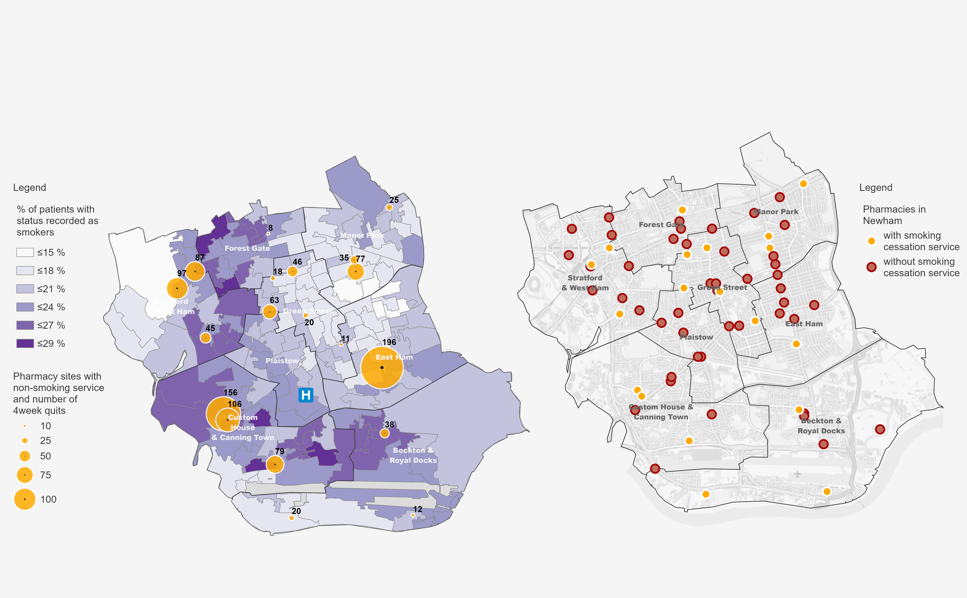
Smoking prevalence and distribution of stop smoking services
Stop Smoking services are currently provided by a network of 17 (of 52) community pharmacies trained to level 2 NCSCT standards.
The most successful Pharmacies are located less than 10 minutes walk from a referring GP practice. Most of the pharmacies with high registrations and quit rates are less than 5 minutes walk from a referring GP.
Smoking prevalence and quit numbers at pharmacies with smoking cessation services
All pharmacy locations in Newham

Slide 44
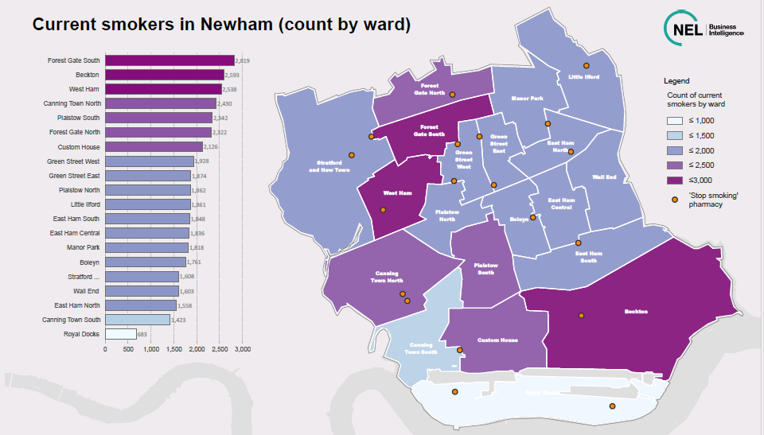
Smoking services gap analysis
Over 1 in 5 people in Newham are smokers, and it disproportionately affects some of the lowest earners. As such, smoking remains a driver of health inequalities nationally as well as locally.
Newham has the has the 3rd highest smoking prevalence out of 33 London Boroughs and ranks 23rd out of 151 areas in England.
Despite the evident need, there has been a substantial decline in annual smoking quite rate in the last 5 years from 910 in 2014/15 to just 337 in 2018/19.
Some of the Wards in Newham with a high number of smokers have very few Stop Smoking Services available (Beckton, Forest Gate South and West Ham). Areas such as Plaistow South and Wall End wards have none available.
Smoking cessation services are a cost effective intervention, both in the UK and globally, and are an important way to reduce health inequalities. While there is a London-level stop smoking website and phone line, it has rarely been used by Newham residents.
Improving the reach and uptake of community-based services, and targeting the services towards those with the highest smoking rates (men, Eastern European population, people working routine and manual occupations, patients with mental health conditions) and those at highest risk (patients with long-term conditions, pregnant women) could help to reduce health inequalities in Newham.

Slide 45
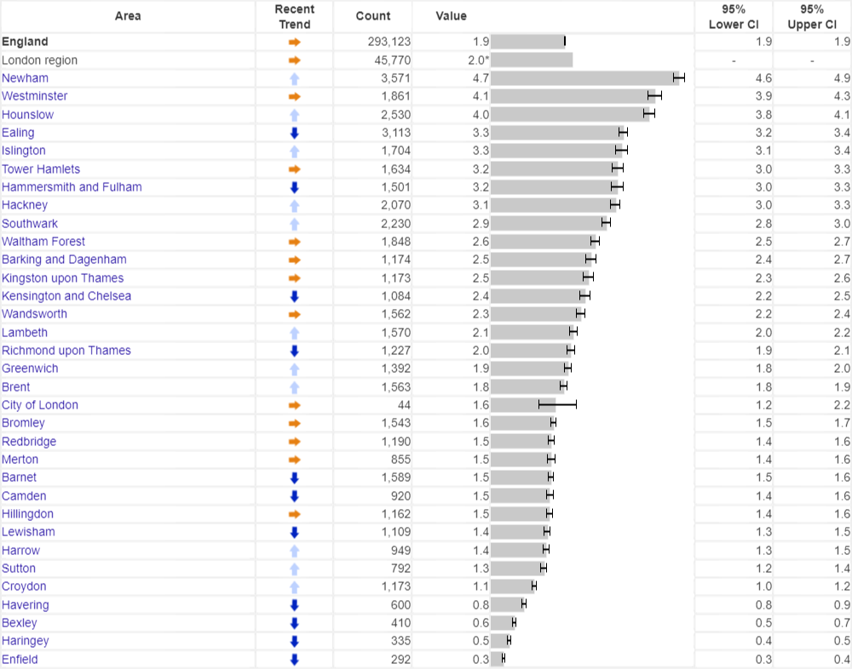
NHS Health Checks: Highlighting Pathway Gaps
Percentage of NHS Health Checks received by the total eligible population in the quarter (Q1 2019/20), by London borough
NHS Health Checks is a cardiovascular disease risk assessment programme that has been rolled out nationally since 2013. It aims to check the CVD risk of adults age 40 – 74 every 5 years.
Newham has been doing well on service coverage. During the 5-year period between 1st April 2014 and 31st March 2019, over 90,000 Newham residents were offered a health check and over 53,000 received one. This uptake rate of 59% is significantly higher than London and England. Newham consistently ranks in the top boroughs for percentage of eligible population receiving a health check.
However despite this high level of delivery of checks over the last 7 years, Newham still has significantly higher levels of premature mortality from CVD compared to London and England, and higher prevalence of risk factors such as smoking and obesity. This highlights that NHS Health Checks must be part of a wider prevention pathway to be effective; delivering checks without referring into effective interventions does not appear to be effective.
Source: https://fingertips.phe.org.uk/profile/nhs-health-check-detailed/

Slide 46
Risk clustering
National data illustrates the concept of Risk Factor Clusters – the idea that smoking, physical activity, unhealthy diet and alcohol consumption are not randomly distributed mong the population but often occur together, and cluster within population groups, and that the resulting health effects of these can multiply.
Deprivation is found to have a large impact, as expected. Almost half (46%) of men in highest-income households had 2+ risks, compared with 62% of men in lowest-income households. Among women, only a third (34%) in highest income households had 2+ risks, compared with 60% of women in the lowest income households.
Pre-existing conditions were also linked to multiple risk factors. Two-thirds (68%) of those with a mental health condition had 2 or more risks, compared with less than half (46%) of adults with no longstanding physical or mental health condition.
In Newham, with high levels of deprivation, obesity, smoking, unhealthy diets and physical inactivity, it is important to consider the role of risk clustering in service design. Many residents being referred into smoking cessation services and physical activity programmes are likely to have multiple risk factors that need to be addressed.
Source: UCL, Multiple risk factors among adults: results using the Health Survey for England 2016 and 2017

Slide 47
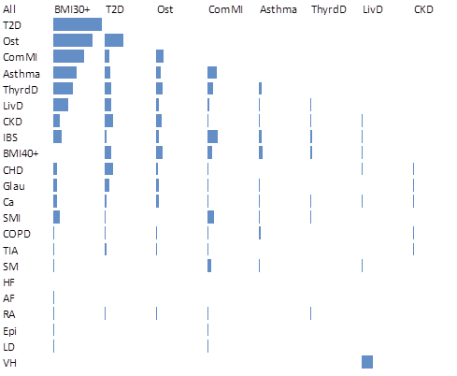
Multi-morbidity
Graphical representation of the main co-morbidities in Newham, where bars represent the number of people who have the two conditions diagnosed
Multi-morbidity refers to the presence of 2 or more disorders in an individual, and is affected mainly by older age and socio-economic deprivation.
Disorders include both physical and mental health conditions.
The onset of multi-morbidity tends to occur around 10 – 15 years earlier in people living in the most deprived areas compared to those living in the most affluent areas.
The presence of a mental health condition is linked to an increase in number of physical diseases and was also much more common in those living in more deprived areas .
Reference: Epidemiology of multimorbidity and implications for health care, research and medical education: a cross-sectional study Barnett et al, Lancet 2012; 380:37-43
Most common co-morbidities in Newham
obesity
type 2 diabetes
osteoporosis
depression/ anxiety
asthma
thyroid disease
chronic liver disease
irritable bowel syndrome
coronary heart disease
morbid obesity
chronic kidney disease
serious mental illness
Source of data: Clinical Effectiveness Group, QMUL, 2020

Slide 48
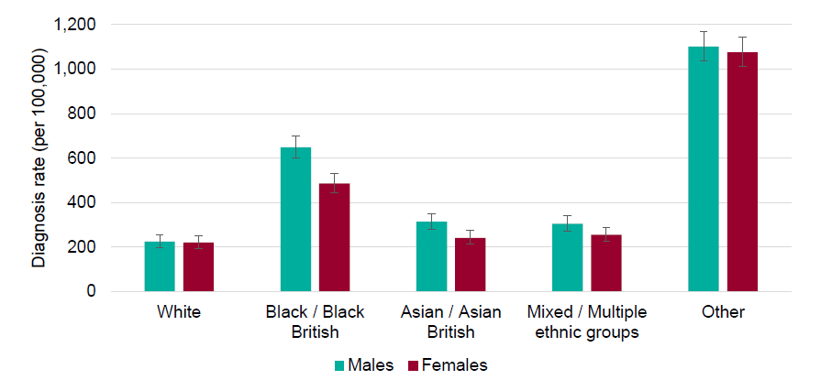
COVID-19 implications
The COVID-19 pandemic has had devastating consequences in Newham – a borough which has suffered the highest mortality rate in the country (as at May 2020). The reasons for this include deprivation, over-crowding, risk factors such as obesity and diabetes, and the disproportionate impact of COVID-19 on some BAME ethnic groups. The need to improve the health of Newham residents and reduce inequalities has been starkly highlighted.
Ethnicity
Wider determinants
COVID-19 diagnosis rates and mortality rates were higher for Black and Asian ethnic groups when compared to White.
Nationally, adjusted data shows people of Bangladeshi ethnicity had twice the risk of death compared to White people. People of Chinese, Indian, Pakistani, Other Asian, Caribbean and Other Black ethnicity had between 10 and 50% higher risk of death.
In Newham, 52% of adults are in ethnic groups that had an increased risk of death compared to white people.
Nationally, mortality rates from COVID-19 in the most deprived areas were more than double the least deprived areas.
ONS reported that occupations such as taxi drivers, bus drivers, sales and retail assistants, construction workers, and social care workers had significantly high rates of death.
Newham is one of the most overcrowded boroughs in the UK; a factor that has contributed to increased virus transmission.
Underlying conditions
People with obesity are significantly more likely to have severe outcomes from the virus than people of a healthy weight.
Diabetes was mentioned on 1 in 5 death certificates where COVID-19 was also mentioned. This finding is consistent with other studies that have reported a higher risk of death from COVID-19 among patients with diabetes. This proportion was higher in all BAME groups compared to White, and was 43% in the Asian group. A similar pattern was seen for hypertension.
Data source: Public Health England, Disparities in the risk and outcomes of COVID-19, June 2020

Slide 49
COVID-19 and underlying conditions
Obesity and Covid-19 death risk, UK data
Topic | Covid-19 relevance | BAME disproportionality | Newham context
Obesity | A review¹ of 75 studies globally has found that obese patients are 74% more likely to be admitted to intensive care and are 48% more likely to die, compare to those who catch Covid-19 who are not obese. | People of some ethnicities such as South Asian, Chinese and Black experience obesity at a lower BMI threshold (27.5), however the threshold of 30 is commonly used. | In Newham around 26% of the population (48,473 adults) are obese. When ethnically adjusted, this figure increases to 36% (66,811 adults). However, there are few comprehensive community-level weight loss programmes in the borough.
Diabetes | Patients with Diabetes are around twice as likely to die than adults without the condition. Those with poorly controlled diabetes are around three times more likely to die. | Type 2 diabetes is up to six times more likely in people of South Asian descent, and up to three times more likely in people of African and Caribbean ethnicities. | There’s over 28,000 diabetics in Newham and over 7,000 people have prediabetes. There could be many people living with undiagnosed diabetes. In Manor Park, Green Street and East Ham, almost 1 in 10 adults have Diabetes.
Hypertension | Patients with Hypertension are around 22% more likely to die than adults without the condition. It also contributes to other risk conditions such as cardiovascular disease. | Studies in the UK show that people of Black African and Black Caribbean ethnicity are up to three of four times more likely to develop hypertension.² | There are around 43,000 people with diagnosed hypertension in the borough. More people could be living with undiagnosed hypertension as it can have no symptoms.
Diabetes and Covid-19 death risk, UK data
Source: factors associated with COVID-19-related hospital death in the linked electronic health records of 17 million adult NHS patients.
Notes:
https://onlinelibrary.wiley.com/doi/full/10.1111/obr.13128
https://www.ncbi.nlm.nih.gov/pmc/articles/PMC3063048/?report=reader

Slide 50

Urban lifestyles and health
Daily experiences:
Supporting factors:
Opportunity
Support
Resources
Culture
Knowledge
Stress and strain
Crowding
Migration
Fast pace
Alienating
Oppression and inequality
Conflict
Exposures
Taken from “Finding Hope in the City” presentation
(Kenneth S Thompson, King’s Fund, June 2019)

Slide 51
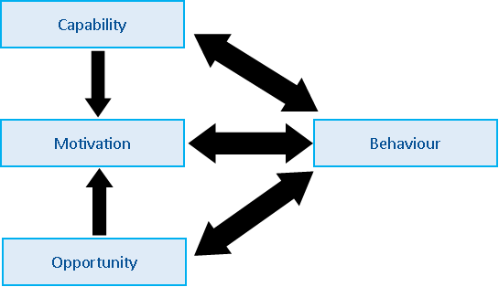
Capability, Opportunity and Motivation – Behaviour (COM B)
    The APEASE criteria for assessing interventions, intervention components and ideas
How we approach individuals and systems
Acceptability
Practicability
Effectiveness
Side-effects
Equity
How far is it acceptable to key stakeholders? This includes the target group, potential funders, practitioners delivering the interventions and relevant community and commercial groups.
Can it be implemented at scale within the intended context, material and human resources? What would need to be done to ensure that the resources and personnel were in place, and is the intervention sustainable?
How effective is the intervention in achieving the policy objective(s)? How far will it reach the intended target group and how large an effect will it have on those who are reached?
How far can it be afforded when delivered at the scale intended? Can the necessary budget be found for it? Will it provide a good return on investment?
Affordability
What are the chances that it will lead to unintended adverse or beneficial outcomes?
How far will it increase or decrease differences between advantaged and disadvantaged sectors of society?
The behaviour change wheel: A new method for characterising and designing behaviour change interventions
(Michie, S, 2011)
Source: Public Health England, Achieving behaviour change A guide for local government and partners, 2019

Slide 52



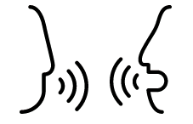








Poor health: Evidence of what works
Green Space
Connect with other people
Learn new skills
“The contribution of green space:
Creates a sense of place belonging
Creates a reduced sense of social isolation
Offers opportunities to manage stress”
From Health, Wellbeing and the Environment, William Bird, Intelligent Health, January 2019
5 ways to mental wellbeing
Be physically active
Give to others
Community connectedness
Pay attention to the present moment (mindfulness)

Slide 53
CONTRIBUTERS
Led by: Dr Adeola Agbebiyi
Contributors to Slideset:
Gemma Lyons
Eleanor Priestnall
Lynne Kitson
Adeola Agbebiyi
Analysis and Research:
Eleanor Priestnall
Lynne Kitson
Gemma Lyons
Robert Sinfield
Felicity Antwi–Adjei
Phil Veasey
All age Healthy Living Needs Assessment Workshops took place in June 2019, organised by Simon Reid and Kieran Scott
If you have any questions please contact Adeola Agbebiyi on Adeola.Agbebiyi@newham.gov.uk

