Slide 1
ROUGH SLEEPING
TRANSFORMATION
COPRODUCTION

Slide 2
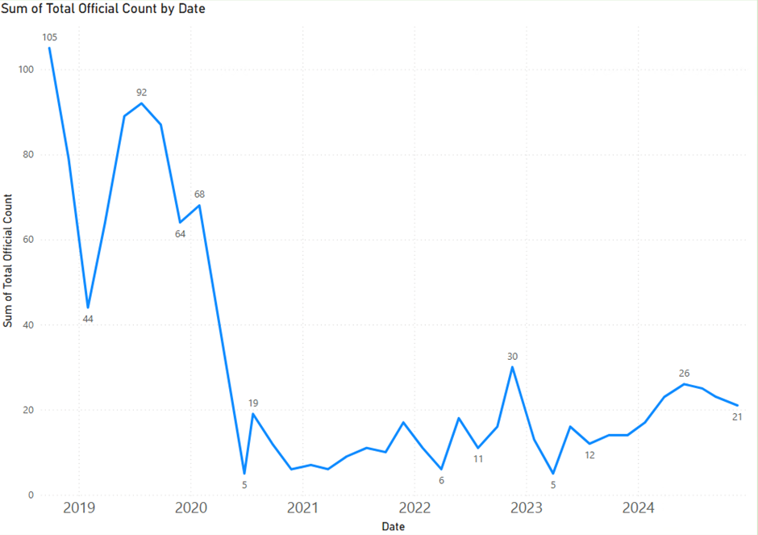
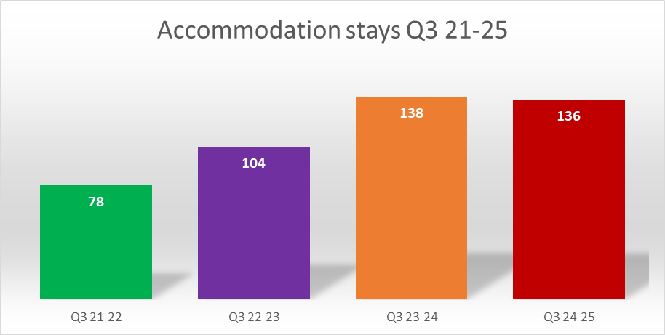
Context
Background – what we did..
At the start of 2020, Newham had the second highest rough sleeping population in London, the COVID-19 pandemic accelerated local plans to address rough sleeping.
Building on this achievement and delivery of our commitments in the Homelessness & Rough Sleeping Strategy we have brought about a significant reduction in our street population numbers and maintained this downward trend since 2020.
Collaboration and partnerships was key to the transformation of the rough sleeping pathway this included key stake holders across the Council and input from the rich and diverse Voluntary, Community, Faith and Social Enterprise partners in Newham. We acknowledged that our VCFSE partners had prior to 2020 provided essential support in a space that was previously overlooked and their understanding of this cohort was essential to developing local plans.
Targeted coproduction was undertaken to ensure meaningful engagement with a wide range of residents who accessed homelessness & rough sleeping services to inform the transformation of local rough sleeping pathway, develop commissioning intentions and service model which was co produced by experts by experience.

Slide 3
Who we reached
Who we reached and how?
Following a strategic review of rough sleeping services and needs assessment we were able to use this intelligence to help shape and triangulate information to identify gaps and opportunities to address the complex and often entrenched rough sleeping.
A wide range of stakeholders, provider market leaders and residents who accessed services were consulted/ interviewed.
A core group of experts by experience was established from various in depth conversations and were pivotal in the development and implementation of competitive tender process and were involved in provider selection. All those who participated received reward and recognition for their time and formal letter of recognition.
Various forums and groups helped shape collaboration with VCFSE organisations to develop innovative approaches to tackling rough sleeping with care and compassion.
We have since established a strategic Rough Sleeping Partnership group to provide oversight and accountability with representative membership across the Council, VCFSE including Resident voice.

Slide 4
Outcomes and Impact
What we found out as a result
Informing the transformation included findings from coproduction and data which highlighted the diverse needs of those who experienced rough sleeping required a service pathway that could flexibly offer a stepped pathway approach to offer the right level of support at the right time. Examples included:
Those with no recourse often tended to have low needs and willingness to engage with services offering support to ETE but required specialist immigration advice to regulate status.
Those with recourse were often presented with more complex Substance Misuse/ Mental Health needs and ambivalent to engage with services.
Those accessing services did not want to keep repeating their ‘story’ with multiple referrals between agencies would further deter willingness and motivation to engage in support services.
It was critical that the good will from VCFSE organisation was harnessed and directed to support routes off the streets such as food donations being coordinated to align with accommodation offers to reduce numbers in ‘hot spots’.
How has it changed things.
Views and opinions helped shape and inform commissioning intentions and design of service specification and
LBN moved away from a roof over one's head to a dynamic pathway that supports people by flexibly aligning to their needs.
Service design adopted a streamlined pathway that offered direct access to immigration advice and support, a tailored substance misuse pathway, access to specialist ASC MDT coordination, expanded day opportunities with in-reach from wider preventative universal services and wrap around VCFSE offers.
LBN also changed how we collated data, capturing a minimum dataset to track needs and the impact. This has allowed us to evidence and invest more in what works.
We incorporated the outcomes star into support planning. This allowed us to engage with all residents, identify issues form their perspective and the areas they were motivated to change. We then focused on those areas in order to maximise motivation and build confidence, rather than a more generic approach. This also provided feedback on what was working and wasn't in real time.
An Expert by Experience co-chairs the Rough Sleeping Partnership. This individual was involved from initial coproduction and evidences inclusion of resident voice in full the commissioning cycle and provides ongoing feedback loop.

Slide 5
Reflections
The importance of representation at partnership board is an example of true coproduction providing a platform to influence decision making which informs and shapes local strategic direction.
We've since supported 1,200 since 2020.
We currently have c20 on the street, down from a peak of 200.
c65 are housed in temporary accommodation, demonstrating the various pathway ability to support and return to people to independence with time limited floating support.
90% of those who have moved on to independence have positively sustained tenancies.
Through delivering a biopsychosocial model service, One resident said 'losing their home was the last thing to go, the issues they were facing went back years'

