Slide 1


Renters’ Rights: Where we are and what comes next
Meera Chindooroy | Deputy director, campaigns

Slide 2
Where we are
The RRA is now in force.
Fixed terms and S21 have gone.
Soon will have to register on a database
www.nrla.org.uk
Notes:
This slide is here to give you a chance to elaborate that the RRA is now implemented and any provisions you want to mention.

Slide 3
Renters’ Rights timeline
Date | Milestone
December 2025 | New enforcement measures and investigatory powers for local councils came into force.
January 2026 | Wording for tenancy agreements was confirmed.
March 2026 | Publication of the mandatory information leaflet on changes for current/existing tenants.
30 April 2026 | Last day you could serve a Section 21 notice.
1 May 2026 | Implementation of the first phase of the Act.
31 May 2026 | Deadline for serving information leaflet to existing tenants, and for notifying student tenants that you may use the new Ground 4A.
1 June 2026 | Updated HHSRS guidance. Regulations came into force on 23 of June. They apply to inspections starting after the 22 June 2026.
31 July 2026 | Deadline for applications to court for possession under Section 21.
From 15th December 2026 | PRS database goes live. This will involve a phased, regional roll-out for landlords.
April/May 2027 | Deadline Government expects for the end-to-end digitisation of the courts.
2028 | Expected date for the mandatory sign-up to the PRS Landlord Ombudsman.
2035 | Updated Decent Homes Standard will come into force in the private rented sector.
We are here
www.nrla.org.uk
Notes:
Slide is in place to show that RRA implementation has only just begun and there is lots more.

Slide 4

Tenancy reform
Tenancy agreement
All assured tenancies are now periodic from the outset. No more fixed terms.
Rental periods are limited to no more than a month at a time.
Before the tenancy is entered into you must give the tenant a written tenancy agreement, or a written statement, covering the key information about the tenancy and the rights that tenants have.
Failure to provide this can lead to a fine of up £7,000.
Rent
You must advertise a listed rent. You must not accept an offer over that amount.
You must not accept rent before the tenancy is signed or demand more than a month’s rent at any time after that.

Slide 5
Tenancy reform
Terminating the tenancy
Any tenant can give two months’ notice (or less if agreed in writing), and it can come in any form of written communication (text, WhatsApp, etc).
Landlords can only end the tenancy by first serving a Section 8 notice and stating one or more grounds for possession. These grounds have been updated.
Pet requests
Contractual right to request a pet for tenants. Can only be refused on reasonable grounds and must be responded to within 28 days.
Reasonable grounds include your superior landlord banning pets, and the property being unsuitable for the specific pet, other tenant’s allergies or concerns
Unreasonable grounds would include things like concerns the pet might cause damage, disliking pets

Slide 6
Rent increases
Rent can only be increased once per year and must start with a Section 13 notice (Form 4A). Requires two months notice of the new rent.
All clauses that would increase the rent from one period to another are void
After serving the section 13 notice then either:
  You and the tenant can agree to a lower rent than the one on the S13 form in writing
  The tenant accepts the rent and the new rent starts on the day the notice expires
  The tenant challenges the rent for £47, delaying the rent increase until the Tribunal has decided on a new rent level. The Tribunal may not increase the rent above the landlord’s proposed amount but may lower it.
Tenants may also ask the Tribunal to decide whether the starting rent is too high in the first six months of the tenancy.

Slide 7

Tenant selection
The act bans you from discriminating against families or people receiving benefits, but you can still make an informed decision about who to let to based on things like:
Who can best afford it (taking all their income into account).
References from previous landlords, employers, etc.
Whether the tenant is likely to stay long term.
What you can’t do is apply a criteria to discourage applications or viewings because someone is receiving benefits or has children. For example:
Inconsistent criteria like higher affordability criteria for benefit tenants or requiring guarantors only for families.
Not accepting viewings from those tenants.
The key is to apply decisions consistently and fairly and keep a record of this.

Slide 8
Ending a tenancy
To end a tenancy you must first serve a Section 8 notice (Form 3A) that includes one or more of the legal grounds for possession and then seek a possession order.
Grounds have been updated, including:
Grounds for sale or moving family in (1 and 1a). These Require four months’ notice, can’t end in the first 12 months and you cannot relet, or try to relet, for more than a year after serving.
An updated mandatory rent arrears ground (8) that requires three months’ arrears and four weeks' notice. Any Universal Credit delays don’t count as arrears.
A new student possession ground (4a) available where the property is a HMO, the landlord gave prior notice, and all the tenants are, or would become students during the tenancy.

Slide 9
Landlord database (I)
Phase 2 of the Renters’ Rights Act requires landlords to register themselves and their property on a new database.
The ‘Register Your Rental Property Service’ will open for registrations on 15th December 2026, with a different deadline for registration for each region of England.
For landlords with properties in London, regulations apply from 15th July 2027 and the deadline is 14th October 2027. You can register from 15th December 2027 prior to regulations coming into force.
The fee for registering is £65 per property per year. Multi-property landlords will need to pay the fee annually on, or before the day they first registered a property.
Initially only required for tenancies occupied under an assured or regulated tenancy. Will change in the future so you can’t market property until registered.

Slide 10
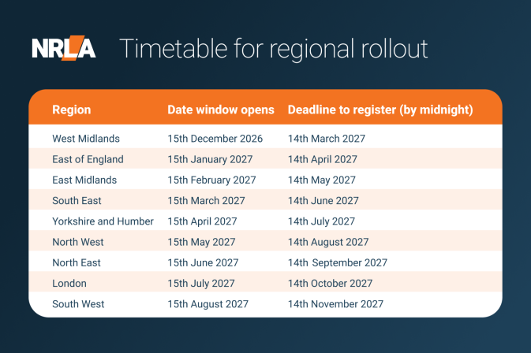

Slide 11
Landlord database (II)
As part of the registration you will need to give information to the government:
Your details: name, DOB, address, phone, email
Property details: address, ownership type, type of property, contact details of superior landlord/property manager, number of bedrooms, whether property is currently let
Tenancy details: rent (frequency, amount, bills included), number of people living in the property, number of households, whether it needs a licence, furnished/unfurnished
Safety standards: copies of latest GSC, EPC, EICR where needed, MEES exemption details if applicable.
Agents cannot register for you, but will be able to provide some of this information at your request.

Slide 12
Landlord database (III)
In the future, once the database is up and running fully then:
You will not be able to advertise a property without an active registration
Tenants will be able to access limited amounts of information about the property via a public portal
Local authorities will have access to the database for their housing enforcement powers.
You may be fined up to £7,000 for breaching the database requirements. In some cases, this may go as high as £40,000 for serious breaches.
You won’t be able to get a possession order in most cases unless you are registered on the database.
Local authorities will be able to enter residential premises if they believe the property should be registered on the database but isn’t.

Slide 13
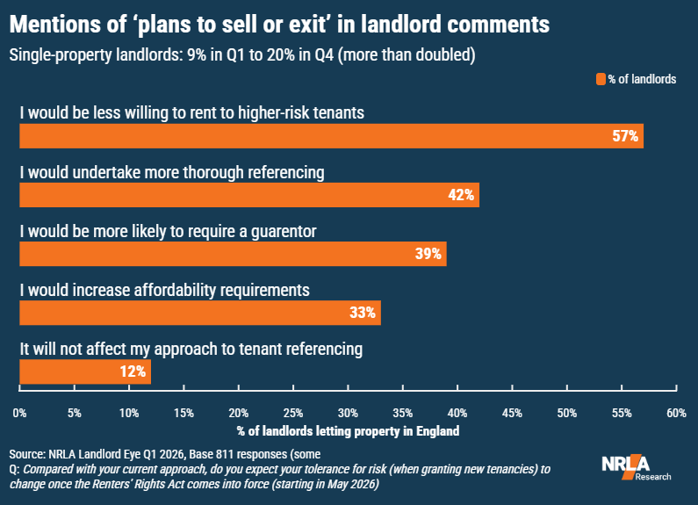
Impact on landlord behaviour
With a more complex possessions process, potential for court delays, a ban on rent upfront and more, landlords are likely to adopt a more risk-averse attitude when deciding on potential tenants.
Consequently, accessibility to the PRS for those unable to secure a UK-based guarantor, such as international students, or those with poor credit history or no references could be reduced.
Notes:
Section focuses on changing landlord attitudes to risk with landlords now stating they will increase referencing checks, etc. in light of RRA changes.

Slide 14
Is the state prepared?
Average time from claim to possession for private landlords is over 6 months according to the latest MoJ data.
This has led to the average unpaid rent due at the time of eviction per property rising to £12,708 in England and Wales and £19,223 in London according to the High Court Enforcement Officers Association.
Landlord possession claims April–June 2026: 23,635, up 6% year on year, section 21 claims up 16% to 8,569
The Housing Minister Matthew Pennycook has already previously admitted that the courts system is “on its knees”.
Notes:
Slide on issues with court preparedness, latest MoJ possession stats were published on the 12th February 2026.

Slide 15
Tribunal system
With 11 million private renters now able to challenge rent increases, there are serious concerns as to how the tribunal system will cope with an increased workload.
So far at least, rent determination cases are progressing relatively quickly despite a significant increase rent determinations. It remains to be seen if this will last.
Government confirmed that it plans for the Valuation Office to begin to make initial rent determinations to limit pressure on the Tribunal – but needs further legislation for this.
Government has powers to backdate rent increases should the tribunal system be ‘overwhelmed’ however it has stated it does not hold data on the average time for the FTT Property Chamber to consider, process and rule upon rent appeal cases.
The question is how can Government can therefore determine if the tribunal is “overwhelmed” and put in place mitigations?
Notes:
Current concerns with the tribunal system, lack of capacity, issues with the data and how they will determine the tribunal is “overwhelmed” and the apparent lack of progress on implementing the alternative body to adjudicate on cases before they go to tribunal.

Slide 16
What else is coming
MEES reforms raising the EPC of PRS properties.
New Decent Homes Standard coming in 2035.
Introduction of Awaab’s Law to the PRS.
www.nrla.org.uk
Notes:
MEES and MTD are being covered by other presenters but thought I would include this in your presentation so you can briefly mention it and give your opinion on these changes as well.

Slide 17
What needs to change?
A plan for court reform and increased capacity.
Working in partnership with, not against, landlords.
Transparent tribunal performance data.
Notes:
A slide to go over our key asks with regards to concerns on the preparedness of the courts and state generally to cope with implementation of the RRA.

Slide 18



Any questions?
Renters’ Rights Hub
Renters’ Rights Q&A Webinar Series – registering on the database
Renters’ Rights Training
Notes:
Slide for questions if applicable.

