Slide 1







Idling and Air Quality Workshop

Slide 2



What do we breathe?
What is the air made up of?
What do we need air for?
Notes:
Hello everyone! Everybody take a big breath in. How does that feel?
We breathe all the time but can anyone tell me why we need to breathe? (what happens if we can't breathe?)
What is the air made up of?
What are we breathing in? (Oxygen / CO2)
Does anyone know the names any other gases in the air? (Nitrogen makes up most (80%) of the air we breathe. It is a neutral gas. It isn't good for us or bad for us)
What about pollution and some of the things we breathe in that might be bad for us?

Slide 3

What pollutants are there in the air?
NO₂
PM
Nitrogen Dioxide
Particulate Matter
They are usually invisible so how do we know they are there?
Notes:
There are many other pollutants, but our focus is on NO2 and PM
Who can name something we might breathe in that is bad for us? (might say smoke / carbon monoxide / dust / pollen / cigarettes, all correct)
The main things we look at when we talk about air pollution are nitrogen dioxide and particulate matter.
Nitrogen dioxide is an invisible gas that comes from burning fossil fuels. It might smell a bit bitter or not smell at all. It is made when nitrogen –that neutral gas we spoke about- reacts with oxygen around very hot temperatures and turns into a gas that is very bad for us.
Particulate matter is tiny bits of dust, much smaller than a grain of sand, that we might breathe into our lungs.
Because this pollution is normally invisible, we have to test for it with special equipment. Newham has over 100 small air quality testing tubes outside all schools and more advanced air quality monitors as well as two hubs / stations - one in Canning Town and another in Stratford. You can find more information and relevant data on Newham website https://www.newham.gov.uk/Pages/ServiceChild/Data-on-local-air-quality.aspx

Slide 4
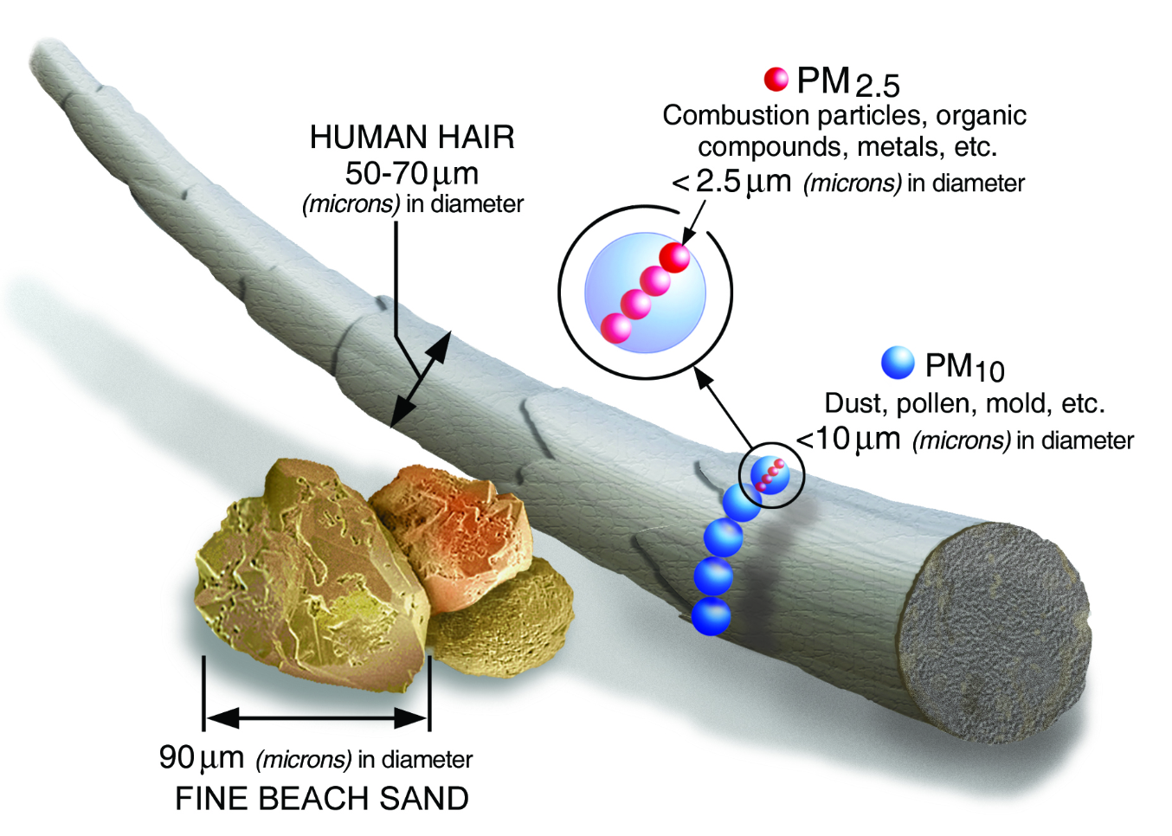

PM₁₀ : are tiny inhalable particles that are generally 10 micrometres and smaller.
PM_{2.5} : is even smaller in size than the PM₁₀. The fine particles are generaly 2.5 micrometers and smaller.
How small is 2.5 micrometers? Think about a single hair from your head. The average human hair is about 70 micrometres in diameter – making it 30 times larger than the largest fine particle that comes from pollution.

Slide 5
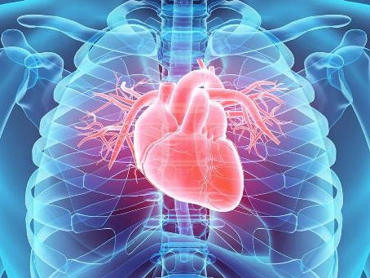
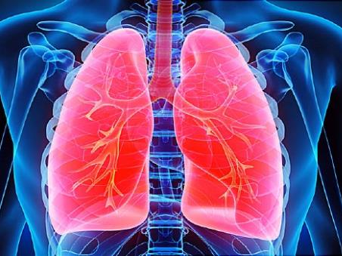
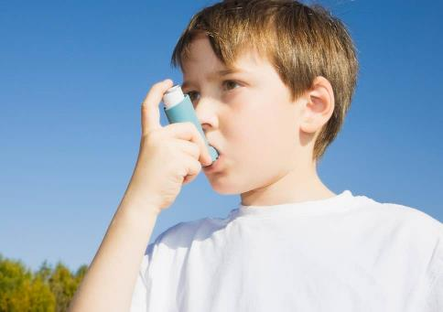

HEART
LUNGS
Why do we need clean air?
ASTHMA
CONCENTRATION
Notes:
Why do we need clean air
What happens when we breathe in polluted air? (affects lungs, heart, concentration)
What happens to us when we breathe in polluted or dirty air? (we might cough and splutter. It might make our throats, noses and eyes sore and itchy)
Let’s think about the parts of our body that need oxygen from the air (our lungs, hearts, brains/ everything). All of these organs need good, clean air to stay healthy.
Pollution: Nitrogen dioxide or particulate matter can cause disease especially in our hearts and lungs. Who knows what asthma is?
Who can explain what happens when we have asthma? (asthma attack / make our lungs tight and makes it hard to breath / carry inhaler)
When I do these sessions in schools in the middle of London I find many more of the children I talk to have asthma. Why might that be? (more exposure to pollution and traffic)
Scientists have found that children who live in polluted areas might find it more difficult to concentrate in class.
https://www.scientificamerican.com/article/childrens-attention-deficit-linked-to-air-pollution/

Slide 6
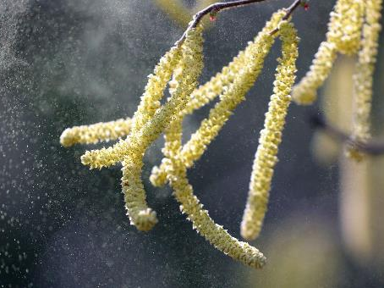
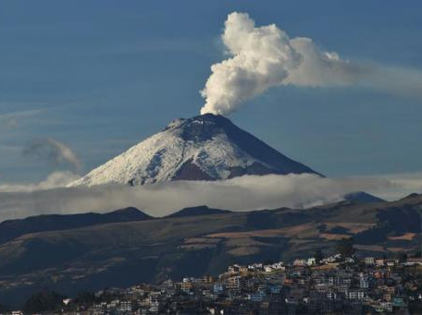
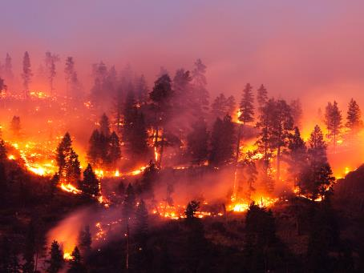
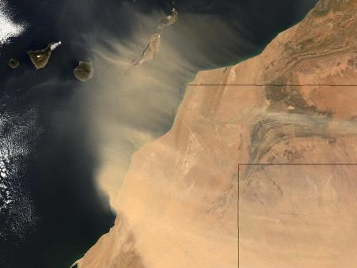
POLLEN
VOLCANOES
Where do pollutants come from?
FIRES
DUST
Notes:
There are some natural sources of air pollution.Where do these pollutants come from?
Who can tell me what’s happening in these pictures?
Even though they are natural they still can be bad for us.

Slide 7
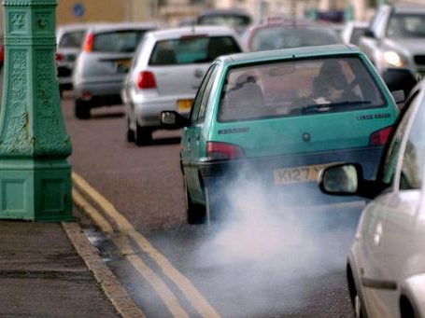
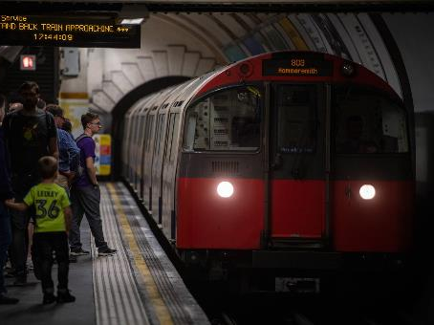
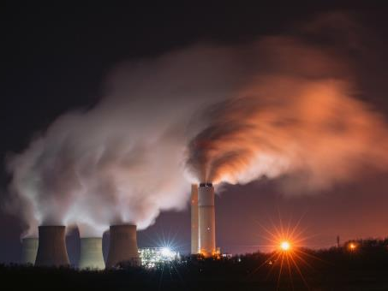
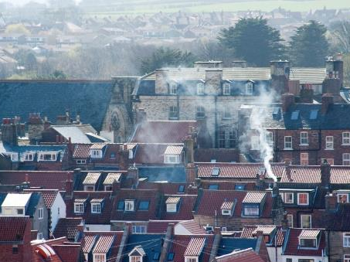
ROAD TRAFFIC
TRAINS
Where does pollution come from?
INDUSTRY
HEATING
Notes:
Where might man made pollution comes from?
We talked about how Nitrogen dioxide was made around very high temperatures. So who can tell me what is going on in this picture *pic of exhaust pipe* - combustion of fossil fuels makes pollution.
Who can tell me what combustion means?
Who can tell me what fossil fuels are / what do we put in the back of our cars? (petrol / diesel)
What is the air like on the tube? Thick and smoky. It makes the floor and the walls dirty; this is because of the particulate matter (and heavy metal deposits) created by the trains’ brakes as they move along the rails.
The most common source of pollution in London is from the traffic on our roads. The engines (especially diesel engines) make nitrogen dioxide and the wheels and the brakes make PM pollution. There are 2.6 million privately owned cars in London and many more cars driving through each day.

Slide 8
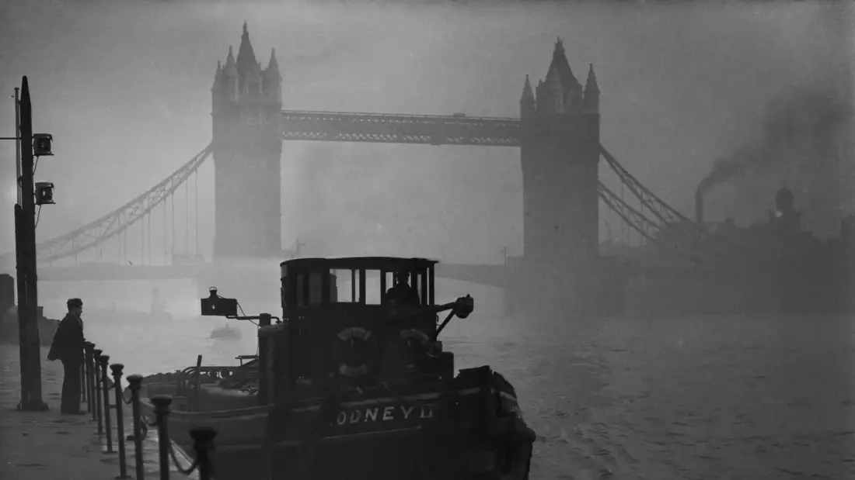
Pollution in Cities
Notes:
Smog used to be a very obvious form of pollution because emissions from coal burning were different. Thick soot, sulphur oxides etc. This pollution was visible. Smoke and smog were sometimes so thick that people couldn’t see across the street and cars and even ambulances couldn’t drive safely.
Great Smog 1952
First Clean Air Act 1956

Slide 9
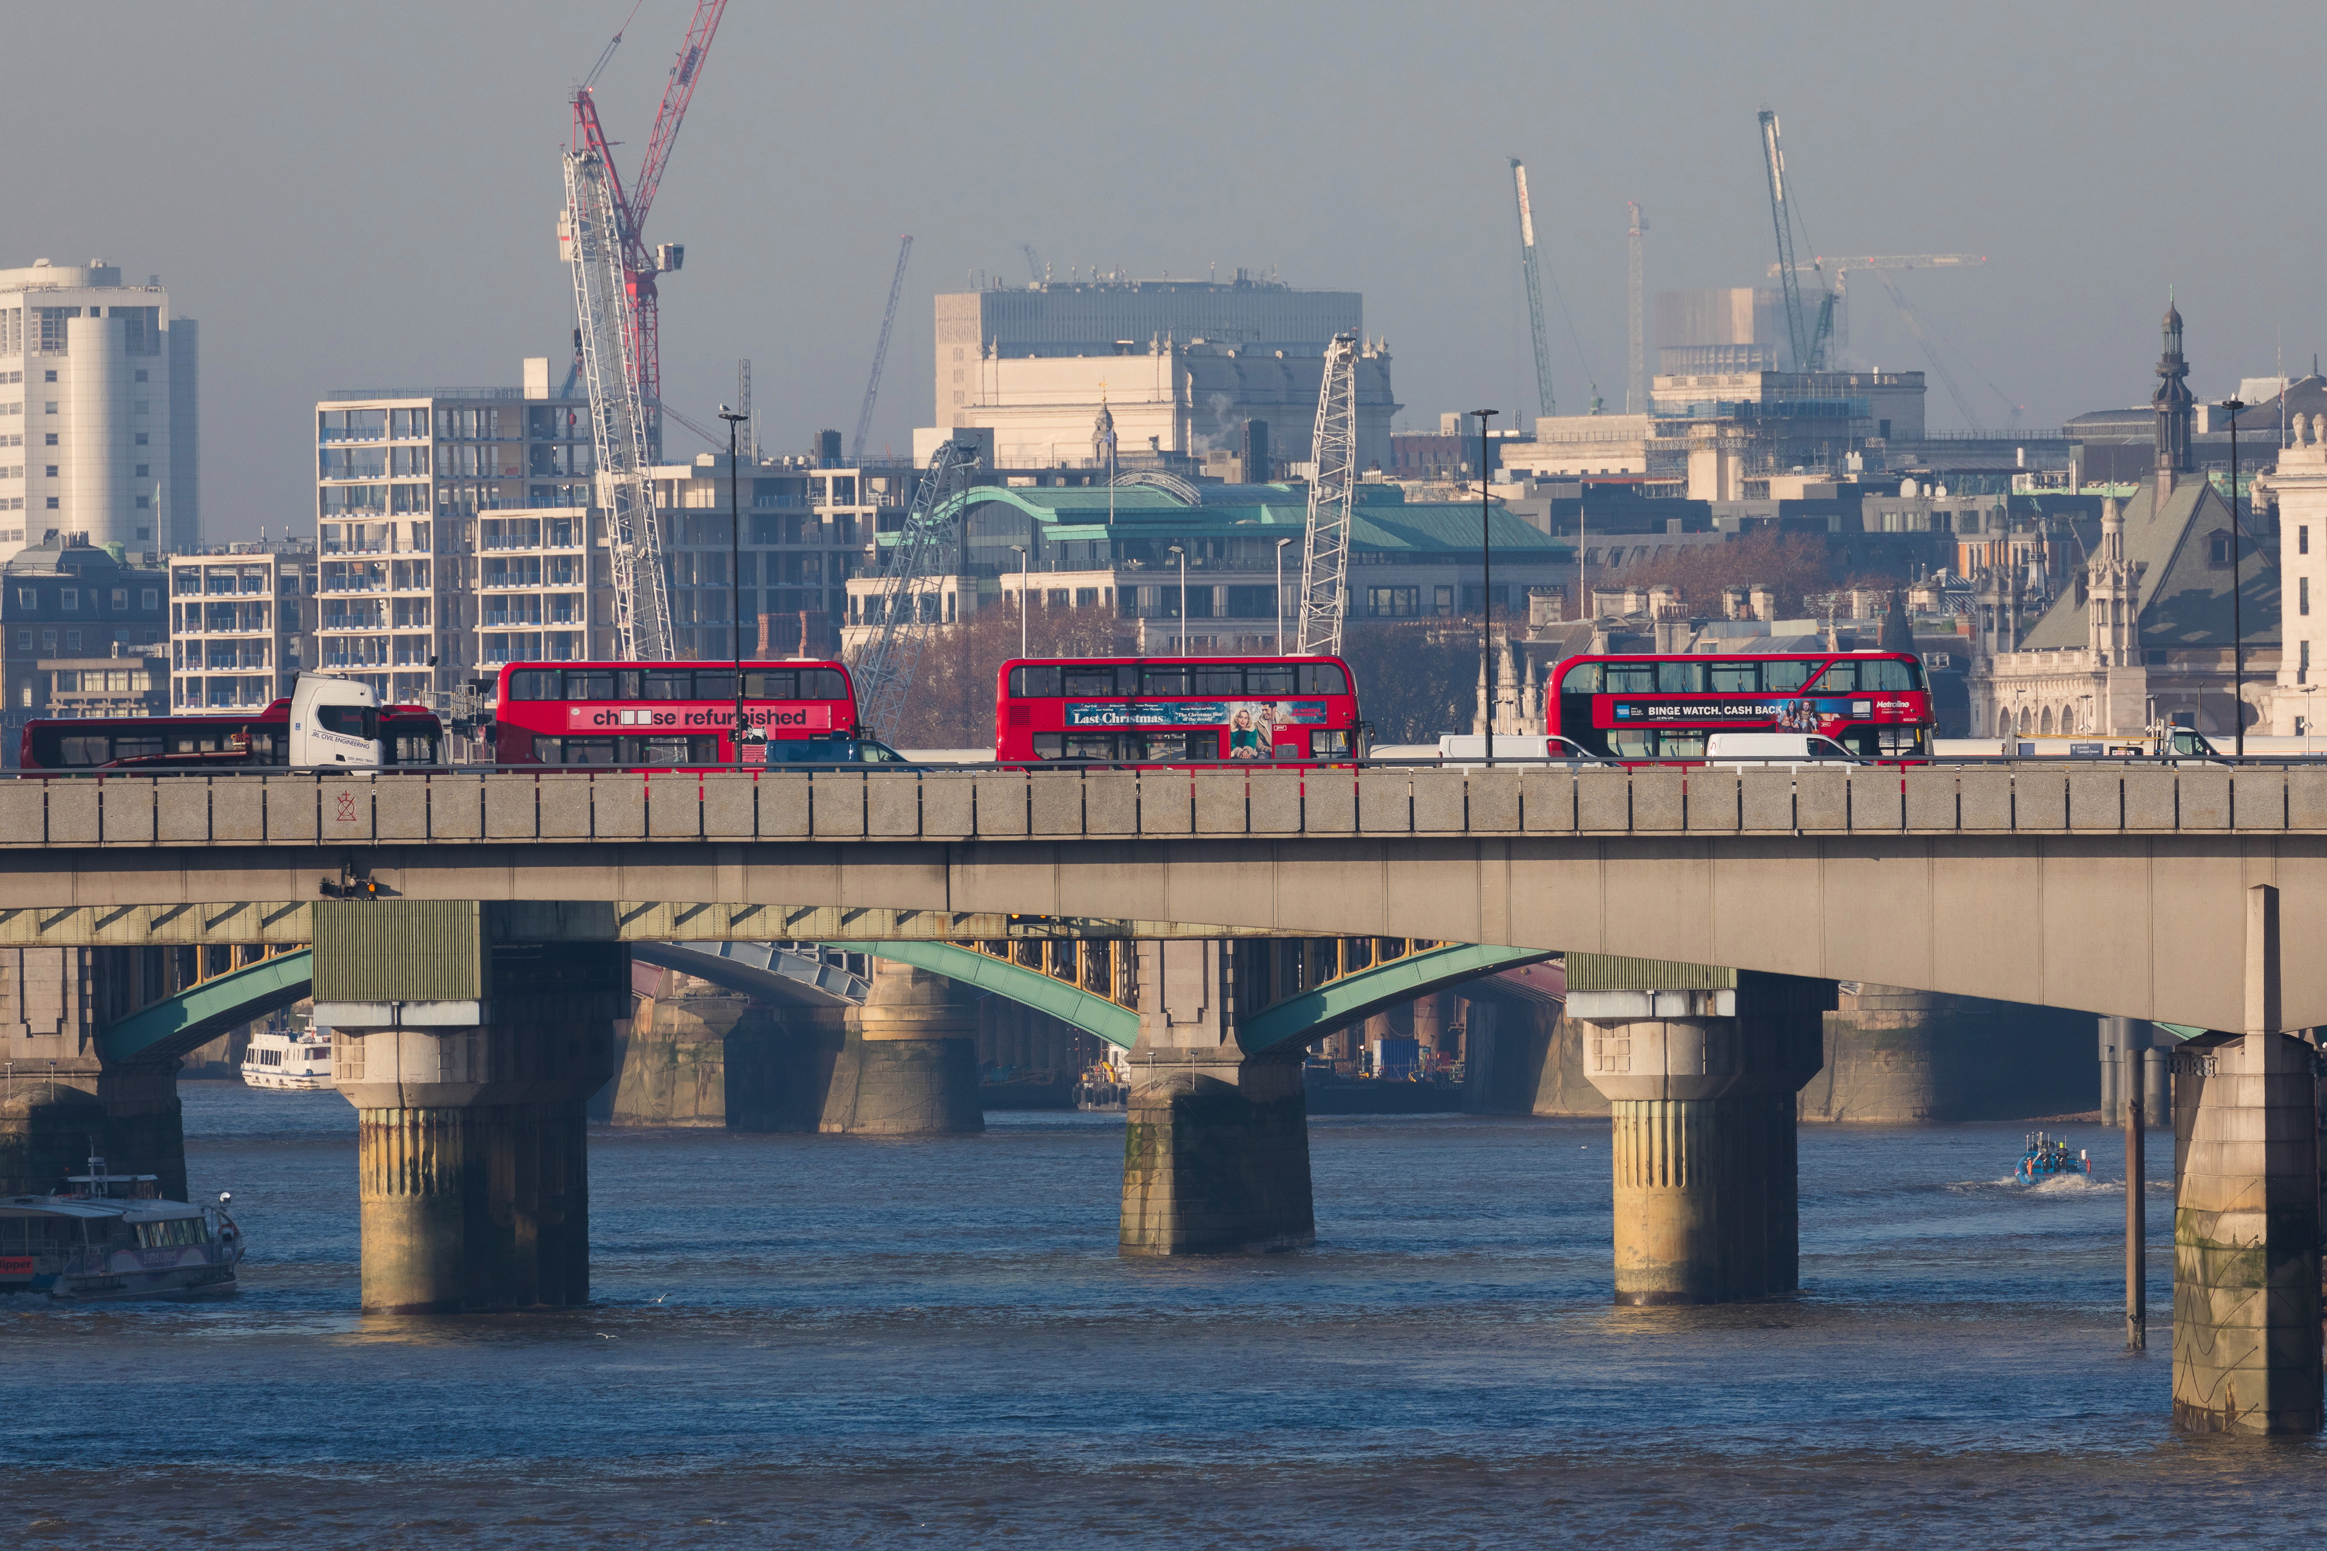
Pollution in Cities
Notes:
This is a picture of London today. The pollution hasn’t disappeared but it has changed. What can we see in the picture?
I’ve chosen a picture of another bridge surrounded by mist and haze but we know that London doesn’t always look like that. It’s not always misty and hazy like this and that might make us think that there is nothing bad in the air. But because of all the people living and working in London, heating their homes and driving around there is still a lot of pollution being placed into the air. The pollutants from burning petrol, gas and diesel are bad for us but they much harder to see now.
What do we call the little tube at the back of a car? (exhaust pipe)
What comes out of the exhaust? (fumes)
And we know that these fumes are really bad for us. But they are also usually totally invisible. You can’t see a big cloud of smoke behind most cars (unless it's a very cold day).
For this reason we often need scientific equipment to tell us where the pollution is and how bad it is.

Slide 10
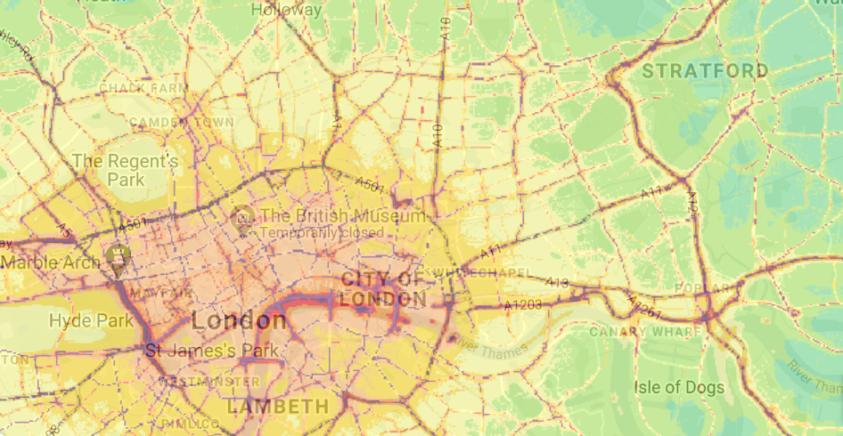
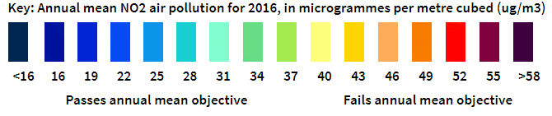
Greater London - annual mean NO2 concentrations in 2016
Notes:
What does this map show us? (it is a map of London. It is showing us where the pollution is and the colors show how bad the pollution is. What we really want is this map to be coloured in either light or even better dark blue).
Talk about the scale and what it shows.
What is NO2?
Who can remember the types of pollutants we were talking about earlier? If CO2 is carbon dioxide then NO2 is nitrogen dioxide.
What do you think these little lines are? (roads)
It is roads that have the highest pollution in London. Why do you think that is?
(can talk about legal WHO limits which currently is 40 and on the map, the level of air pollution almost everywhere exceeds and is above 40). This map shows us that the most dangerous source of pollution is roads and the traffic on them.

Slide 11
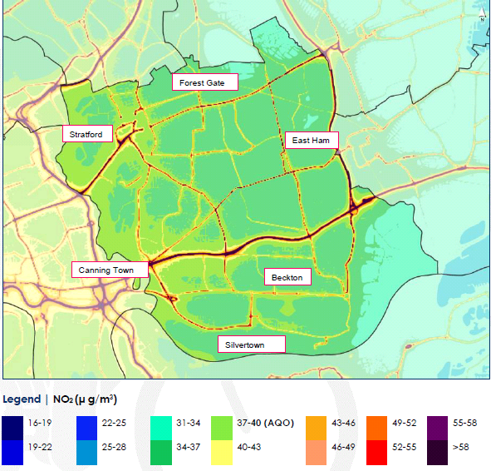
Newham - Annual Mean NO2 Concentrations 2016
The modelled map predicts that NO2 concentrations are exceeding the national air quality objective (AQO) for the protection of human health (40 μg/m3) in the locality of all major roads in the across the borough.
Notes:
Similar map to that in the above slide, just localised for Newham. Explain that redlines represent high levels of pollution. Ask if children can recognise where the school is located / where they live.

Slide 12
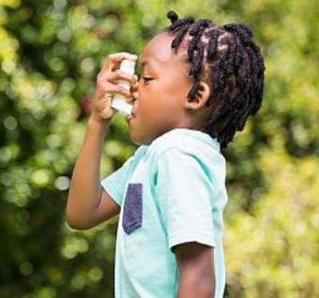
What do we know about air quality in Newham?
Notes:
Newham residents are exposed to higher particulate pollution than in any other London Borough causing the highest number of child asthma hospital admissions.

Slide 13
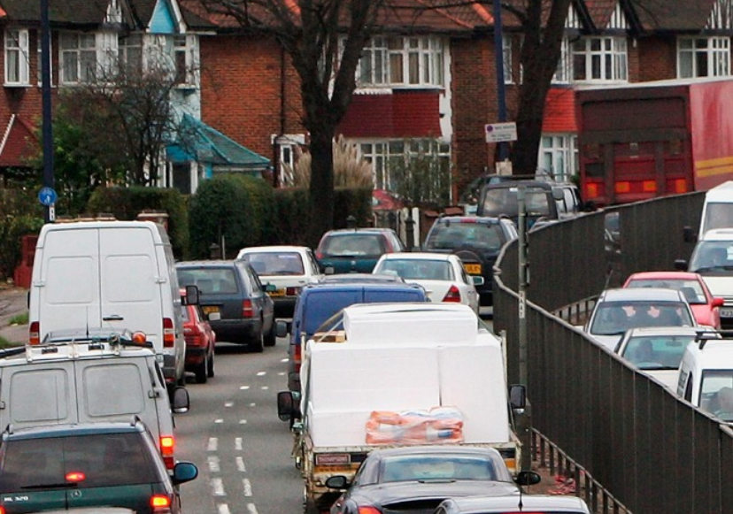
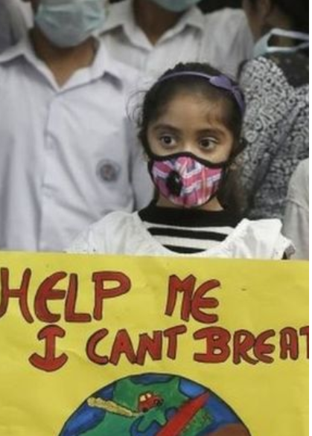
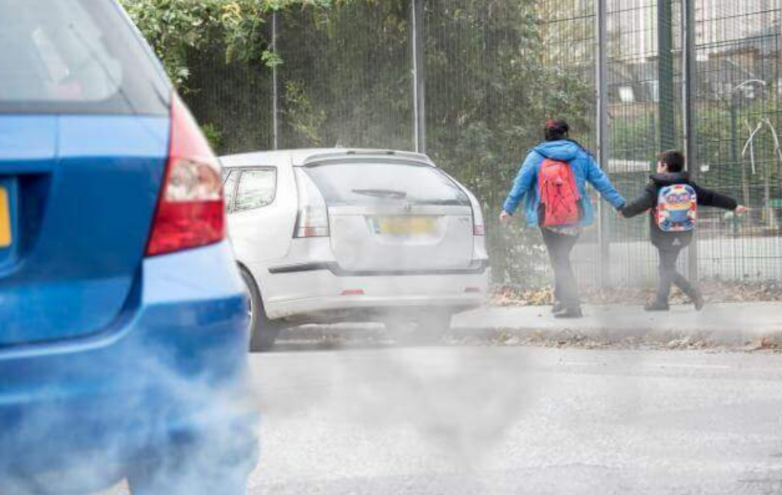
What do we know about air quality in Newham?
Notes:
Newham has the highest population exposure to PM2.5 in London due to road traffic, prominence of flats above shops and Victorian terraced properties with small front gardens. The town centres of Stratford, East Ham, Forest Gate and Canning Town are particularly affected.

Slide 14

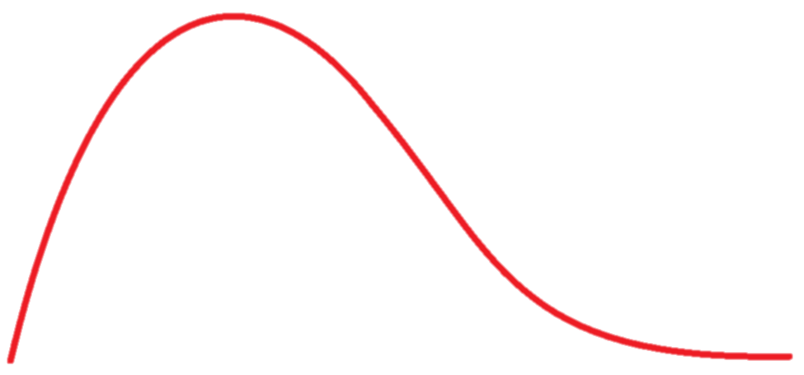
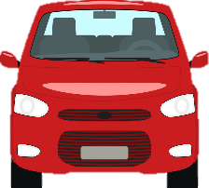
Emissions concentration
Distance from source
Notes:
Introduce concept of exposure. Being closer to the source of pollution means that you are breathing more of it in. Pollution is much higher when you are closer to the exhaust of a car. Being even one meter further away can mean that we are breathing much cleaner air. This is why pollution from cars disproportionately effects young people. Children also breathe at a faster rate than adults so you are taking more breaths each minute and might be inhaling more pollution. Because your lungs and hearts are still developing / growing it is really important that you are note exposed to high levels of pollution especially when that pollution is easily avoidable.
Who knows the word that we use to describe a car that is not moving but still has it’s engine running. It starts with ‘i’. (they usually say ignition.
Idling
When something is idle it is not doing anything so when a car has its engine on, making pollution, but it isn’t going anywhere we say that it is idling.
Why might idling be really bad?
It makes pollution collect in one place. An idling car makes up to 20 times the pollution of a moving car and most of the time cars are idling for no reason.
An Idling car creates enough exhaust (the gas that comes out the back of the car) to fill 150 balloons in a minute.

Slide 15
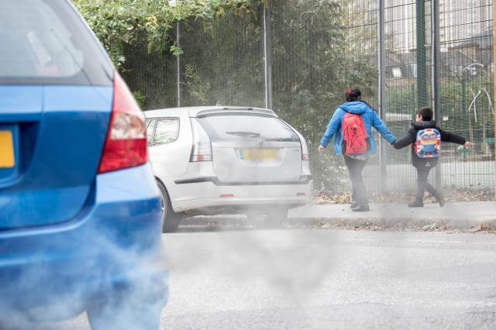
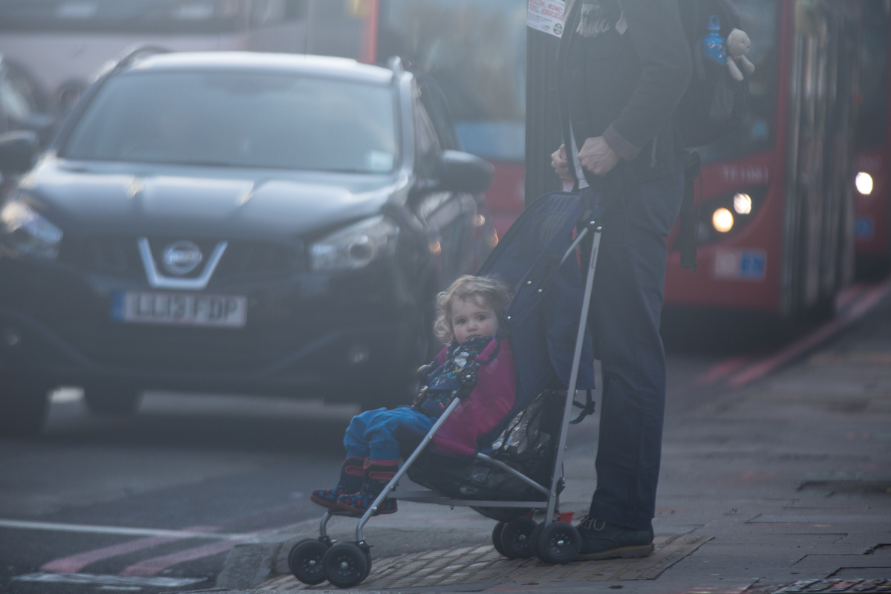
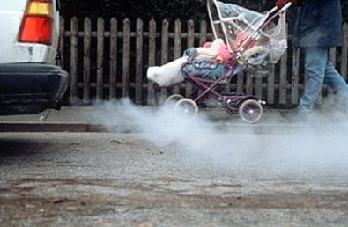
If pollution is worse the closer you are to cars and their exhaust pipes, what does that mean for us?
IDLING
Notes:
You can look up for more information on idling and its affects here - https://www.newham.gov.uk/Pages/Services/Helping-to-clean-up-Newham-air-Anti-Idling.aspx

Slide 16






What type of pollutants are there?
Where does pollution come from?
RECAP
Why is pollution bad for us?
Notes:
What types of pollutants are there?
Where do they come from? (stress road traffic. Over half of all the pollution in London comes from road traffic). We are all driving a lot more and walking a lot less than we ever have before. So every journey we make might contribute to the air pollution/ might make the problem worse.
Why is pollution bad for us? (heart, lungs, brain).
What are some of the conditions that dirty air can cause? (asthma, cancer, dementia).

Slide 17


What can we do about air pollution?
How do we prevent air pollution?
How can we avoid it?
How can we help other people avoid it?
Notes:
Hands up for ideas
Share lifts to school
Walk or cycle to school (ACTIVE TRAVEL *introduce term*)
Park and stride
Walk a quieter route
Plant hedges around the school
Talk to people about pollution
Idling-action event

Slide 18
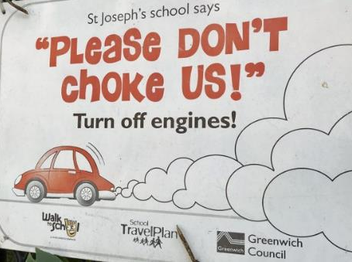

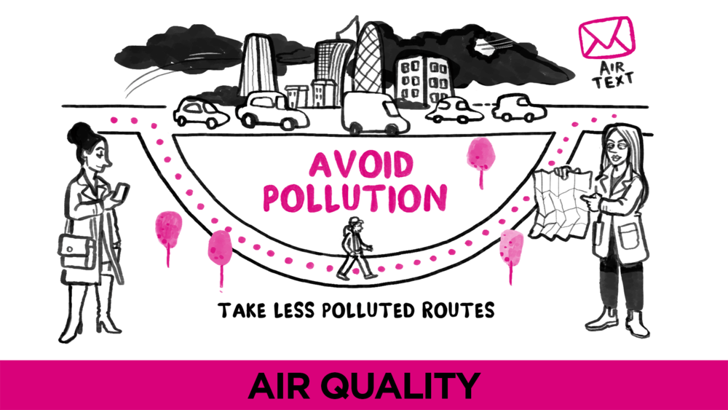
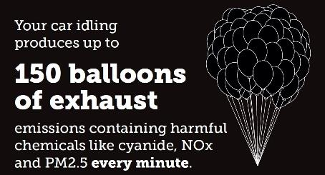
Notes:
Become an Air Quality Champion
Running an anti-idling campaign
Air text
Putting up signs and posters
We can encourage others to change their behaviour (no idling!)
Tackling idling is an effective way of engaging people
It stops easily preventable pollution
What might be reasons people might have their engines on? Discuss - keep warm, charge phone, listen to radio, work - refuse vehicles, ice-cream vans although later is acceptable.
So what can we say –very politely- to someone if they have their engine running but they are not going anywhere? Can you please switch your engine off!
We are going to run an idling action event after class to share the no idling message with drivers. Hopefully this will make grown ups think twice before leaving their engines running for no reason and creating dangerous pollution next to the school (an elsewhere too).

Slide 19
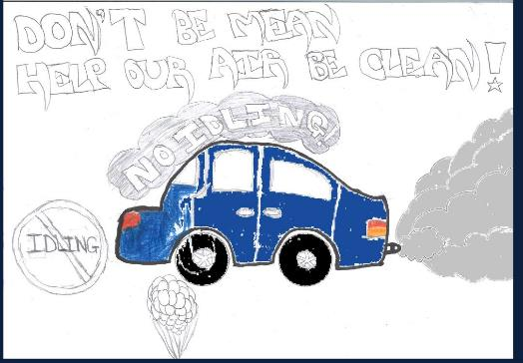
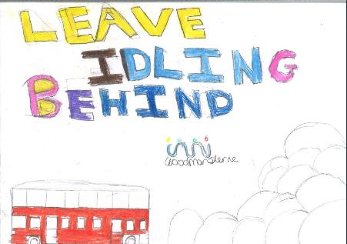
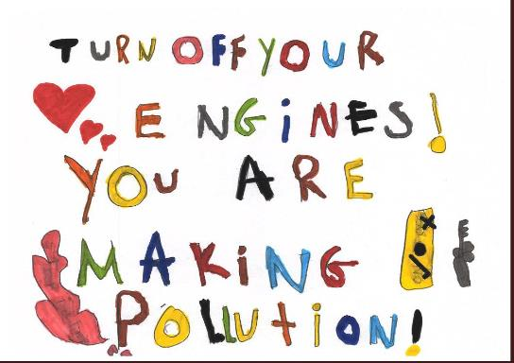
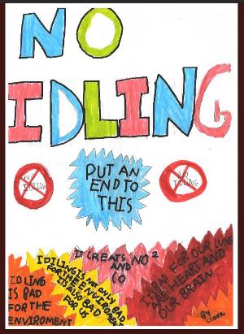
QUESTIONS?
Notes:
Some of the drawings and messages that children from other schools have designed.

Slide 20
The next two slides are not part of the presentation to students.
If you have any questions or queries, please contact: Lijana.Mitrijevaite@Newham.gov.uk

Slide 21
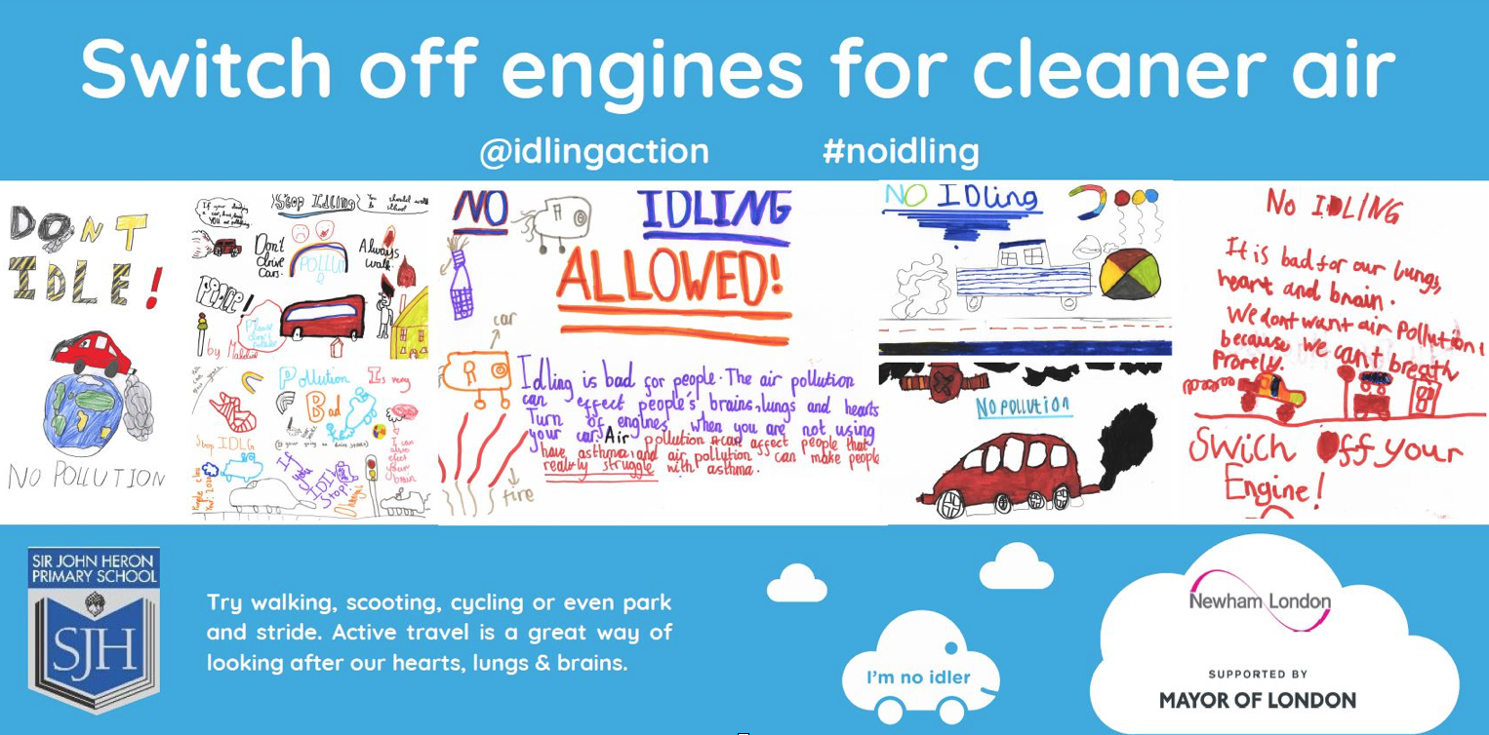
Sir John Heron Primary School in Manor Park was the first school in the borough to host an ‘Anti-Vehicle Idling’ event!
The one hour workshop to students involved learning about what air pollution is, the sources, and what can be done about it – centralising an anti-idling campaign as an effective way to reduce air pollution they may be exposed to at school. Students then made posters with anti-idling messages, some on which were turned into a banner which will be hung outside the school to prevent drivers idling their engines.

Slide 22
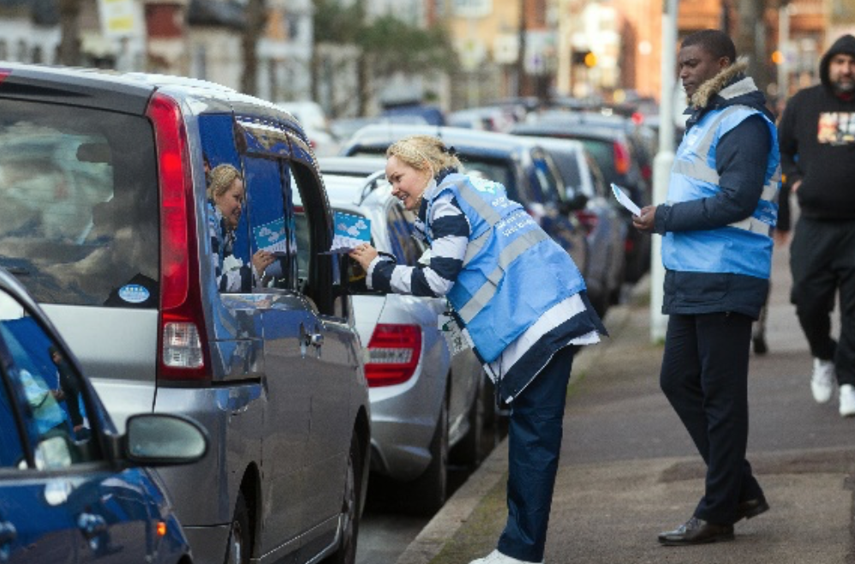
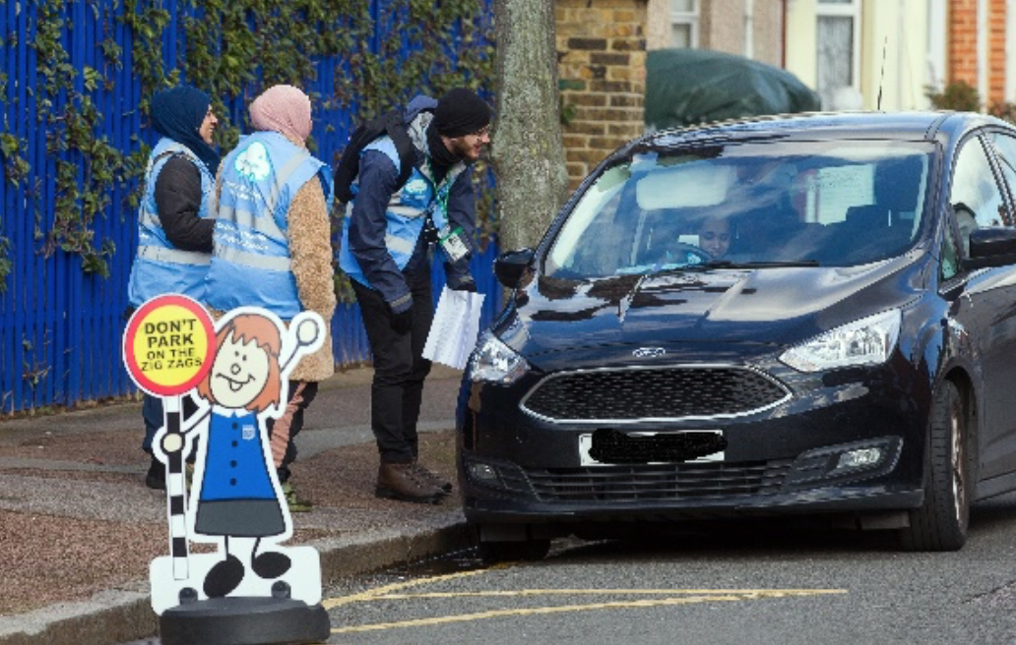
How to deliver anti-idling action event at your school
Due to the pandemic, we had to postpone all our face-to-face workshops, but we would like to encourage teachers to incorporate this teaching resource if and when possible. As a thank you for your time and work, we will post an anti-idling campaign poster to your school.
Hopefully in the not so far future and it is safe to do so, you can download a toolkit to host your own Idling Action campaigns here, as well as access further lesson resources for students to conduct experiments into air quality.

