Slide 2
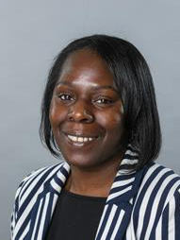
Welcome
Councillor Charlene McLean
Deputy Mayor (Statutory)
Cabinet Member for Resident Engagement & Participation ​

Slide 3
Housekeeping
Attendees are automatically muted and their videos turned off when joining zoom
This webinar is being recorded
Please use the window to ask questions which we will go through at the end of the webinar

Slide 4
Duration | Session | Presenter
5 mins | Welcome, housekeeping & introductions | Cllr. Charlene McLean
10 mins | Introduction and context to the ‘Towards a Better Newham – a budget for recovery and hope’ | Mayor Rokhsana Fiaz
10 mins | Setting the 2021/22 Budget and journey so far | Cllr. Terry Paul with input from Mayor Fiaz
10 mins | Budget Overview | Andrew Ward
10 mins | Case Studies | Cllr Terence Paul
18 mins | Q&A session | All
2 mins | Closing remarks | Cllr. Charlene McLean

Slide 5
Introduction
​​
Mayor Rokhsana Fiaz OBE
Lead for Inclusive Economy and Housing Delivery

Slide 6
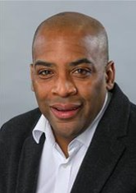
Setting the 2021/22 budget
Councillor Terence Paul ​
Cabinet Member, Finance and Corporate Services​

Slide 7
March 2019 People’s Budget (transitional budget) -
Transitional re-set, linked to a corporate plan
Better financial governance
Key policies established,
extended Council Tax Support scheme by £2.5m - up to 90% relief,
London Living Wage (now £10.85 per hour)

Slide 8
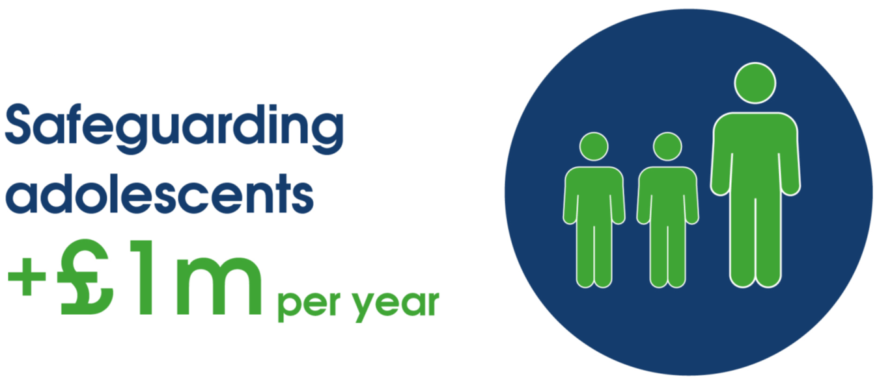
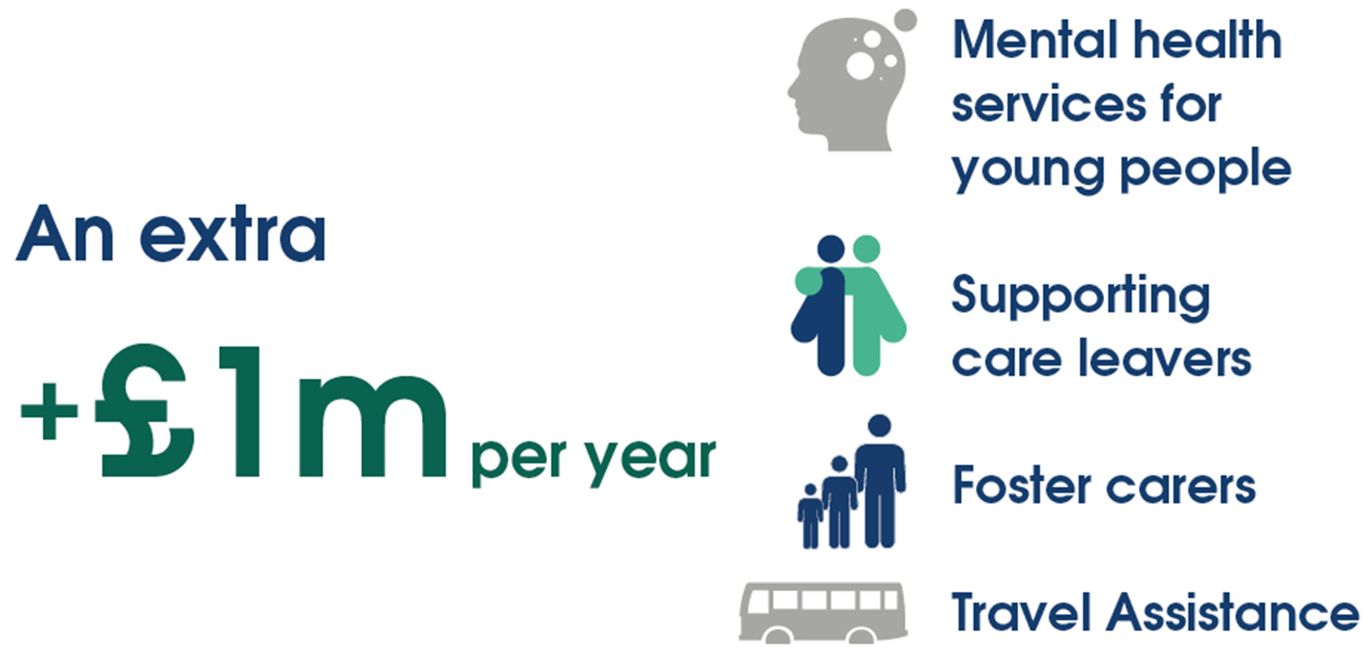
March 2020 CWB and Inclusive Economy Budget (1) - £10m of Investment, with £4m in Brighter Futures for Young People

Slide 9
March 2020 CWB and Inclusive Economy Budget (2) – a 3 year budget set out £10m of Investment – including these measures

Slide 10
Covid-19 impact on the Budget at a time when we are supporting residents through the pandemic
#HelpNewham, Covid-19 Health Champions, Well Newham and Newham Food Alliance
30,000 residents assisted through #HelpNewham
2,637 isolated residents reached by the befriending service
264,000 support parcels provided by #HelpNewham and the Newham Food Alliance
Provided a total £4m Council Tax Hardship support to 27,000 Households on the lowest incomes
Supported Local Businesses - £170m of business support grants and rates relief have gone to businesses, including £13m of discretionary grants mainly to micro businesses
Campaigning for fair and proper government funding, including for a Covid-19 Deprivation Premium

Slide 11
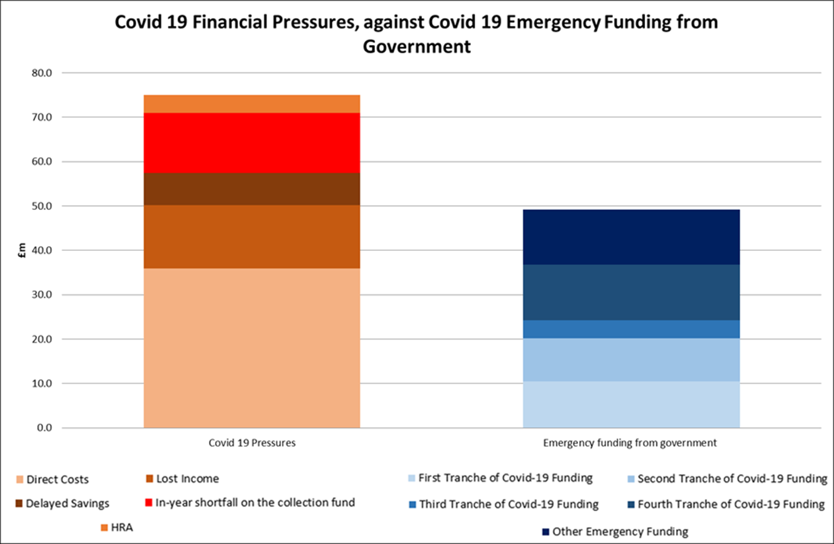
Government funding has not kept up

Slide 12
Setting the 2021/22 Budget, and Responding to Covid-19
A combination of:
Continued support through the pandemic – including £12.5m of extra costs for Adult Social Care, £4m on Children’s Social Care.
Shortfall in Government Covid-19 funding, longer term impact on the Council’s income sources and £4.5m less from local taxation
Results in a budget gap - £12m - and some difficult savings decisions, on top of £40m savings agreed in our March 2020 budget
March 2020 Investments and Key Financial Commitments will be maintained

Slide 13
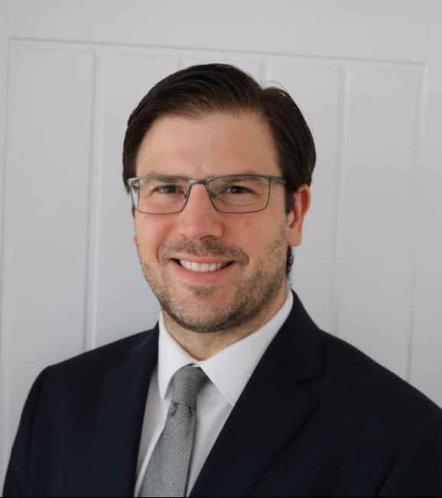
Budget Overview
Andrew Ward ​
Assistant Director
Finance and Transformation ​

Slide 14
A Snapshot – What the Council does for you
The income Newham Council receives – from your Council Tax; Government grants, and other income is invested back into services for residents and businesses, including:
Education - £448m
Business support - £170m
Covid-19 support and impact - £75m
Public Health - £31m
Waste collection - £22m
Housing - £20m
School meals - £6m
Environment - £6m
Libraries - £3.7m
Leisure & Recreation - £2m

Slide 15
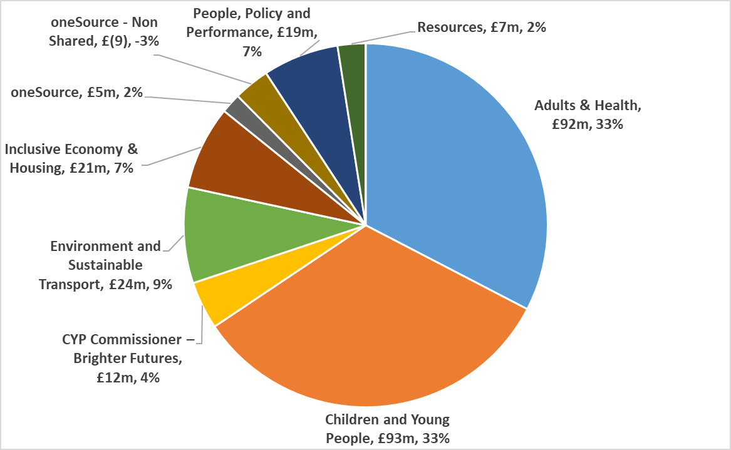
Departmental Spend
66p in every pound is spent on adults and children’s services

Slide 16
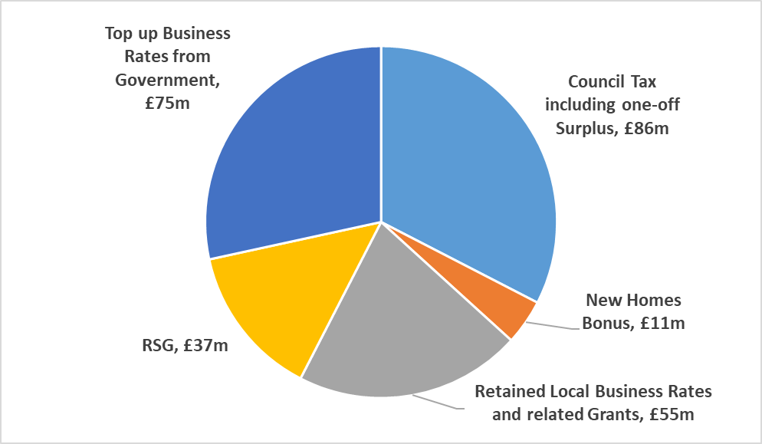
How that spend is funded

Slide 17
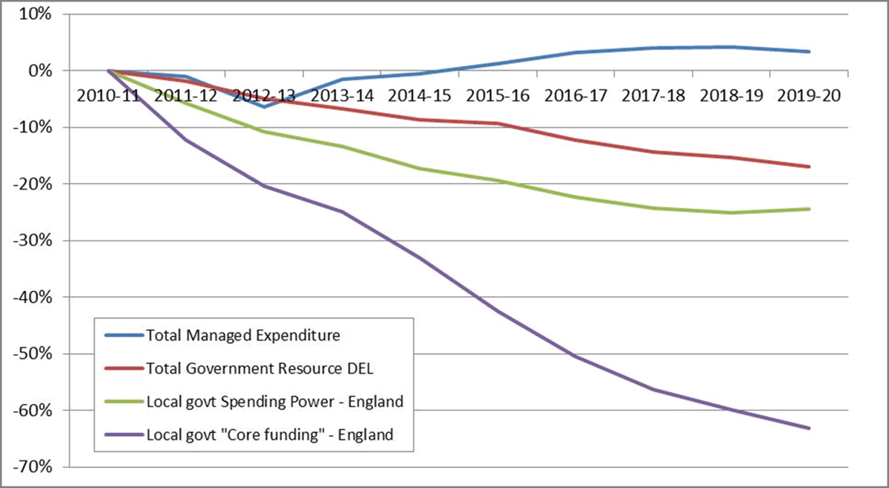
Local Government Funding has been cut over the last 10 years

Slide 18
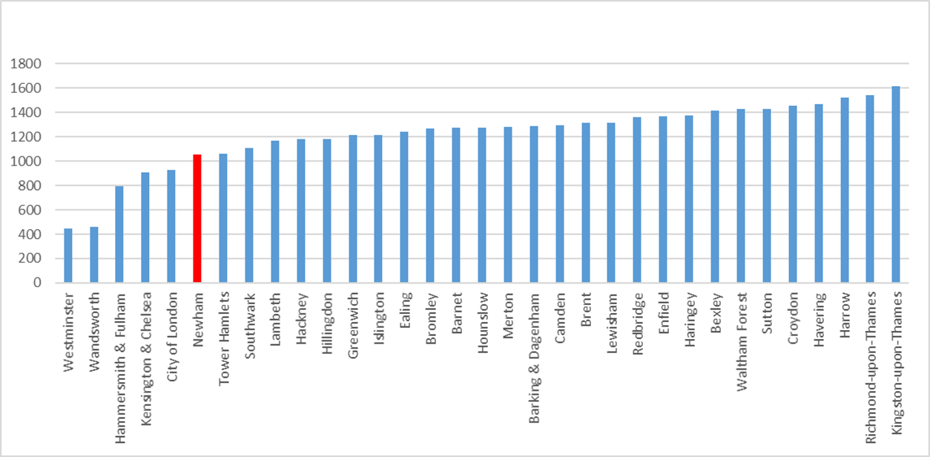
Council Tax in Newham is one of the lowest in London and the lowest in East London
Band D Bills in 20/21
Newham £1,051
Tower Hamlets £1,060
Hackney £1,179
Barking & Dagenham £1,285
Waltham Forest £1,428

Slide 19
Financial Commitments: what we’ll continue
Eat For Free and Food Security: Continue to fund school meals for all Primary school children | £6m
Address Poverty: Help Low-Income Households by safeguarding the Council Tax Support Scheme | £2m
London Living Wage: pay London Living Wage for new contracts in 2021/22, will cost £3m in the year alone = £6m in total | £3m
Keeping Residents Safe: retain the Met Police Enforcement Partnership | £1m
Protecting Core Services: Maintaining Weekly Bin Collections | £1m
Maintaining Community Hubs: Keeping our Libraries open. All our Libraries will be kept open, with the whole of the budget retained as set out in Feb 2020 | £4m
Valuing our staff: the Council will retain national terms and conditions on staff pay. Pay increases = £2.5m for 2021/22 | £3m
 | £20m
Notes:
TP to talk to

Slide 20
Food Security: addressing food poverty and health inequality
In response to the pandemic in 2020, #HelpNewham and Newham Food Alliance founded: a collaboration of the Council and voluntary / community / faith organisations to support vulnerable residents:
940 tonnes of food to Newham residents with a value of £3.5 million
184,000 food parcels to Newham residents
10,000 children helped
More than 17,000 food vouchers to address holiday hunger during Christmas holidays, with a similar amount to follow this half term
Saved 3.8 tonnes of CO2 emissions
More than £6 million invested directly or mobilised
Eat for Free Scheme: £6 million guaranteed Free School Meals to all primary school children, regardless of background
New ‘Young People and Food Security’ initiative

Slide 21
Supporting Residents and Improving Air Quality
The Council remains committed to Investing in our streets and neighbourhoods to encourage healthier and sustainable travel – walking cycling and enjoying our Borough
E.g. Investment of £450,000 to create and maintain electric vehicle charging points, to enable the council and residents to move to electric vehicles
NB: 20% COVID 19 discount applied to Emission Based Parking Permits and a further 20% discount proposed to be approved at a Council meeting on the 2nd February 2021

Slide 22
Challenging Savings
Return families to local, shared accommodation from self-contained accommodation out of the borough | £1,500k
Adult Social Care contributions – reviewing the cap on charging for Social Care | £300k
Enrichment activities for pupils in schools – maintaining £750,000 per year plus new provision through partnership working and Youth Empowerment | £250k
Reform and repurpose support offer to Care Leavers 21 years + | £900k
Rationalise use of buildings for children’s health and support | £150k
Review the impact of low traffic neighbourhoods | £352k
NRPF – redesigning help given through the immigration advice service | £140k
Pause service – integrate this provision elsewhere in the service | £175k
 | £4,767k

Slide 23
What the budget means for local people: some illustrative examples
Housing
Education
Leisure & Recreation
Environment
Waste collection
School meals
Libraries
Business grants
Public Health
Covid-19 support

Slide 24
Jenny & Alfie
Single-mum Jenny and her son Alfie benefit from Newham’s budget and policies in the following ways:
Free school meals, worth approx. £500 through Eat for Free
Single person’s 25% Band C council tax discount worth £233
WellNewham help with holiday hunger, which has delivered food and support to more than 8,000 households during the pandemic.
Help from the council’s £3.2m employment advice and benefits services
Cleaner air around Alfie’s school improves his asthma. The council has invested £1m in climate improvement, including anti-idling and safer school streets, as well as introducing emissions-based permits
Age: 27
Family: Single, one son, 9 Work: Teaching Assistant
Health: Jenny’s son, Alfie, has asthma
Home: Placed in temporary accommodation outside of borough

Slide 25
The Maxwell Family
The Maxwell Family can access support including:
A 90% reduction worth £728 per year from the Council Tax Support Scheme
Ongoing school meals worth almost £500 per year per child when the children reach junior school age
Access to Newham’s libraries, including books and children’s activities. Libraries and community centres receive £3.7m of funding.
Using Newham’s Workplace Employment advice service, which has had £3.2m investment, to find more secure work.
Improved environment through Low Traffic Neighbourhoods and Healthy School Streets
Use of Newham’s parks and recreation grounds
Age: Mum and Dad both 35
Family: Married with children aged 6 and 2, pregnant with third child
Work: Supermarket checkout & delivery driver
Health: Good
Home: Owner-occupiers

Slide 26
Anna & James
Anna and her son James benefit in the following ways:
Future support for social care needs, with carers paid at London Living Wage, £10.85 p/h
Improvements to her council home from the council’s planned £70m investment in Council Homes in 2020/21.
Support from £3.2m Workplace Service for coaching to help James find suitable work
Community Neighbourhoods & Libraries network, including over-50s exercise and social groups
Online shopping help during Covid-19 lockdown
Age: 76
Family: Widow, disabled adult son
Work: Retired teacher
Health: Has trouble getting around, fell and broke her arm
Home: 1 bed council flat

Slide 27
The Abbas Family
The Abbas family have had the following support:
Small Business Rates relief and Covid-19 support grants of £17,000 to help his small business survive the pandemic
£5.6m investment in Good Growth Programme and Queens Market Investment Works
Children accessed some of the £0.75m of enrichment activities and youth hubs
Access to 37 parks & open spaces and leisure facilities, boosted with £1.5m public health funding
£1m investment in better air quality, including through healthy school streets and emissions based permits
Age: Dad Imran is 50, mum Sara is 49
Family: Married with five school-aged children
Work: Shop owner and full-time parent
Health: Good
Home: Rent a council property

Slide 28
The Khan Family
Abdul and his family have seen their wellbeing improve thanks to:
HelpNewham support including one of 8,000 food parcels when they had to isolate due to Covid-19
Access to all 10 local libraries, and community activities
15-minute neighbourhoods to bring amenities closer to home
Activities at Community Neighbourhoods Centre to keep them in touch with friends
£36m investment in school places means the grandchildren are educated locally at one of Newham’s good or outstanding schools
Age: 62
Family: Married with four children and six grandchildren
Work: Retired
Health: Poor eyesight and not very mobile
Home: Owns a family home

Slide 29
Demitri
Demitri has benefited from the following:
High street and environment improvements, which have made his local area more wheelchair-friendly
Better air quality and greener accessible open space, helping to lower his stress
Access to local leisure facilities, boosted by £1.5m investment in Active Newham
Community Covid-19 testing at one of the borough’s eight testing sites has enabled Demitri to continue working during the pandemic
During lockdown, the Covid-19 befriending service helped him to stay connected
Age: 48
Family: Single, lives alone
Work: Senior finance manager
Health: Good health in general, wheelchair user
Home: Home owner

Slide 30
Alex & Christina
Alex and Christina benefit from the following:
£150 Council Tax Covid-19 support during the first lockdown
Christina’s pay increased through the council’s commitment to London Living Wage, insisting all contractors pay staff LLW as a minimum. As a result her pay increased by £2 per hour to £10.85
Access to 37 local parks and open spaces, leisure facilities and events
Newham’s landlord licensing scheme means their private rented house is well maintained
Commitment to the Armed Forces Covenant places the couple on the priority list for a council home
Age: 37 & 34
Family: Couple with no children
Work: Alex is ex-Forces and Christina is a care worker
Health: Good health
Home: Rent a room in a shared house

Slide 31
What next?
Ongoing residents conversations via People’s Budget Forums and online
Cabinet decision: 16th February 2021
Full Council approval: 22nd February 2021
Mid-March 2021: Council tax statements
For more information:
www.newham.gov.uk/budgetengagement
Tell us your views, email:
newham.budget@newham.gov.uk

