Slide 1
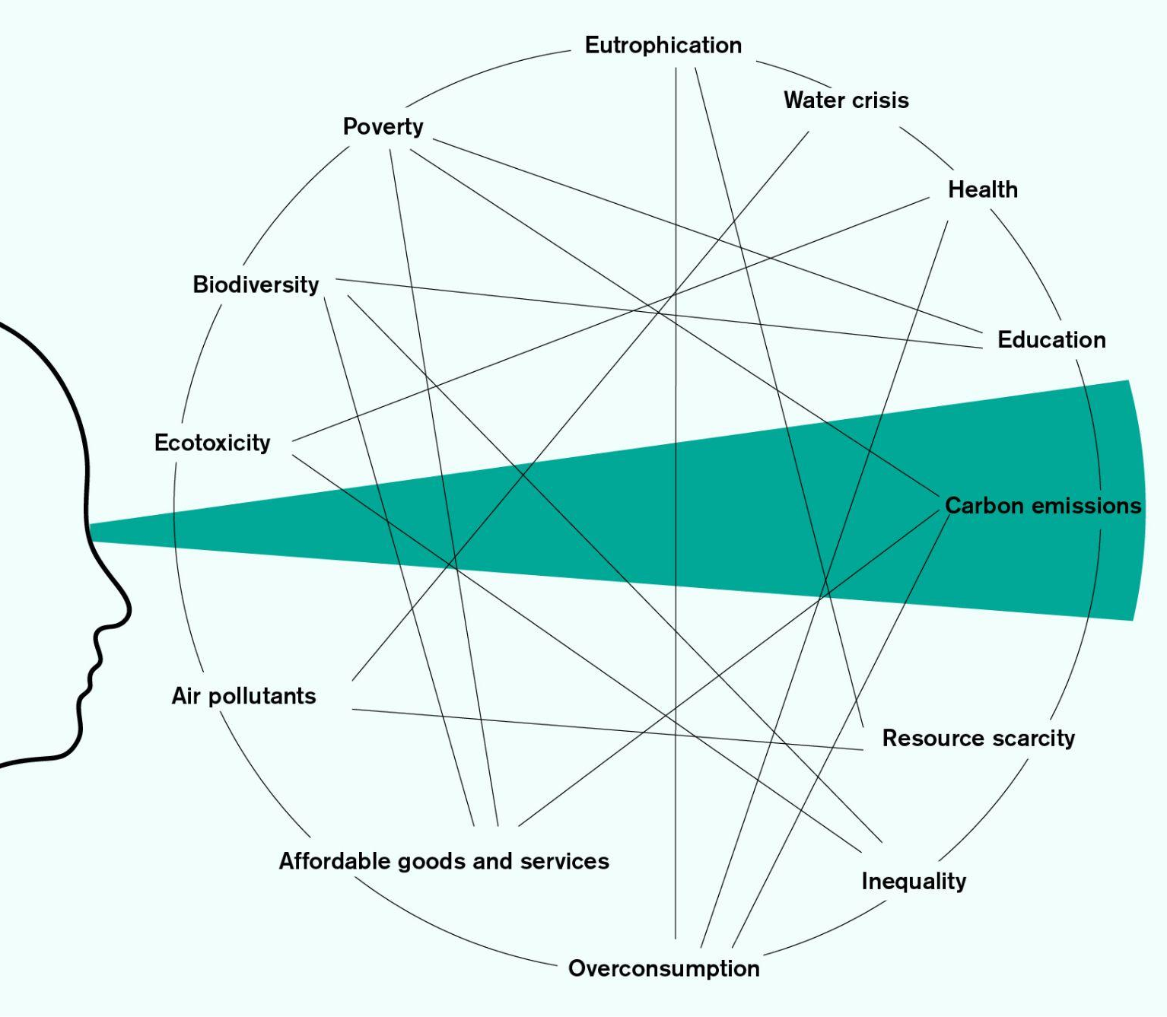
Newham’s Just Transition Plan
The Bigger Picture
Leading-edge climate action must look beyond ‘carbon tunnel vision’, to initiate a Just Transition.
The case for reducing greenhouse gas emissions, and the means by which to do so, are familiar, albeit difficult. But the climate emergency comprises a range of factors that impact human and nonhuman life and environments across the globe. Meaningful climate action needs to look beyond ‘carbon tunnel vision’.
In attempting to address the climate emergency holistically, Newham can initiate its Just Transition.

Slide 2
Newham’s Just Transition Plan
Where Newham is Now
Align title (24pt) to this box
Climate action in Newham must address the interlinked challenges faced by residents and workers
Health and wellbeing
Essential Services
Economic Prosperity
Planetary Boundaries
Newham residents experience the highest rates of death attributable to air pollution in London (1/7 deaths in 2019).
Some 35.5 percent of all homes in Newham are now owned by private property owners. Average rent represents 65% of average wages, compared to 30% across the UK.
1 in 2 children in the borough live in poverty.
Newham is among six London boroughs particularly exposed to extreme flood and overheating risks relating to climate change.
According to a 2020 British Heart Foundation study, Newham has the worst levels of fine particulate matter pollution (PM 2.5 ) in the whole of the UK.
Newham has the highest number of households in temporary and non-secure housing in the UK.
Over a quarter of Newham residents are paid below the London Living wage. After housing costs, almost half of Newham residents live in poverty.
There were 41 callouts to grass fires in Newham during the July 2022 heatwaves: three times as many as in the same month in 2021.
726 people in Newham died of Covid-19 between March 2020 and April 2021. Newham’s mortality rate was more than double England’s average.
Over two thirds of Newham residents are worried about being a victim of crime.
A quarter of Newham neighbourhoods are in the 20% of most deprived neighbourhoods in the country.

Slide 3














How does the Just Transition plan work?
Newham’s Just Transition Plan
Introduction
Align title (24pt) to this box
Align title to this box
3 Principles
6 Futures
5 Enablers
Increasing equity
Reducing emissions
Future-readiness
Our homes, workplaces and schools are comfortable, healthy and efficient
Our energy system is resilient, equitable and not dependent on fossil fuels
We prefer to walk, cycle or use public transport and goods are safely moved without polluting our streets
We increase sharing and reduce waste building a sharing and circular economy
We eat well and sustainably
Our neighbourhoods are resilient, connected and green
Growing the Council’s Climate Action capacity and effectiveness
Targeting and increasing investment
Partnering with Newham’s
Anchor Institutions
Enabling civic and place-based action
Working beyond Newham’s borders

