Slide 1


Rozina Iqbal
Director of Operations

Slide 2
Founded in 2008 by a dedicated group of Newham residents, the Newham Community Project (NCP) emerged in response to growing disparities in education and social welfare related to race, gender, and religion within the London Borough of Newham. The founders were driven by concerns over the lack of support and opportunities for the community, prompting their intervention. NCP has remained steadfast over the years, consistently stepping in during crisis times.
During the unprecedented pandemic and subsequent economic challenges, NCP has witnessed a surge in difficulties faced by the community, disproportionately affecting BAME individuals, disadvantaged populations, the underprivileged, and those with no recourse to public funds. To address the adverse impacts of the pandemic, NCP initiated a food bank in March 2020 followed by extended wraparound services which have been serving the community ever since.
At the height of the pandemic, the food bank distributed weekly groceries to thousands of adults and children. To this day, it continues to support over 650 families with children every week, providing essential provisions. Currently, NCP has more than 8,500 registered beneficiaries utilising various services.
Recognising the persistent adversities, discrimination, and disadvantages faced by their service users and the community at large, NCP has expanded its efforts. They have implemented further comprehensive wraparound services to address the myriad challenges confronting the community in the wake of the pandemic and the ongoing cost-of-living crisis.
Newham Community Projects' initiatives have had a profound positive impact on the lives of hundreds of families. Our service users have demonstrated remarkable resilience in overcoming adversities and crisis events, leading to enduring changes in their attitudes and behaviours towards these challenges.
Many of our service users have made significant strides in breaking down language barriers and fostering appreciation for cultural diversity in various settings. Their overall social and communication skills have shown remarkable improvement, enabling them to engage effectively with others.
A considerable number have not only become more employable but have also secured employment opportunities, empowering them to combat poverty and reduce unemployment. This newfound stability is helping them chart a course toward a more manageable financial future.
Moreover, our workshops have played a pivotal role in enhancing awareness and understanding of mental health concerns, as well as dismantling the stigma surrounding them. Many individuals are now better equipped to manage their emotional trauma and navigate the cultural constraints linked to mental well-being, leading to improved overall mental health.
In both the short term and long term, as necessary, our beneficiaries continue to utilise access to essential resources such as food banks, baby banks, workshops, dedicated case workers, and trauma and mental health support professionals, among a wide range of other vital services.

Slide 3
Current Newham Community Projects
Combat Food Insecurity
Welcome Newham
Academic &
Community Caseworkers
Winter
Warm Havens
Trauma-Informed &
Mental Health Practitioners
NHSBT
Gateway to Life
Organ Donation
Peabody Community
Support
Violence Against Women & Girl’s Hub
Combat Child Poverty
Integration, Cohesion &
Inclusion Project
NLP & Cognitive Restructuring
Workshops
Community Safety
Employability & Life Skills Programme
Taqlis
Illicit Drug Awareness
Support for Disadvantaged Ethnic Minority Families
Food Insecurity
Queen Mary Uni
Research Project
Youth Mental Wellbeing UCL Research Project
UCL Research Project – Newham History Recorded
Perinatal Programme
Charge Safely
&
Deliver Safe

Slide 4

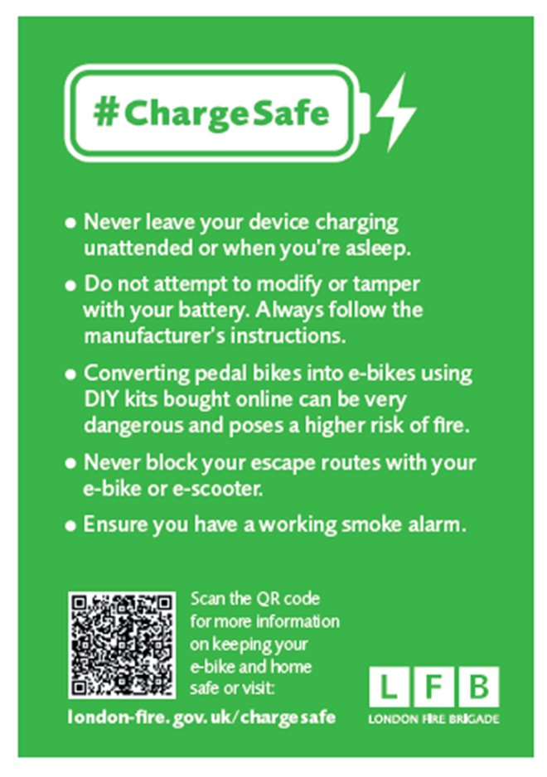
Having no recourse to public funds leaves many destitute families grappling with any jobs they can find to pay exorbitant rents, bills, food, and university fees. The majority live in Houses of Multiple Occupancy (HMO) to afford accommodation.
This has resulted in delivery drivers modifying bikes to go faster to enable more jobs. These modifications with cheaper alternative chargers are risking lives!
2023 London Fire Brigade have been called out, on average, at least once every two days for fires caused by lithium batteries that also charge e-bikes and e-scooters.
The level of risk within HMO - Analysis of national fire statistics has concluded:
You are six times more likely to die in a fire if you live in any HMO, compared to a single-family house.
The risk increases to sixteen times more at risk of fatal injury if you live in an HMO that is 3 or more storeys high.
Wider Complications Example
What is a Life Worth of Destitute Families
E-Battery Fire Safety Campaign

Slide 5
Research Questions…
Exploring Barriers and Interventions for those with No Recourse to Public Funds:
  How do individuals with no recourse to public funds navigate barriers to accessing support services?
  What interventions prove most effective in addressing destitution within this population, considering the intersecting factors of gender, race, and age?
  How can research and advocacy efforts effectively amplify the voices of individuals with no recourse to public funds, fostering empowerment and inclusion, while concurrently addressing the potential detrimental repercussions on their immigration status?
  How can support services be tailored to provide not only safety and reassurance but also a sense of belonging for individuals in this vulnerable demographic?
Impact on Mental Health and Community Support:
  To what extent does the lack of access to public funds contribute to mental health challenges among individuals facing destitution, and how do community and social support networks influence their well-being? Additionally, how can NGO and charity involvement enhance these support systems and obtain regular funding without the need for individual grants to effectively make a difference?
Legal Frameworks and Policy Recommendations:
  How do current immigration policies and legal frameworks impact the availability and effectiveness of support services for individuals with no recourse to public funds, and based on research findings, what policy recommendations can be proposed to improve the support system and alleviate experiences of destitution among this vulnerable demographic?

Slide 6



Thank you
Contact Details
rozina.i@newhamcommunityproject.org
07535652755
www.newhamcommunityproject.org
Please do follow our social media:
LinkedIn: Newham Community Project
X: @Newhamcommunity
Facebook: Newham Community Project
Instagram: @Newhamcommunityproject

