Slide 1
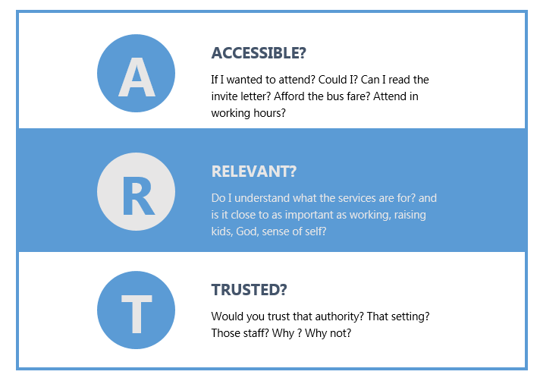
THE ART OF TACKLING INEQUALITIES IN HEALTH AND CARE:
A NEW FRAMEWORK
FOR ACTION AND INSIGHT
Adeola Agbebiyi
Newham Public Health Team
Notes:
Framework originators : Adeola Agbebiyi and Anne Bowers with Jason Strelitz and Ysabella Hawkings.

Slide 2
ART – our Why
Developed around the 2020-21 COVID pandemic Vaccination campaign.
ART also arose from observations of NHS Diabetes Prevention Programme assessments with feedback from community conversations around COVID-19 vaccine uptake.
It is an adaptation of the 2014 Sage vaccine hesitancy framework (known as ‘the 3 Cs’) to address the observation that Literature and interventions often focus on behaviour and attitudes of populations and omits structural, system and service drivers of activity and outcomes.
ART’s Aim –is to shift agency for uptake improvement from potential service users towards providers and services.
It does this by clarifying the drivers of uptake and establishing the
actions within the service or provider’s circles of control and influence.
This shift supports services and providers to identify issues and make often small, but highly effective changes to processes that improve service uptake, retention and the experience for service users.
Notes:
Othering
B sci

Slide 3
How ART is used in Newham
ART supports teams to systematically explore a service pathway and find what is working well and what isn’t from the service user perspective
ART works well with other approaches like Coproduction / User feedback / Data monitoring and
And with other tools designed in Newham
DWeLLIN /DILLIN
Core 20 cohort finder
Well Newham Approach
ART supports teams to better understand the needs of existing and potential service users to improve the experience for all.
ART is simple and easy to use.
ART can be used to code insights from qualitative enquiries.
The impact of using ART and the experience can be captured via the ART Process Evaluation Pack.

Slide 4
How you can get involved with an ART Project
Providers
Pathway optimisation guide
Guide use Process and outcome evaluation
Commissioners
Specification optimisation guide
EQIA support tool
Community insights
Coding framework
Peer researchers
ICB/ADPH
Service ART implementation framework
Academic
Validations
relationship with COM-B/ EAST etc
Service pathway improvement
To use ART in your pathway and complete a short process evaluation, to help us refine it please contact :-
Adeola.Agbebiyi@newham.gov.uk Mobile : 07956 937961
Notes:
We are developing other tools to support Providers and commissioners and services to deliver equitable services and tackle inequalities
Support tools to identify your local core 20 cohorts
A check tool to assess if your service uptake maps to the demographic of your service area
An Equity routemap for your system organisation or service (Newham Health Equity routemap). Contact as above for more information.

