Slide 1
Youth Safety: Centre of Equity Proposal
Cassandra Beckford: November 23

Slide 2
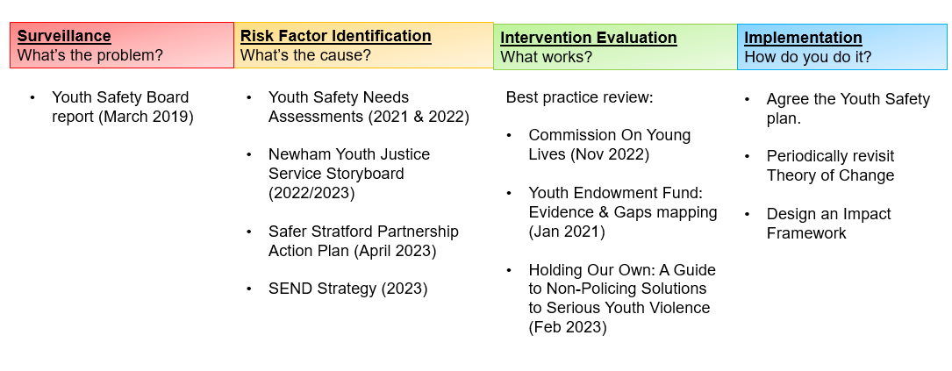
Youth Safety: Public Health Approach

Slide 3
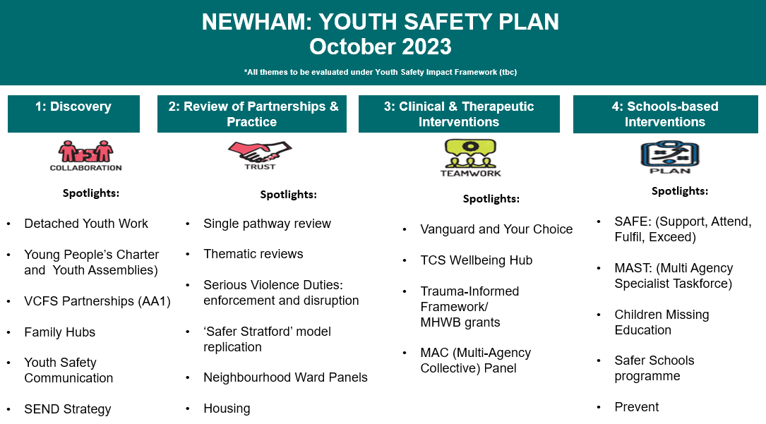

Slide 4
Questions for Researchers:
We are keen to explore working with a partner that can build a Youth Safety Impact Framework.
A tool or product that:
    Measures the direction of travel across all interventions, programmes and projects on the plan
    Ensures the right support and provision is directed across localities at the right time to children, young people and their families
    Demonstrates impact and outcome across our work
    Builds a body of evidence across to support continued, testing, learning, monitoring and evaluation

