Slide 1
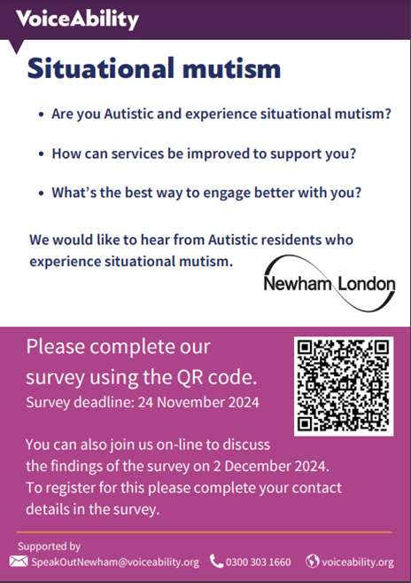
Situational Mutism Survey & Meeting Summary

Slide 2
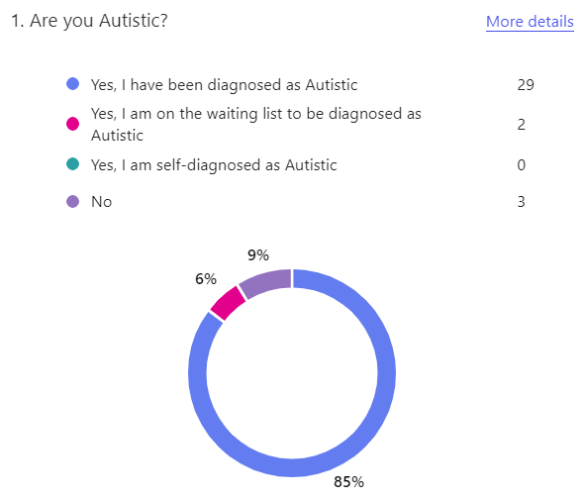
Survey results summary
Context - Respondents
34 people responded to the survey
85% (29) of respondents have been diagnosed as autistic
9% (3) respondents were a family or friend, parent or unpaid carer

Slide 3
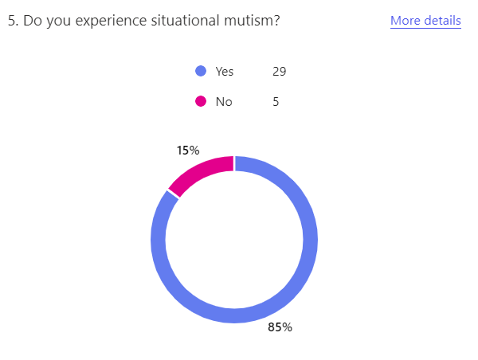
Survey results summary
Context - Respondents
85% (29) said that they experience situational mutism
15% (5) did not experience situational mutism. They were not invited to complete the rest of the survey.
29 respondents who stated they had (or representing someone who had) situational mutism went on to complete this survey
Going forward we will only be looking at responses from 29 participants

Slide 4

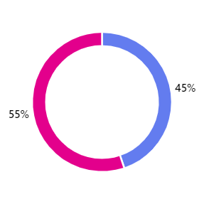

Survey results summary
Context - ARAG
29 Respondents who completed the survey were:
55% (13) existing members of the Autism Residents Advisory Group (ARAG)
45% (16) not members, although one (1) respondent had attended the ARAG

Slide 5
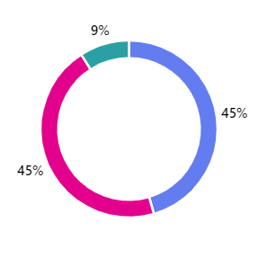
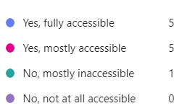
Survey results summary
Context - ARAG
11 respondents had previously attended an ARAG meeting
90% (10) respondents found the ARAG meeting 'mostly accessible' or 'fully accessible'
9% (1) respondent found the ARAG meeting 'mostly inaccessible'

Slide 6
Survey results summary
Context - ARAG
Suggestions to improve accessibility to ARAG meetings:
Slides available before the meeting
A calmer environment at the meetings - minimise external noise
Better awareness of and access to communication aids (eg. Cards, white boards)
Hold meetings at weekends our outside work hours
Inform participants of the possibility that there may be non-speaking attendees
Allow participation via text (eg. Web forms, text-to-speech, chat apps)
Participants to provide a profile name or Alias
Cameras are optional, facilitators will have cameras on
Use your virtual hand to indicate you want your chat read out or if you want to speak
All chats will be read out aloud
Meeting Chair to make it clear when it is someone's turn to speak
Participants to Mute microphones at all times unless invited to speak

Slide 7
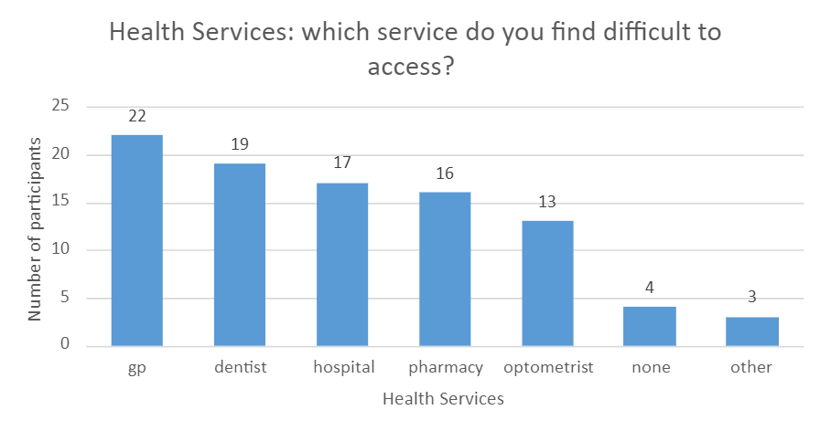
Survey results summary
Health Services
What health care services do you find difficult to access?
76% (22) GP
66% (19) Dentist
59% (17) Hospital
55% (16) Pharmacy
45% (13) Optometrist
14% (4) None
10% (3) Other

Slide 8
Survey results & meeting summary
Health Services
What changes in these service provisions would make these services more accessible for you?
Suggestions from the survey:
Clinicians should explain what they are doing
Inform staff in advance about any potential problems relating to situational mutism
Reminders about appointments and the ability to change them online or over the phone
Longer appointment times
Using plain language and visual aids
Having an advocate* accompany you
Being able to self-refer
Access to a quiet room
Suggestions from the follow up meeting on 2 December 2024:
GPs require more training on autism
Special care dentists are a good option for autistic people
Access to a "quiet room" at A&E would be useful

Slide 9
Survey results summary
Council Services
What Newham Council Services do you find difficult to access?
52% (15) ASC Access Team
45% (13) Our Newham
45% (13) Council Tax
45% (13) Housing Benefit
41% (12) Contact Centre
38% (11) Newham Homes
34% (10) Send
34% (10) Specialist Ed. Service
31% (9) Parking
31% (9) None
03% (1) Children Services

Slide 10
Survey results & meeting summary
Council Services
What changes in these service provisions would make these services more accessible for you?
Suggestions from the survey:
A better understanding of the adjustments needed for autistic people
Answering phone calls and emails promptly
Patience and understanding
Forms that are straightforward and easy to understand
Better training for staff
Being able to use email rather than having to make a phone call
Having a single point of contact
Having a companion/social interpreter
Suggestions from the follow up meeting on 2 December 2024:
More awareness that people with autism have a right to "reasonable adjustments" when accessing council services

Slide 11
Survey results summary
Local Services
What local services do you find difficult to access?
76% (22) Westfield/Malls
69% (20) Supermarkets
59% (17) DWP/Job Centre
55% (16) Banks
52% (15) Post Office
52% (15) Leisure Centers
52% (15) Parks/Playgrounds
52% (15) Hair/Nail Salons
48% (14) Local shops
24% (7) Libraries
14% (4) None
07% (2) Other

Slide 12
Survey results & meeting summary
Local Services
What changes in these service provisions would make these services more accessible for you?
Suggestions from survey:
Quiet areas
Better training for staff
Simpler forms
Having a badge or a lanyard identifying you as autistic/situationally mute
Online booking
Having a companion/social interpreter
Suggestions from the follow up meeting on 2 December 2024:
Not discussed due to time constraint

Slide 13
Next steps
ARAG meetings
To use this format from today to make future ARAG meetings more accessible & welcoming for those who are situationally speaking
Sharing & promoting results of survey
To share these findings with ARAG members, Autism Strategy Delivery Board, Autism Partnership Board and Planning Group – covering both adults. This includes adults and children's teams, partnership organisations including ELFT and ICB (Integrated Commissioning Board/NHS), Providers and equivalent Learning Disability Commissioners and Leads.
Autism Strategy Action Plan
Incorporating these findings as part of the strategy e.g. include in staff training

