Slide 1
Market Position Statement
Domestic Abuse & Sexual Violence
December 2024

Slide 2
Demand / Local Picture (2023-2024)
Newham is third highest London borough for reported domestic abuse incidents and fourth highest for reported sexual violence
In 2023-24, our community domestic abuse support services received over 1359 referrals and directly supported over 800 survivors
Our Multi-Agency Risk Assessment Conference (MARAC) heard 618 cases
62% of children subject to a children protection plan have domestic abuse as a risk factor and one in five have no recourse to public funds (NRPF)
We currently have nine open Domestic Homicide Reviews
Our new three-year domestic abuse strategy for the borough will deliver a public health whole borough community approach to tackling domestic abuse. The strategy was co-produced with residents, survivors and domestic abuse organisations and included the views of perpetrators of domestic abuse.

Slide 3
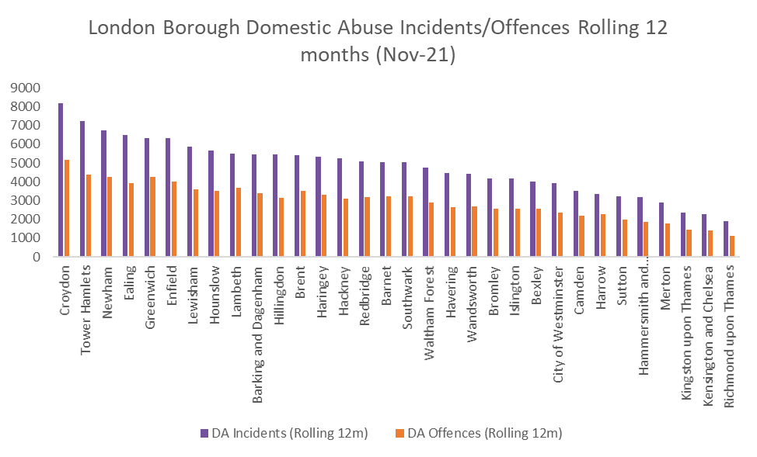
Demand / Local Picture Domestic Abuse Crime (2021-2022)
Source: MOPAC DA Dashboard
The Metropolitan Police
In 2023 -2024, 6773 domestic abuse incidents were reported to The Police. Third highest in London.
4073 of these reports were classified as offences.
36% of those who reported were male.
12% of all survivors who reported domestic abuse are repeat victims

Slide 4
Demand / Local Picture (2023-2024)
CYPS Multi-Agency Safeguarding Hub (MASH)​
1205 referrals received ( which is 50% of total amount) had domestic abuse recorded in assessment​
25% of all referrals have domestic abuse recorded as the primary referral reason ​
62% of children subject to a children protection plan have domestic abuse as a risk factor​
30% of cases open are due to domestic abuse​
20% of families who have no recourse to public funds (NRPF) have experienced domestic abuse ​
Multi-Agency Risk Assessment Conference (MARAC)
497 cases heard in 12 months
92% female survivors and 8% male survivors
14% repeat cases (further domestic abuse reported within 12 months)
Domestic Homicide Reviews
Between 2011- 2021 Newham has completed 9 Domestic Homicide Reviews (DHR) in response to the murders of 9 people
Between 2021- 2024 we have 9 further reviews open in response to the murder of 8 people
MARAC​
Indicators​ | Q1 | Q2 | Q£
Number of referrals received | 148 | 122 | 174
Number of Repeat referrals received with the same perp (within the last 12 months) | 21 | 12 | 9
Percentage of referrals which are repeat cases | 14% | 10% | 5%
Declined referrals | 74 | 53 | 60
Gender of victims​ | 14 women​
 | 2 men​
Gender of perpetrators​ | 15 men​
 | 1 woman​
Relationships between the V/S and AP​ | 10 intimate partner​
 | 2 death by suicide​
 | 4 murdered by a family member ​
Multiple disadvantage​ | 3 victims are women who sold sex/were sexually exploited​
Age​ | 4 victims are age 67+​
Housing Services
190 approaches (increase of 42% from previous year) where DA is a factor

Slide 5
Commissioned Services - Community Domestic Abuse Support Services
The community domestic abuse and sexual violence service is provided by Hestia and provides:
Low to medium risk casework support
IDSVA Services (providing support to survivors experiencing high risk)
Female Genital Mutilation (FGM) support and prevention;
Specialist services to support women who sell sex and/or experience sexual exploitation
Specialist Domestic Abuse Court Co-ordination
Coordination of MARAC
A 24 hour domestic abuse telephone helpline (open to survivors and professionals)
The service is co-located across the borough with IDSVA support in CYPS MASH Team, Housing services, children’s centres and Newham hospital
Current services commenced on 1 June 2019 for 2 years +1+1 and ends in December 2023.
The contract cost is £545,000 per annum
Service Aims:
Providing inclusive domestic abuse advocacy to all genders age 16+
Addressing high risk and preventing repeat victimisation through MARAC processes
Supporting survivors through criminal justice processes
Increasing domestic abuse awareness and access to services through increased co-locations where survivors will present- CYPS, Newham hospital, Housing services and children’s centres
Facilitating domestic abuse training to all services
Providing specialist FGM education, awareness and casework to professionals and survivors
2023-24 Service Demand
Data | Numbers
Number of referrals received | 1359
Number of adults supported | 815
Number of children supported | 886
Gender | Female: 786 Male 27 Refused to say/ NK 2
Sexual Orientation of survivors | 789 heterosexual 10 LGBTQ 15 NK/ prefer not to say
Number of survivors with a disability | 51
Number of survivors supported with NRPF | 74
Age Range | No.
NK | 0
15-19 | 13
20-29 | 235
30-39 | 320
40-49 | 177
50-59 | 44
60-69 | 17
70-79 | 9
80-89 | 3
90-94 | 0
Asian / Asian British
Bangladeshi | 158
Pakistani | 65
Indian | 63
Other Asian | 62
South East Asian | 6
Black African / Caribbean / Black British
African | 89
Caribbean | 29
Other Black | 48
Other Groups
White British | 100
Arab | 13
Mixed heritage | 28
Travelling community | 3
Other | 13
Prefer not to say/not known | 5

Slide 6
Commissioned Services – Specialist Refuge Accommodation
The service was recommissioned in 2021 with the new contract awarded to London Black Women's Project which commenced on 1 April 2022. LBWP were also the incumbent provider prior to April 2022.
The new contract is for 5 years with the option to extend for a further two years.
Total contract cost is £198, 000 per year
The service provides 25 bed spaces to women at risk of homicide and provides 10 bed spaces for children. The service is a specialist refuge accommodation for women of Black and South Asian heritage and includes support to families with NRPF.
Residents are able to access additional services including legal advice, mental health advocacy, therapeutic services for adults and children and education and employment opportunities
Service Aims:
Providing emergency accommodation to women and children at risk of homicide
Offering specialist support to meet the needs of minoritised communities including addressing language, communication, cultural and faith needs
Completing safety planning and managing risk for all refuge residents and children
Enabling women and children experiencing multiple disadvantage to access specific support including legal advice and representation, therapeutic services including counselling and one to one play/dram therapy for children
Accessing safe move on accommodation for women/families
2022-23 Service Demand
Data | Numbers
Numbers supported | 29 women and 10 children
Number of women with multiple needs | 19
NRPF | 8
Disability | 6
Sexual Orientation | 29 heterosexual
Age 16-18 19-21 22-30 31-40 41-50 51-60 60+ | 0 2 11 13 2 0
Numbers accessing move on accommodation | 4
Cultural Identify
Bangladeshi | 0
Caribbean | 0
African | 14
Indian | 0
Pakistani | 8
Other Asian | 3
White/African mixed | 0
White/Caribbean mixed | 0
Other ethnicity | 5
Other Black | 0
Other African | 0
Any other Caribbean | 0

Slide 7
Our Work Addressing Domestic Abuse
In the last 12 months the partnership has embarked on addressing domestic abuse in the following areas:
The Newham Domestic Abuse Strategy 2022-2025 Development of a new partnership strategy presenting our ‘whole community’ approach to addressing domestic abuse
The strategy and action plan have been directly informed through extensive consultation with domestic abuse organisations, the voices of domestic abuse survivors, residents and Newham service users
There are 12 key priorities identified including addressing perpetrators behaviour and developing an extensive domestic abuse campaign across the borough
https://www.newham.gov.uk/downloads/file/5313/newham-domestic-abuse-strategy-2022-2025-final
Women’s Safety
Engaging with women to identify their safety concerns and priorities
Working with businesses to develop messaging about women's safety
Engagement to identify area hotspots where women say they feel unsafe
Developing targeted responses to improving safety for women.
CYPS domestic abuse working group
Increasing focus on developing domestic abuse responses for children
Developing the ‘Safe and Together’ model and implementing this
Development of MARAC responses
Consideration of risk assessment tools

Slide 8
Our Work Addressing Domestic Abuse
Drive model ( addressing the behaviour of domestic abuse perpetrators)
Working in partnership with Victim Support to establish a perpetrator panel
Includes training for social workers and all frontline staff/managers
Identified practice lead from ‘Respect’ to support case work and learning
Review of the Newham model and outcomes to be completed by Bristol university
The MEAM approach
Offering support to women who sell sex and are sexually exploited
Partnership response to supporting women with multiple needs
Creation of a women's hub open twice a week at the CGL premises offering safe spaces to women and support services
Developing responses to addressing buyers of sex
Development of a ‘sex work high risk monthly panel’ to address risk and safety for women who are experiencing significant harm.
The Domestic Abuse Re-commissoning
Current best practice will continue including 24 hour helpline, and universal service
Addition investment of 10% of budget in local community organisations
Risk associated with Domestic Abuse is well managed through the co-located model, MARAC and the sex worker risk management panel. The service does not operate waiting lists or close referrals.
Service commissioned to run until 2029

Slide 9
Direction of Travel / Commissioning Intentions
Joint working with ‘Safe Lives’ implement the review of survivor experience in the borough
CSP DA sub-group to lead on the development of the domestic abuse strategy and action plan. The strategy will also be overseen by the Health and Wellbeing Board
Established a domestic abuse advisory panel for survivors, residents and users of services in Newham to advise and support the CSP DA subgroup, building on the excellent co-production that took place as part of the strategy development
Promotion of the Domestic abuse strategy and aligned domestic abuse publicity campaign – both internally and externally.
Established the perpetrator programme model for Newham and review outcomes
Promote the three women’s hub for women exploited into selling sex
Implement the newly commissioned community domestic abuse service
Implement the co-produced sex work strategy for the borough.
Review the outcomes of the social value investment

Slide 10
Gaps / Opportunities
‘safe spaces’ for sex workers to access support for domestic abuse, substance misuse, and holistic needs
Wider culturally competent service provision in the community through investment in ‘by and for’ organisation, and community and religious groups
Perpetrator programme outcome review
Campaigning and awareness raising in the community
Training to prevent suicide by promoting DA training for frontline health workers
Review of Domestic Abuse Related Deaths in partnership

Slide 11
Achievments/Priorities
What we have successfully delivered in 24/25
Implementation of two impactful perpetrator programmes (CIFA and Drive)
Recommissioning of DA Community Services
Development of Sex Work Strategy with a public health approach
Safe Lives partnership review of the whole DA system to be concluded February ‘25
Implemented counselling and family services at Refuge
Implemented a weekly MARAC in partnership with Met Police
Review strategic oversight with implementation of DA partnership board
What we plan to deliver in 25/26
Fully co-produced partnership review of LBN’s DA Strategy Vision and Priorities
Launch Sex Work Strategy with community engagement including people with lived experience
Development a LBN staff HR Domestic Abuse Policy
Implement and launch new community DA service

