Slide 1
Market Position Statement Carers Support Service UPDATED January 2025

Slide 2
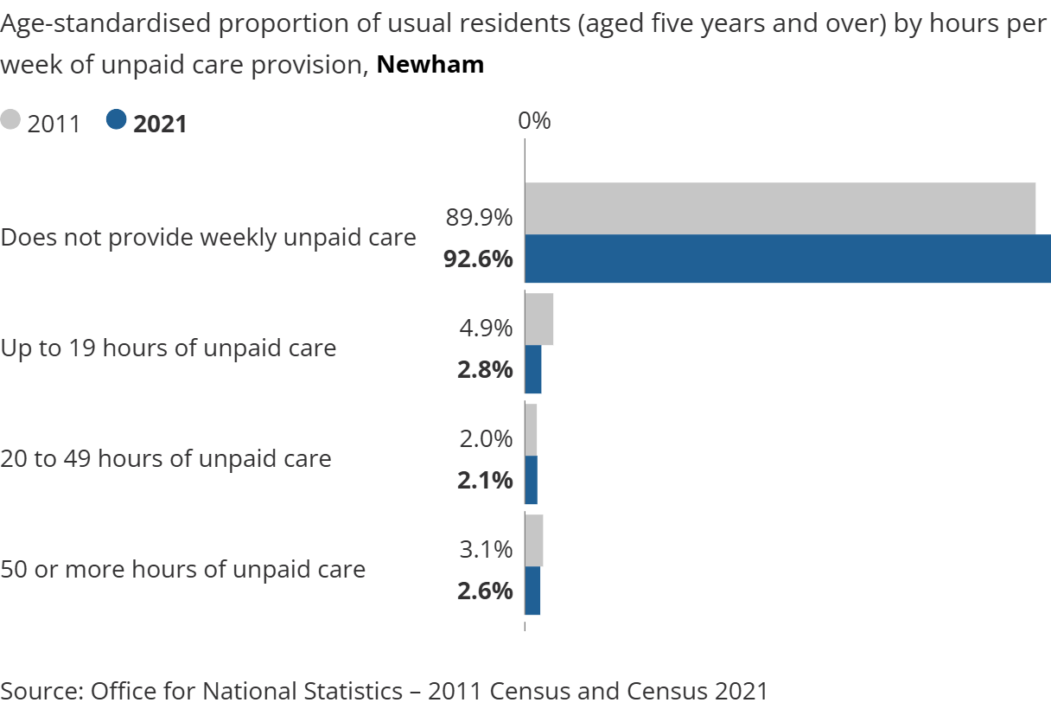
Overview
A Carer is defined as ‘anyone who spends time looking after or helping a family member, friend or neighbour who, because of their health and care needs, would find it difficult to cope without this help regardless of age or whether they identify as a Carer’.
Caring can come about unexpectedly or can develop gradually over time; and whilst it can be rewarding, it can also be challenging: and many Carers often put their own lives on hold to provide care and support to someone close to them - impacting on their own health and wellbeing, relationships, employment opportunities, finances and social and leisure activities.
The 2021 Census advises that 7.5% of Newham’s population is a Carer. Whilst the Census provides valuable data, it is widely recognised, nationally and locally, that it is likely to underreport the number of Carers due to not all Carers relating to or accepting the term ‘Carer’. Many Carers view their caring responsibilities as part of another role, such as that of a parent, partner, child, relative or friend; and in many ways, the pandemic cemented this view.
The virus disproportionately affected older people, those with disabilities and / or long term health conditions - resulting in both the numbers of Carers - and the level of caring provided - increasing. Carers UK advise that 70% of Carers now provide an average of ten extra hours of care and support a week.

Slide 3
Demand
The Council has a duty to assess the needs of any resident or Carer who appears to have needs for care and support and then to determine whether those needs are eligible for support or services from the Council, as stipulated in The Care Act (2014) and The Children and Families Act (2014).
Council support for Carers in Newham currently comprises three elements:
statutory Carers Assessments;
provision of low level emotional and practical support, via a commissioned Carers Support Service;
Carers Peer Support Groups.
 | Number of Carers Supported
 | 2023/24 | 2024/25 (as of the 31.12.2024)
Adult Carers Assessments | 261 | 303
Parent and Young Carers Assessments | 1 | 4
Carers Support Service | 395 | 1,090
Notes:
Cabinet – Newham Council
See also deputy Cabinet Ministers of importance including Cllr Dasgupta Deputy Cabinet Minister for Equalities and Social Justice

Slide 4
Supply
There is a number of organisations across the country who support Carers, although they tend to specialize in either Adult Carers or Parent and Young Carers.
The current Carers Support Service, is delivered by a consortium of three Newham-based organisations: Age UK East London, SubCo Trust and The Renewal Programme - and is in place until the 01.06.2026, with the option to extend for a further two years until the 01.06.2028.

Slide 5
Commissioning Priority 1: Hospital Discharge
In 2023, the DHSC Accelerating Reform Fund enabled Local Authorities within a given Integrated Care System area to collectively bid for funding to deliver innovation projects at a sub-regional level against 12 priority areas.
North East London successfully secured funding for a Carers and Hospital Discharge project (focusing on Priority 8: services that reach out to, and involve, unpaid Carers through the discharge process, Priority 11: ways to better identify unpaid Carers in local areas; and Priority 12: encourage people to recognise themselves as Carers and promote access to Carer services).
The project aims to improve and standardise the way Carers are identified and supported within, and beyond acute Hospital settings. It will also pilot how Care Technology can be used to support Carers to deliver and maintain their role. Eight new Carers Support Workers (CSW) will be employed on a 12mth fixed-term contract via the existing commissioned Carers Support Services across North East London. The CSW will be based in the local Hospitals and will have an active presence on the wards – identifying and supporting Carers and ensuring that they are engaged throughout the discharge process. CSW will also operate as a Team across all eight boroughs – coming together regularly to share learning and review impact.
The project will run for 12mths, starting in February 2025; and will be
independently evaluated by Care City an independent research organisation - to
assess impact and evidence 'what works' to help facilitate sustainable change
at a sub-regional level.

Slide 6
Commissioning Priority 2: Peer Support
In 2022, the Council piloted a Newham Carers Small Grants Programme, enabling Newham residents to develop or continue running local peer support groups and access the wellbeing activities that they want and need. Successful applicants receive one off funding of up to £1,000 per group, per year.
The funding can be used flexibly to achieve two key outcomes for Carers:
to support existing groups to continue meeting and grow their membership and / or support new groups to start up;
enable groups to run activities and events that will increase the wellbeing of Carers.
So far 17 grants have been awarded covering a range of activities, from day trips and group lunches, to bespoke support for bereaved Carers, and a new resident led group for Carers of autistic people.
The 2024/25 round will be opened in March 2025 and the 2025/26 round in October 2025.
The Council is interested in filling the gap of groups for Young Carers, Young Adult Carers (18 - 30) and Carers supporting people with Dementia.

Slide 7
Commissioning Priority 3: Digital Support
In September 2021, Cabinet agreed plans to commission a two-lot Carers Support Service. The first lot was an online / virtual Carers Support Service with an annual contract value of £50,000, and a target of supporting 20,000 local Carers across a range of demographic groups by the end of contract year 2. The service was to deliver a combination of online support (via interactive information and guidance, online chat groups and forums) and targeted / goal focused 1:1 over the phone support.​
​
The decision was taken not to award a contract under this lot following the tender evaluation the following January.
The Council is still keen to develop a bespoke digital offer for Carers that aligns with its Well Newham platform over the next 12 months.

