Slide 1
Market Position Statement
Older Adults (65+) Care Homes
UPDATED December 2024

Slide 2
Overview
The Council aims to support its Adult Social Care residents to remain independent in their home, for as long as possible. However, Care Home provision is key for those who can no longer live safely in their own home.​
There are five Older Adults Care Homes in Newham, with a total of 323 ‘open’ beds​.
Available in-borough capacity has reduced significantly (by 212 beds) over the last three years due to two Homes closing, and two standing down entire wings / floors during Covid and not re-opening them.​
The lack of capacity is likely to worsen in coming years due to projected increases in demand from the growing and ageing population.​
The Council’s success in delaying Care Home admission via the use of Domiciliary Care and other community-based services means that new residents are more likely to present with greater frailty, Dementia and / or additional Nursing needs and so therefore require more complex support.

Slide 3
Overview
The proportion of placements requiring Dementia care has increased over the last ten years from just under a third, to 54% in 2023/24. The Council has found it increasingly difficult to source Dementia placements with 57% purchased out of the borough.​
Similarly, placements for older residents with a Learning Disability or Mental Health need are also becoming more difficult to source, particularly when combined with frailty with 56% sourced out of Newham in 2023/24.​
The Council has published rates for in-borough Care Home placements which are reviewed annually. ​
The Council currently commissions placements on a spot purchase basis - first referring to Homes in-borough who are rated ‘Good’ by CQC and who accept its published rates. Quality is variable in the borough, with three Homes currently rated ‘Good’ by CQC and the other two rated ‘Requires Improvement’.

Slide 4
Commissioned Activity
As of May 2024, the Council has 390 residents aged 65+ who have been placed in a Residential (223) or Nursing Home (167). Of these, around half are located outside of Newham.​
Around 60% of those residing out of borough are a result of resident / family choice, with the remaining 40% placed out-of-borough due to lack of in-borough capacity (i.e. an actual bed, or the Homes advising they are unable to meet the residents’ need).
The demographics of the residents are as follows:
Gender​ | Number​
Female​ | 214​
Male​ | 176
Age​ | Number​
65-69​ | 54
70-79​ | 104
80+​ | 232

Slide 5
Equity & Protected Characteristics
Ethnicity​ | Number​ | % Placements​ | % Newham Population​
White British​ | 202 | 52 | 17​
White Other​ | 28 | 7 | 12​
Asian Indian​ | 21 | 5 | 14​
Asian Pakistani​ | 4 | 1 | 10​
Asian Bangladeshi​ | 2 | <1 | 12​
Asian Other​ | 16 | 4 | 8​
Black African​ | 11 | 3 | 12​
Black Caribbean​ | 64 | 16 | 5​
Black Other​ | 28 | 7 | 2​
Mixed Heritage​ | 1​ | <1 | 1​
Other​ | 13 | 3 | 3​
White British and Black Caribbean residents are over-represented. All other ethnic groups are under-represented.

Slide 6
Equity & Protected Characteristics
Religion​ | Number​
Christian​ | 251
Hinduism​ | 12
Islam | 11
Sikhism​ | 7
Judaism​ | 2
Other​ religion | 19
No religion​ | 16
Refused​ | 8
Unknown / Not yet asked​ | 64
Sexual Orientation​ | Number ​
Hetrosexual / Straight​ | 324
Gay or Lesbian​ | 2
Bisexual​ | 0​
Refused​ | 2
Unknown / Not yet asked​ | 62
Data is currently available on the protected characteristics shown in this market position statement.​
During 2023/24, work commenced to: collect information for residents who are recorded as 'Unknown'; and to enable collection of all other protected characteristics. As of May 2024, data has been refreshed for around 30% of residents with all residents to be completed during 2024/25.

Slide 7
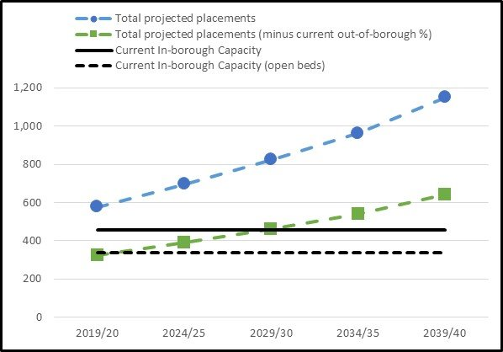
Commissioning Priority 1:
Increase in-borough capacity
Based on projected demographic growth and current placement trends, it is anticipated the Council will require significantly more beds in the next 10-15 years.​
​
We would like to work in partnership with local Providers to:​
​
Open vacant floors and units by giving certainty and assurance via new procurement arrangements and assisting with quality and workforce issues​
Review our published rates so that we pay the most sustainable market price that we can​
Develop capacity in the areas that meet our resident needs and increasing demand

Slide 8
Commissioning Priority 2:
Workforce
Dementia - the Council would like to work with in-borough Homes to grow and embed tailored high-quality Dementia Care, including specialist training for staff (e.g. ‘Dementia Champions’ etc.) so it can place more residents with Dementia within Newham. ​
​
Complex Learning Disability and Mental Health Needs – the Council would like work with in-borough Homes to develop, deliver and embed specialist training for staff to provide outstanding care for residents aged 65+ with more complex needs (e.g. Forensic Mental Health, Profound and Multiple Learning Disabilities - in combination with frailty / Dementia), so it can place more residents with these needs within Newham. ​
​
Other - the Council would like its in-borough Care Home workforce to have a clear career path so they stay in the sector. It would like the workforce to be paid London Living Wage – bringing them on par with in-borough Domiciliary Care. It would also like to conduct a Training Needs Analysis and develop a Workforce Strategy with Providers to ensure a co-ordinated approach and ensure any funding opportunities have maximum impact.

Slide 9
Commissioning Priority 3:
Develop Areas of Provision
Step Down - there is no dedicated step-down or intensive rehabilitation provision in Newham, leading to Delayed Transfers of Care and step-down patients often not being supported to ‘move on' to community-based accommodation or home - leading to their intended short-term placements becoming long-term.​
​
Respite Breaks for Carers - there is no dedicated respite break provision. Providers advise they require a minimum two-week placement, but these can usually only be booked a week in advance due to Providers not wanting to commit beds in advance for respite in case they are subsequently offered a long-term placement. In addition, they feel temporary residents coming in and out of the Home can be disruptive and distressing for permanent residents; and does not allow them to understand the needs of the cared for individual. ​
​
Accessibility of provision - placements for Older Adults with a Learning Disability or Mental Health need within 65+ Care Homes can be hard to source locally and this is a current gap in the market. By working with Providers to develop specialist provision in mainstream settings we can avoid these residents ending up in placements outside of the borough.

Slide 10
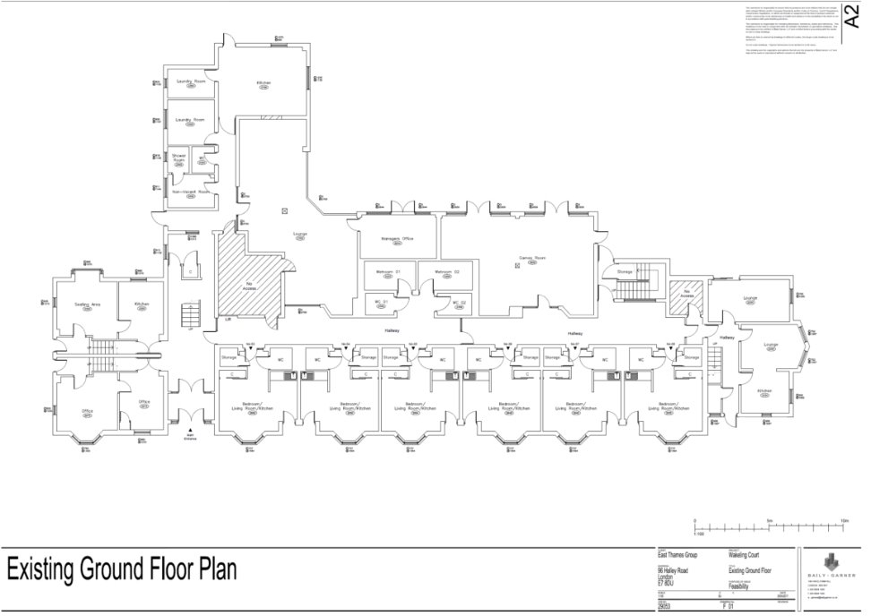
Commissioning Priority 4:
Build, Acquire and Transform
The Council has decided to invest in building, acquiring and transforming existing buildings into high-quality supported accommodation for our vulnerable residents. We want to design spaces which can redefine quality of provision, innovation in approaches and excellence for those we serve. We will be engaging with the local market to test our proposed delivery models and will be inviting tenders for each site as they become available.​
​
The first scheme is likely to be a 24-bed scheme in Forest Gate, for residents with Dementia with a separate wing for Intermediate Care to step down those who have been discharged from hospital but require reablement and rehabilitation before returning
​
The Council will use specialist designers to propose innovative solutions and best use of the space available.

Slide 11
Achievements and Priorities
What we have achieved in the last 12 months (Jan-Dec 2024):
After consulting with Care Homes and a pilot, we implemented a new Quality Assurance Framework focused on prevention via early identification of quality issues. This has reduced the frequency of monitoring visits where good quality provision is evident, and the data submission burden on Homes.
Building on the Fair Cost of Care survey, we have worked with local Providers to understand their costs in more detail and re-modelled our Care Home fee structure to better reflect these
Development of alternative delivery models for those with residential needs in partnership with Providers (such as Assisted Living for Older Adults) including market testing in preparation for procurement
We have started acquiring and transforming vacant properties in the borough to use to deliver these alternative models of care – this is our ‘Newham Living’ initiative
What we plan to deliver/achieve in the next 12 months:
Run mini competitions for our DPV (Cat. 6) for Care Homes and other relevant care and support providers to deliver alternative models of care
Further develop our Newham Living model and open our first scheme
Complete our Newham Care Homes Survey (in which all residents were invited to participate) and share the results with Providers to facilitate learning, and to understand user feedback and trends which will inform future commissioning intentions

