Slide 1
Market Position Statement
Adult and Young Person
Substance Misuse Services
Dec 2024

Slide 2
Demand / Local Picture – Young People (11 – 24)
Main drugs:
  96% Cannabis
  17% alcohol
Emerging issues around vaping and the use of THC/Spice vapes in schools, as well as reports of edibles. Currently working with public health and schools to deliver a package of support to role out to schools, pupils and parents
Partnership with MOPAC to deliver 16-25 substance misuse support via youth to adulthood probation services
Increased resource in the YP service to deliver more prevention and education works across schools
Our targets over the next 12 months are to increase referrals and numbers in structured treatment, as well increase the number of Young People competing treatment successful.

Slide 3
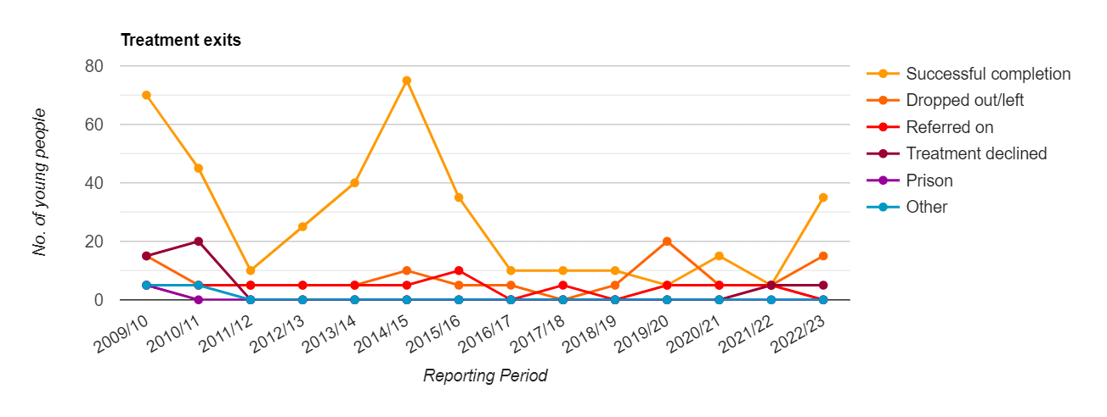
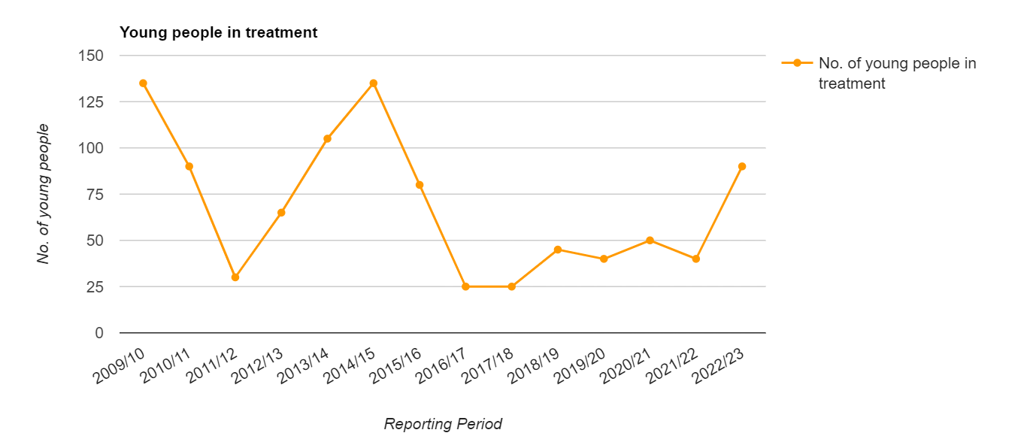
Local Picture – Young People (11 – 24)

Slide 4
Local needs assessment
The majority of those in treatment are primarily opiate use
The majority of those in treatment are of white ethnicity, which is not representative of our residents
Synthetic estimates show high unmet need amongst alcohol users.
Consultation with service users shows that many experience barriers to accessing treatment
10% of those in treatment are in contact with the criminal justice system
Full needs assessment is published in 2023

Slide 5
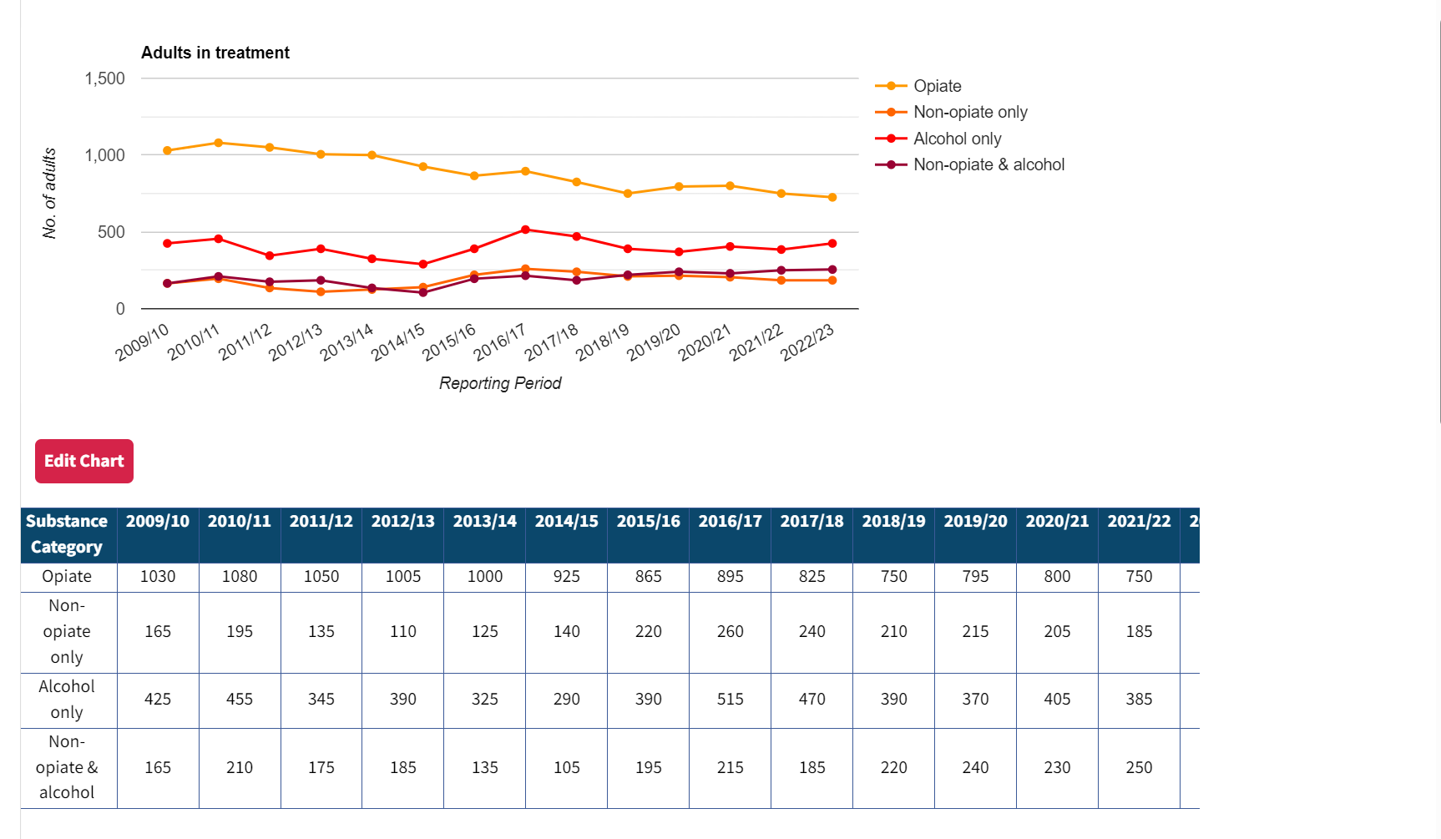
Demand / Local Picture – Adult

Slide 6
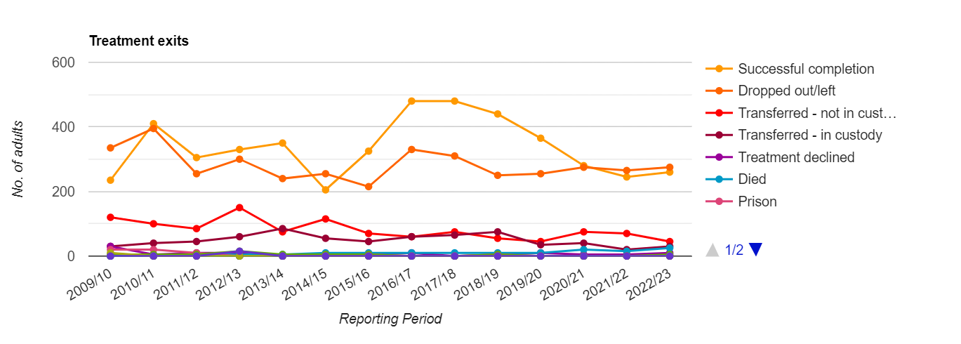
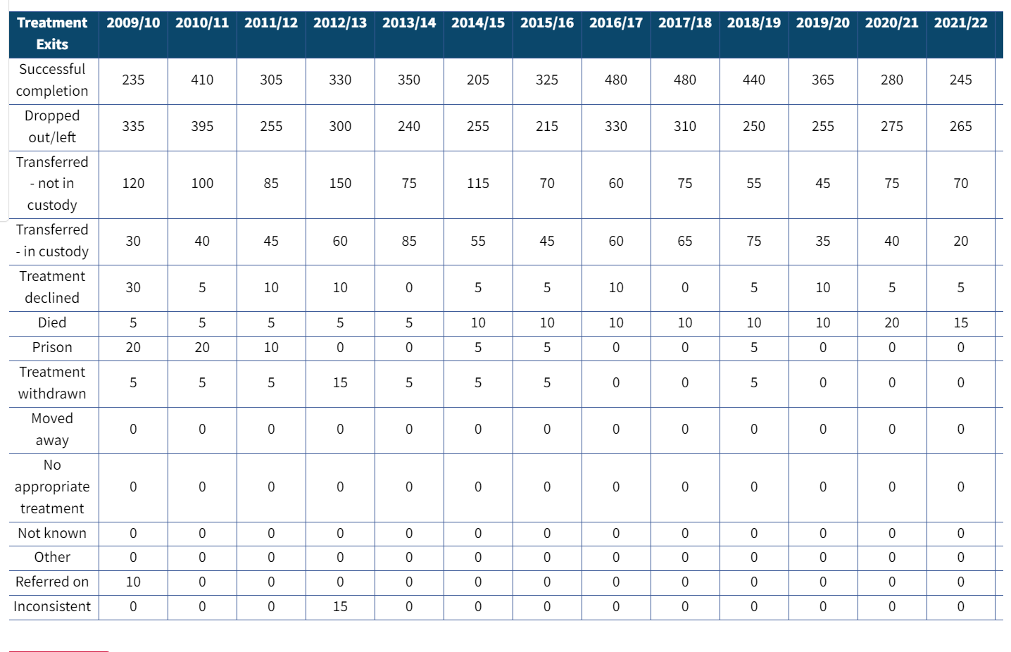
Successful completions

Slide 7
Commissioned Service Overview
Core Public Health Funding
In July 2019, Newham commissioned an all-aged integrated substance misuse service, which is provided by Change, Grow, Live (CGL). The annual contract value is £3.1m pa over five years
The services are provided over three hub across the borough – Canning Town, Stratford and Manor Park, with young people services delivered in the community and in schools
We also provide a small shared care service via the Newham Health Collaborative across five GP sites in Newham
We spend on average £250k pa on residential rehabilitation and in-patient detoxification
Total annual spend (including needle exchange and supervised consumption) prior to additional investment was £3.6m per annum
Additional investment
An additional £1,325,422 was received between April 2023 and March 2024 to increase service capacity, and improve outcomes for those in the criminal justice system
An additional £748,664 was received between April 2023 and March 2024 to increase service capacity, and improve outcomes for people rough sleeping or at risk of rough sleeping. Using this funding, we provide an enhanced holistic wrap substance misuse service for rough sleepers with multiple disadvantages and have invested in more education, treatment and prevention to help rebuild the wider Newham treatment system
The three-year funding agreement via the government’s 10 year drug strategy will provide (amongst additional targeted investments) several additional front-line workers, significantly reducing caseloads and increase our numbers in treatment.

Slide 8
Commissioned Service 24-29
We have committed to deliver against key ambitions and outcomes, including but not limited to:
Increasing the number of residents accessing treatment and support
Improving the offer to residents not currently accessing the service, e.g. Asian residents, women and LGBTQI+ residents.
Further developing the offer to children and young people, including addressing issues around vaping etc.
Increasing working arrangements with health services, including East London Foundation Trust (ELFT) and Newham University Hospital
Expanding the offer to families of substance users, offering them support in their own right. This includes children and young people impacted by parental substance use.
Diversifying the satellite and outreach offer, including outreach to rough sleepers, sex workers and others

Slide 9
Commissioning Priority 1: Implement new service provision
Our current contract with Change, Grow, Live ends in June 2024.
We have recommissioned CGL for five years ending in 2029 (with an option of two further years)
This was informed by our comprehensive needs assessment and our plans for further service development with Year 3 of the supplementary substance misuse grant.
It was designed and assessed through co-production with residents and experts by experience.

Slide 10
Commissioning Priority 2:
Commissioning a culturally competent substance misuse service
Our recently completed Needs Assessment clearly shows us that we are not providing substance misuse services which meet the needs of all our residents.
Key to our future delivery is the development of culturally informed and competent services which reduce the current barriers to accessing treatment experienced by our diverse residents.
As part of the procurement of the substance misuse service we will be co-produced residents and community groups on to develop and sustain these services.
We will be implementing the new service with a renewed focus of social value and working with ‘by and for’ organisations.

Slide 11
Commissioning Priority 3: Develop alcohol prevention and treatment provision
Our needs assessment data tells us that we have some significant alcohol issues where residents are experiencing extremely poor health outcomes as a result of their drinking
We also know that, nationally, there are patterns of increased drinking as a result of the pandemic and lockdowns and due to the cost of living crisis.
A key issue will be delivering our new alcohol brief advice and support to residents before their drinking becomes harmful to their health and wellbeing.
We also need to increase our culturally competent alcohol support and treatment to work with residents who are experiencing significant harm as a result of their drinking.
We are working to deliver greater access to detox and rehab to ensure the best outcomes for harmful drinkers

Slide 12
Achievements/Priorities
What we have successfully delivered in 24/25
Recommissioning of Substance Misuse Services
Implemented grant funding to improve access to services for those rough sleeping or at risk of rough sleeping
Increased capacity in services with projected 20% increase in those accessing treatment through 24/25
Implemented specialist employment support for those in recovery
Implemented Project Adder in partnership with Met Police
Commissioned specific social work support to support those with drug/alcohol issues
New Complex Needs Panel to implement joint approach for service users with significant risks
What we plan to deliver in 25/26
Review access to Tier 4 (Detox and Rehab) to increase access and address barriers
Implement and launch new community SM service
Review new funding requirements from OHID and deliver 25/26 commissioning plans

