Slide 1
Market Position Statement SVSHA May 2024

Slide 2
Overview
What are Supporting Vulnerable Single Homeless Adults (SVSHA) Services?
SVSHA – commissioned services offer accommodation-based support to Newham residents over the age 18 who are homeless, at risk of homelessness or was previously rough sleeping.
Commissioned services currently offer onsite support for residents who are assessed with varying level of needs which may include vulnerabilities due to mental health, substance misuse, ex offender, physical or other health related needs that require additional support to develop independent living skills needed to move onto tenancies in either PRS or social housing and these tenancies are sustained longer term.
Accommodation can be shared between several people and have communal space or consist of separate units of self-contained accommodation – with or without communal space – but which may be in shared buildings such as a block of flats and/or on shared grounds.
The Council currently commissions a range of accommodation-based support for residents based on their care and support need. These can be broadly split into four areas:
Care Act eligible. These service include Supported Living, Extra Care, Shared Lives and Residential Care and are funded through the placements budget.
Rough Sleepers. The service is funded through Adults and Health core funding and Department for Levelling Up, Housing & Communities (DLUHC) RSI funding.
Priority need Section 189 of Housing Act 1996, as extended by statutory instrument sets out who has a priority need when making a homeless application. Housing application are assessed, with the Council accepting that a statutory housing duty is owed, if a single homeless application is deemed to be of priority need, their need level is usually high due to vulnerabilities due to physical or mental health needs, old age or other special reason.
Non-priority need. Council have assessed they do not owe a statutory housing duty. This doesn’t mean that a non-priority decision means that there are no needs, just not enough evidence to demonstrate vulnerability to meet the threshold to be accepted as priority need.
SVSHA services in the main fall into category 4 non-priority need groups but still have vulnerabilities and would benefit from accommodation-based support to build independent living skills and tenancy sustainment to secure and maintain longer term accommodation. The key elements in delivering successful outcomes in this area is contingent on delivery of independent living skills and suitable move on accommodation.

Slide 3
Overview
SVSHA services are currently provided by 4 providers across varying sites, all based in borough.
A breakdown of the services has been provided below:
Complex beds above are predominantly for the rough sleeper pathway but fall within the SVSHA pathway due to method of funding via the Rough Sleeping Initiative (RSI)
The Out of Hospital service is part funded by the Integrated Care Board (ICB) with LBN topping up for night cover.
All of these services have residents in receipt of Housing Benefit and Newham are able to re-invest this into additional and wraparound services.
Contract/Area | Provider | Bedspaces | Annual Cost
Complex | Your Place | 15 | £ 172,484.00
Core | Your Place | 55 | £ 365,069.62
Young Adults | Renewal Programme | 10 | £ 30,321.20
Adults | Renewal Programme | 30 | £ 129,553.84
Young Adults LGBT offer | Stonewall | 6 | £ 19,060.04
Out of Hospital Stepdown | SHP | 5 | £ 239,788.64
 |  | Total | £ 956,277.34

Slide 4
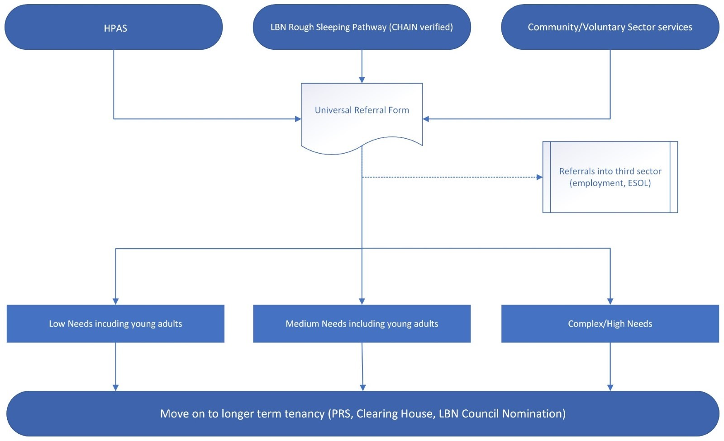
Demand
We are currently seeing unprecedented demand on our SVSHA services due to the numbers that currently occupy temporary accommodation. We are currently engaged in a project to procure a housing related support service at a 120 bedded unit in Stratford to assist in managing demand – this service is due to go live in January 2025.
Temporary accommodation is often high nightly cost comparatively with the LBN SVSHA pathway, with no support in place for service users. LBN are currently exploring floating support in order to provide support for this cohort and to divert demand on accommodation-based services in the pathway.
We are experiencing issues in demand for move on accommodation. Access to PRS properties is becoming more difficult to navigate since the cost of living crisis and LBN operate Article 4 restrictions under the LPA to avoid illegal HMO’s. We are currently reviewing our policy position in relation to exemption due to homelessness for Article 4 restriction.
SVSHA pathway

Slide 5
Equity / Protected Characteristics
Have asked for data on this

Slide 6
Commissioning Priority 1: Re-commissioning through DPV
Newham are currently working on the admission phase of Category 2: Supporting Vulnerable Single Homeless Adults under the LBN Dynamic Purchasing Vehicle. Following the admissions phase, the mini-competitions phase (phase 2) will be completed. Documents for this are currently in the process of being drafted – reflecting updated KPI’s and
Providers already delivering contracts within this category have recently been extended via waiver and the next stage of the process is to admit these providers onto the framework in order to ‘call off’ (contract) with providers. New KPI’s and updated specifications will be drafted following internal intelligence gathering and feedback from the market.
By completing this work, we hope to remain compliant in procurement and continue to develop services that deliver upon Newham’s Homelessness and Rough Sleeping Strategy – as well as delivering tangible outcomes for Newham’s residents. Utilising the DPV allows us to open up admissions for new providers, stimulating growth in the market, providing more versatility/flexibility of provision and improving capacity.

Slide 7
Commissioning Priority 2: Promote efficiency in the pathway
Newham are currently working to try and improve the efficiency of the pathway. Due to levels in temporary accommodation, we are experiencing unprecedented pressure on the pathway in delivering accommodation for service users who are not owed a duty under the Housing Act.
We are meeting regularly with providers to drive move on into long term accommodation including:
Moves into Private Rented Sector Accommodation via rent deposit scheme
Utilising nominations for social housing
Progressing relevant referrals to Clearing House properties
LBN have recently recruited a single pathways officer to drive move on and adequate person matching into accommodation. We are also able to utilise Discretionary Housing Payments to fund rent deposits into Private Rented Sector accommodation.

Slide 8
Commissioning Priority 3: Build extra capacity into the pathway
We are seeking to build extra capacity in the pathway to provide more options to cater for different need levels for those exiting temporary accommodation. Current residents in the pathway are showing higher levels of acuity and long lengths of stay.
There are currently Article 4 restrictions in place via Local Planning Authority policy which prevents operations of HMO’s without change of use (even with the relevant HMO license in place). This restriction does not allow us to quickly mobilise properties when they become available. HMO properties in Newham with relevant licensing are very difficult to obtain and as a result, we are missing out on properties becoming available.
We are currently in the process of trying to amend policy through exemption to mitigate this issue and work is ongoing.

Slide 9
Commissioning Priority 4: Commissioning Victoria Street
We are currently in the process of collating documents to procure a housing related support service based at Victoria Street in Stratford. Victoria Street is a 220 bedded unit comprising mixed accommodation (one-bedroom flats and bedsit style accommodation) with which we plan to utilise half of the units.
We have completed market engagement and have good feedback from the market in relation to the quality of the building.
This will allow Newham the opportunity to place residents who are owed a relief duty (either in priority or non-priority need) into accommodation that is less expensive than costly nightly lets with bespoke support in place to support residents. We will be implanting a programme of work to further support residents with practical skills and advice aimed at developing their independent living skills, strengthening their likelihood of sustaining an independent tenancy.

Slide 10
Commissioning Priority 5: Working in collaboration with providers to improve quality of provision
Following the increase in capacity in the team during 23/24, Newham have begun to have a more identifiable presence onsite at multiple projects. This has allowed the team to review services with greater scrutiny and identify opportunities to improve service provision.
One such review has already taken place where significant issues were presented and an action plan was developed by the provider to address concerns. The provider has been working well in addressing these concerns via a collaborative effort and will lead to good outcomes.
By reviewing in detail existing services we hope to address areas of concern, improve services and reassure senior leaders and politicians that the non-statutory services in place provide good outcomes and value for money.

Slide 11
SVSHA – Mid-Year Update
Commissioning Priority 1: Re-commissioning through the DPV
We have completed the admission phase of the exercise, admitting 15 providers onto the DPV. Commissioners are now working to launch mini competitions for homeless supported accommodation for contracts to begin in early April 2025.
Commissioning Priority 2: Promote efficiency in the pathway
Commissioners have set up additional meetings outside of quarterly contract visits to discuss efficiency and move on in the singles pathway. Commissioners have worked hard to reduce the length of stay from circa 13 weeks to 7 weeks in the hospital discharge service and continue to work alongside providers to promote move on within contracted timeframes, in a complex and difficult national landscape.
Commissioning Priority 3: Build extra capacity in the pathway
Due to lack of assets and limited funding there are some delays that commissioners are currently working through . Work to admit non-commissioned providers onto the DPV and take them through the commissioning process will allow us to build capacity over the next 12 to 18 months and further develop the market.
Commissioning Priority 4: Commissioning Victoria Street
Commissioners have completed multiple rounds of engagement on a 1:1 and group basis and have completed procurement documents ready for publication of the opportunity.
Commissioning Priority 5: Working with providers to improve quality of provision
Commissioners have now embedded a formal contract monitoring framework across the portfolio. Since the drafting of this MPS, LBN have embedded a robust contract monitoring framework including more frequency of onsite visits. Such onsite visits provide valuable intelligence and allow commissioners to speak directly with residents who are able to convey direct feedback.

