Slide 1
CASE STUDY
CO-PRODUCTION

Slide 2
Context
The former Co-Chair of the Learning Disability Resident Advisory Group expressed an interest in having more outdoor activities available where residents could socialise.
This was brought to the Learning Disability Resident Advisory Group, and the members were enthusiastic about this. The Assistant Director of Commissioning shared an opportunity with the Learning Disability Lead on an opportunity at East Ham Nature Reserve.
The East Ham Nature Reserve currently holds Educational and Family sessions. It would like to expand activities to include targeted sessions for adults with Learning Disabilities. In preparation for this, the Co-Chair of the Learning Disability Delivery Board (who is also a wheelchair user) did a site visit and tested out some of the nature paths within the reserve with the Commissioner. During this site visit, the Co-Chair became stuck in a loose, sandy part of the path and their wheelchair had to be physically lifted/pulled to firm ground.
The East Ham Nature Reserve is currently maintained by a combination of paid groundsmen from Newham Council and volunteers from the Green Gym. There are limited funds for works to the site.

Slide 3
Strengths-Based Approach
A proposal has been submitted to utilise Social Value contributions from the Council’s Housing Development partners.It is seeking support with materials and/or labour to create level, safe pathways that are accessible to all.
Access to part of the East Ham Nature Reserve is accessible and we are progressing with plans to start a drop in session for residents. Another group is being developed for autistic residents.

Slide 4
Outcomes and Impact
East Ham Nature reserve sits in the grounds of an 10th Century Church. The Church is the oldest in Newham, it was formally opened as a Nature Reserve in 1983, though still has a functioning church within the grounds. There are added benefits to connecting residents to the local history. While on the site visit the Co-Chair shared information about how long their family had been in Newham and their connections with the community.
While touring the site, we met the pastor of the Church. The commissioner shared details about the Wave Accessible Church Services that another community interest group is providing. They will be linking in with them to look at how to make their services more accessible.
The initiative will support people to engage in healthy activities wellbeing initiatives in the community, including physical activities for adults and children;
Initiatives will support older, disabled and vulnerable people to build stronger community networks;
This is concrete evidence for residents that we are listening to them in the Resident Advisory Group and trying to make changes to make Newham a better place for people with learning disabilities.

Slide 5
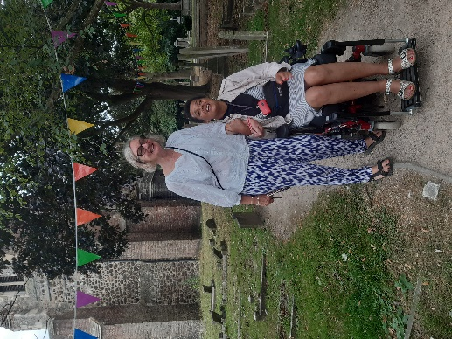
Lessons Learnt and Reflections
This highlighted the need for more site visits for wheelchair users to identify access issues.
The staff at the site were not aware of the inaccessibility of the paths and the risks of the natural paths.
There are many community opportunities and partnership work that could be done, but is limited by capacity.
Co-Chair with a member of staff from the East Ham Nature Reserve

