Slide 1
Market Position Statement
Adult Mental Health
April 2025

Slide 2
Overview
The Market Position Statement for Adult Mental Health sets out the London Borough of Newham's commissioning plans and intentions based on the needs of residents. You can use this document to find out how these plans are shaped by our corporate priorities and our commitments across the mental health partnership.
In the document we cover:
Demand and Need
Equity
Supply – existing services
Current commissioning
Future priorities
Within the context of our overarching adult social care priorities and our strategic policies we are seeking to reshape the provision of support for adults with long term mental ill health to remain living independently wherever possible with support from community mental health teams, enablement and floating support along with technology and wider community. Providing supported accommodation to those with the greatest support needs.

Slide 3
Demand and Need
In 2019, an estimated one in four Newham residents aged 16+ had a common mental illness (defined as any type of depression or anxiety), modelled using data from the Adult Psychiatric Morbidity Survey (APMS) and the demographics of the local population. This was the second highest in England, according to the OHID mental health and wellbeing JSNA (2019). While this was an estimate, and true prevalence might be different, it indicates the potential scale of mental health need in Newham’s adult population, and inequality between Newham and other places.
The recorded prevalence for depression in residents aged 18+ in 2022/23 showed Newham as the lowest (worst) borough at 7%, significantly lower than London average of 13%.
Levels of Newham residents with long-term mental health problems who are in work continues to remain just below the England average of 65.3% at 55.5% 2022/23. We could make an assumption that this is due to increasing good mental health in the population. Or more likely due to under-reporting of mental health difficulties within resident communities.
Newham accommodates 320 adults with mental health problems with supported accommodation schemes; approximately a third of placements are with providers outside of Newham (Azeus April 2025).
Mental health conditions tend to be under-reported and diagnosed amongst some ethnic groups potentially leading to under-reporting and diagnosis might be under- reported amongst Asian communities and amongst Asian females in particular. A recent research study by Blossom CIC interviewed 450 south Asian women 80% acknowledged that cultural background influenced perception of mental health and wellbeing (2023-24). Ankh Place have also undertaken a community engagement and leadership programme with young black men exploring the barriers t accessing mental health support. There is now an ongoing leadership coproduction project being lead by Ankh Place to develop solutions.
Public health profiles - OHID (phe.org.uk)

Slide 4
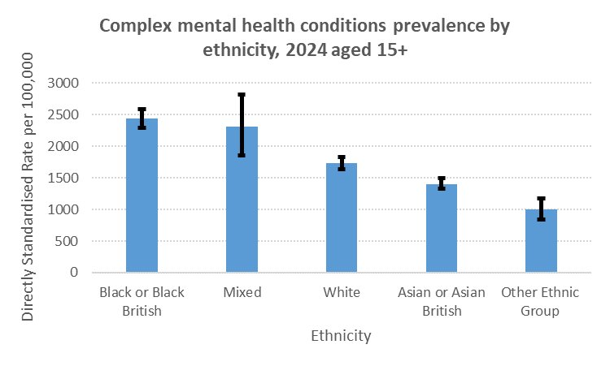
Equity
In 2024, among adults in Newham with a diagnosed common mental illness, over 60% were female, and rates increased with age up to 69 years. This aligned with patterns seen nationally, such as within the Mental health and wellbeing in England: Adult Psychiatric Morbidity Survey (2014). The gender gap may be linked to gender-related pressures which affect men and women in different ways, meaning that, for example, women are more likely to have a common mental illness (‘internalising disorders’), while men are more likely to experience addiction or drug or alcohol abuse (‘externalising disorders’), as published in the Gender Equality Index of 2021.
In the same period, prevalence of diagnosed common mental illness was highest among White British groups in Newham, and rates were significantly lower in all other ethnic groups. In contrast, a large national study found that levels of common mental illness were similar between ethnic groups after adjusting for demographic and socioeconomic factors, which suggests there may be significant under-diagnosis among some ethnic groups in Newham. The analysis also found that, compared to White British groups, all other ethnic groups were less likely to be receiving treatment for common mental illness, which supports the possibility that Black, Asian and other ethnic groups in Newham may be under-diagnosed and under-treated. This highlights that improving equity in access to, and outcomes from, mental health treatment and support should be a key priority in Newham.
In the same period, prevalence rates were significantly higher among Black ethnic groups compared to other groups (more detailed ethnic groups have been aggregated to broader ethnic groups due to small numbers), and rates of diagnosed psychosis (one type of complex mental illness) had the same pattern. These patterns are similar across the UK and have been for decades. One large national study found that Black males had higher rates of complex mental illness than males in other ethnic groups (rates in females were similar in all groups), while other studies have found that risk is highest in Black populations and also higher in Asian and other minoritised ethnic groups compared to White British groups. This inequality is thought to be due to complex factors including racially based social and economic disadvantage, experiences of racism and discrimination, and inequalities in access, quality and experiences of healthcare and other public services.
Source: CEG East London Database, courtesy of the Clinical Effectiveness Group at Queen Mary University of London
From Mental Health Strategy Needs Assessment 2025

Slide 5
Meeting the MH Needs Newham Priorities
10 year All Age Supported Living Strategy for Newham
Action plan themes
Protect the mental health and well-being of residents with high vulnerability and/or experiencing social isolation
Targeted support
50 Steps to a Healthier Newham 2024-27
Step 8 Promote mental wellbeing and prevent the
impact of poor mental health
Build connection and engagement to a wide range of support provided by clinical and non-clinical partners
Mental health supporting services & settings
Step 9 Make treatment and support services for people with mental illness more accessible
Provide accessible and culturally appropriate mental health and well-being support services
Step 10 Make Newham a place where
everyone can feel connected
Well-being and resilience in the community
Strengthen mental health and well-being support across the life course
Promote mental well-being and actively tackle stigma and discrimination
50-steps-2024-2027 (newham.gov.uk)

Slide 6
Mental Health Services in Newham
Community Mental Health Services (CMHS) in Newham are broadly divided into “Core” and “Specialist” Teams.
“Core” CMHS support the majority of people with Serious Mental Illness (SMI) in the Community. Functions range from Assessment, Brief Treatment to longer term care through Medical Outpatients or Care Programme Approach (CPA) – a specific framework of community care for those with the most complex needs. Core teams are often divided into “localities”, aligned to a certain GP Practices.
“Specialist” Teams support a sub-section of the population who have certain needs. This might be related to their diagnosis or clinical presentation (for example, Early intervention in Psychosis or Crisis Teams) or relate to their life stage (Perinatal Mental Health Team, Older Adults Team).
Mental Health Adult Social Care Access Team is the single point of access for all new referrals to Adult Mental Health Social Care.
Provide signposting, information and advice on local mental health services
Support access to services and resources in the community
Undertake an initial needs assessment of people with mental health issues and their carers to establish care and support needs and any risks
Determine people's eligibility for care and support under the Care Act
Maximise the use of available resources to reduce further dependency on social care support
Gather information on safeguarding concerns to determine the level of involvement needed
Facilitate hospital discharge for residents who have mental health difficulties and are referred by Newham Centre for Mental Health
Reduce deterioration in people's situations, and promote independence, control and wellbeing.

Slide 7
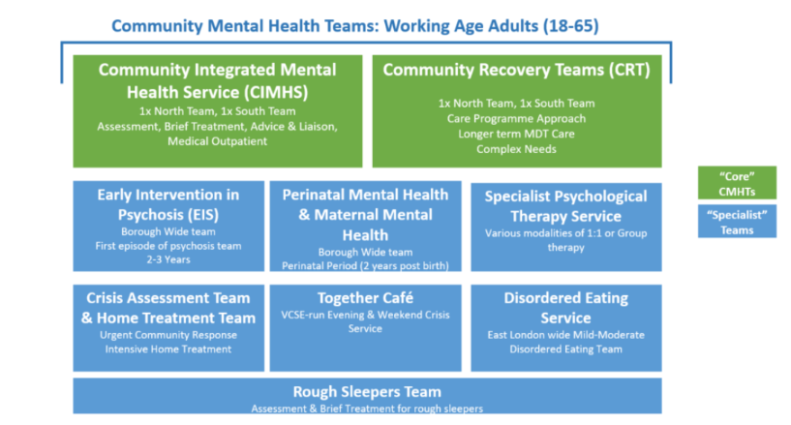
The Newham NHS Mental Health Services

Slide 8
Existing Commissioned Services 2025
In September 2023 ELFT established the Newham Recovery College and Crisis Café's also known as Together Café's.
LBN commission a number of negotiated contracted mental health supported living services outside of this including:
Supported Living Provision of 53 units within Newham
A floating support pilot 2024-2026
LBN commission services which deal with specific aspects of mental wellbeing or health, and which offer preventative support, with a view to halt the development of more profound mental health issues through the Healthier Lives Programme and Our Newham Works.

Slide 9
Existing Commissioned Services 2025
Our Health Partners have:
Re-commissioned the Crisis Café Provision (The Together Café’s) provided by MIND, Tower Hamlets, Redbridge and Newham. Offering Art Therapy, Group and One to One Support (2024-2028).
Commission Community Connectors in adult mental health provided by; MIND, Aston Mansfield and Community Links in partnership with ELFT (2026).
Parents in Mind (delivered by NCT) - Perinatal peer support for parents and dads (2024-2025).
ADHD peer mentoring support delivered by WHUF and Aston Mansfield (2025).
Supported Employment Programme, provided by Twinnings CIC in Partnership with Working Well Trust from July 2024 - 2028.

Slide 10
Additional Mental Health Activity
In addition to commissioned services, adults and health are leading the following areas of activity:
Suicide prevention strategy and action plan
Be Connected Pilots to reduce Loneliness
Coordinating a Newham mental health action plan, with the Joint Mental Health Partnership Board
Signed up to the National Prevention Concordat for Better Mental Health
Strengthening partnership working with Newham’s voluntary community and faith sector organisations through the 50 steps to a Healthier Newham and the mental health small grants programme
Developed the Well Newham Hub providing a directory of voluntary and community sector support that promote good mental health and wellbeing
Supporting the roll out of Good Thinking App in Newham including small grants to support train the
trainer within the voluntary and faith sector.

Slide 11
Future Priorities: Commissioning Intentions for 2025-26
Commissioning specialist supported accommodation for adult mental health through the
dynamic purchasing vehicle (DPV) 2025 -26.
Test through a pilot the approach for adult mental health floating support 2024 -25 with capacity for call off for floating support services through the DPV under category 3 or through a mini competition process in 2025 -26.
Pilot the use of the Outcome Star in Mental Health Supported Accommodation settings 2025 -26.

Slide 12
Future Priorities
Deeper dive needs analysis for specialist supported accommodation for women with complex
needs alongside enduring mental health difficulties.
Deeper dive needs analysis on the need for specialist accommodation for adults in the forensic mental health system.
Connecting Supported Accommodation Schemes with the community mental health offer through Healthier Lives, Change Grow Live and the Community Connectors and the Recovery College and Crisis Café offers.
Working with the voluntary, community and faith sector on addressing inequalities in mental health access to services.
Reviewing our mental health enablement offer and piloting floating support to maintain residents independence.
Developing the Newham Mental Health Strategy.

