Slide 1
Newham Autism Action Plan Let's Talk Autism
You Said, Together we did
Progress Toward the 2024/25 Priorities (May 2025)

Slide 2
Introduction
The purpose of the Autism Action Plan is to provide meaningful change to make Newham a place where all autistic residents can be independent, achieve their potential and live well. To achieve this, annual actions across six priority areas are co-produced:
1. improve understanding and acceptance of autism within society;
2. improve autistic children and young people’s access to education - and support positive transitions into adulthood;​
3. support more autistic people into employment;​
4. tackle health and care inequalities for autistic people;​
5. build the right support in the community and support people in inpatient care; and​
6. improve support within the criminal and youth justice systems.
This document provides an overview of the progress made toward the 2024/25 Priorities. The status of each is recorded at the top of the page:
COMPLETE - indicates the action has been completed and assumed, where appropriate, into ‘business as usual’ activity;
IN PROGRESS - indicates the action has been started, but will be completed in 2025/26;
NOT STARTED - indicates the action has not started due to capacity or resource.
, as appropriate.

Slide 3
Autism Strategic Delivery Board
A multi-disciplinary, multi-organisation Delivery Board has been established to:
oversee the delivery of the Autism Action Plan;
ensure appropriate resident and stakeholder contribution across the delivery of the Action Plan and annual Priorities;
identify synergies between the Action Plan and wider programmes across the Council, its partners and the north east London footprint;
identify and address obstacles, dependencies and risks to the delivery. Of
corporate further related areas of work into the Action Plans, as appropriate.
In 2024/25, Christina Pillai sat on the Delivery Board as the resident co-chair. Christina shares…
“My motivation for being part of the Delivery Board is deeply personal. As an individual on the autism spectrum myself, I am also a parent raising two autistic sons. Challenges and triumphs have marked my journey, and through these experiences, I have developed a passion for spreading awareness, providing support, and making a positive impact on the lives of others. What has been genuinely enlightening since taking on the role of co-chair is discovering the extensive work being done behind the scenes, work that many autistic residents may not be aware of. It has been both inspiring and motivating to see the number of dedicated professionals and companies ready to support and drive positive change for the autistic community. This experience has underscored the importance of collaboration and collective efforts in creating a more supportive and inclusive environment for autistic residents."

Slide 4
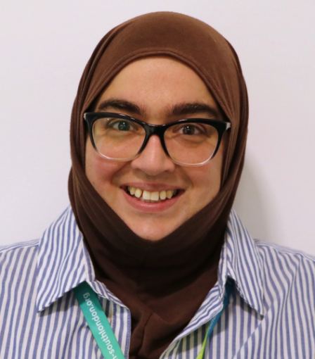
Working Groups
Six working groups have been established, mirroring the six priority areas, each led by a Council, Health or Police representative and an autistic resident. Representatives on each working group support, guide and deliver the actions; all representatives are considered equal partners. Working groups meet regularly to oversee progress - and provide guidance and support where needed; this is reported back to the Autism Strategic Delivery Board.
Resident representatives are also members of the Autism Residents Advisory Group (ARAG). The ARAG meets quarterly and resident representatives report back on progress made at the working group and conversely feedback resident concerns raised by ARAG members to the working group. This framework ensures resident voices are heard and listened to and that the actions prioritised and delivered are reflective of the needs of the community.
Aurora Todisco is one of the resident working group leads. Aurora shares…
“I joined the Autism Action Plan Working Group as the Expert Lead for Priority 3 because employment is such a vital issue for the autistic community. Too often, autistic people are overlooked or misunderstood in the workplace, and I wanted to help change that by contributing my professional expertise in Finance, HR and Governance Development, built over 21 years in the field. Being part of this group has been both meaningful and motivating. It's allowed me to collaborate with others who are committed to breaking down barriers and creating fairer opportunities. The Newham Action Plan is valuable because it doesn't just talk about co-production - it lives it. It's encouraging to see autistic voices not just represented, but leading the way.”

Slide 5
1. Improve understanding and acceptance of autism in Newham

Slide 6
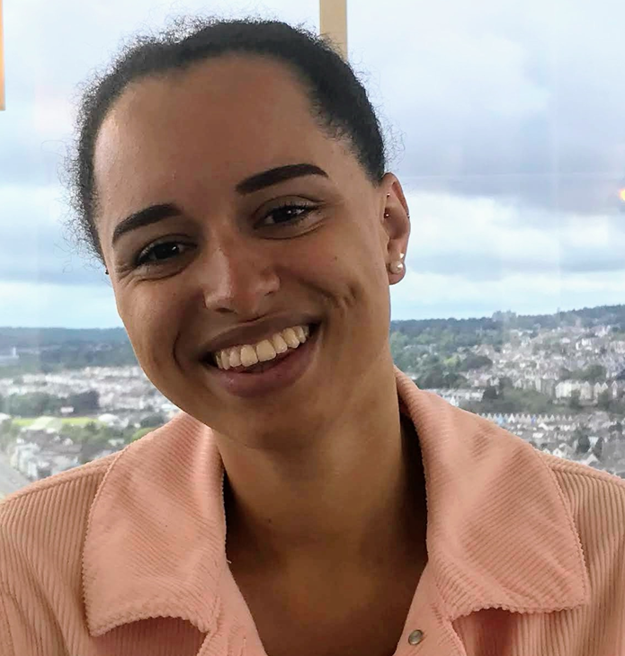
1a: Resident Advisory Group
COMPLETE
Establish an effective adult Autism Resident Advisory Group to: - share ideas and give views on the issues affecting adult autistic residents - and help shape local services; - co-design the relevant actions in this Autism Action Plan; - share information about activities, events and services that may be beneficial / of interest to adult autistic residents; - create a network of peer support.
The Council has established an Autism Resident Advisory Group (ARAG). The Group meets quarterly - offering both face-to-face and online engagement; and is an opportunity for residents to shape and influence delivery of the Action Plan and annual Priorities. As of April 2025, over 90 autistic residents have registered as members for the Group. A newsletter was launched in May 2024, which is now produced monthly going out to over 400 autistic residents and a WhatsApp group with over 60 members established.
To find out more or join, visit: Newham's Autism Resident Advisory Group or email: Autism.Commissioning@newham.gov.uk
In 2023/24, Serena Elstub sat on the Resident Advisory Group as the resident co-chair. Serena shares…
“I put myself forward to stand because I liked the sound of the role - getting to meet and support people in my community, finding out how things in the Council work and influencing decision making. The role has been beneficial for me personally and professionally, boosting my confidence and ability to communicate with others as well as finding out what support services are available. It has also been great to connect with other autistic residents about our shared experiences. My biggest achievements are learning to engage in the delivery board meetings - feeding back from our residents’ group to the various stakeholders involved - and of course the actual Action Plan launch itself. My advice for future co-chairs is to ask lots of questions whenever possible, as this is how to find out what services and opportunities are happening but also ensures that you understand what is going on so you can feedback information that is clear and precise.”

Slide 7
1b: Raise Awareness
COMPLETE
Raise awareness of autism (and autistic residents’ strengths and challenges) to the wider Newham population by: - observing World Autism Acceptance Week/Day/ Month (Council, Education and Health); - map the observation days the Council celebrates / observes where it would be appropriate to promote autism (e.g. Carers Week, Mental Health Week, etc). Ensure each of these include an autism information / stall / session, as appropriate. - identify autistic resident champions to raise awareness of autism (strengths and challenges) at events and activities - and to services.
Event/Initiative | Date | Description | Participants | Impact
Provider Forum | Quarterly from Jan ‘24 | Supporting awareness through the exchange of good practice, lessons learned, and national / local insights. | 15-30 Providers | Strengthened collaboration and shared learning across Provider networks.
School Staff Newsletter | Feb–April ‘24 | Acceptance Week promoted across school communication channels. | 1000+ Staff | Extended autism awareness messaging to professionals in Education.
Westfield Stratford & JCD Screens | Mar - April ‘24 | Awareness campaign across 50+ screens. | Undefined | Visibility of autism in high-footfall areas.
Acceptance Week | 2–8 April ‘24 | 26 activities by 15 teams. Author event sold 30 books. Feedback praised variety and inclusivity. | 200+ residents | Visibility of autism. Celebrated diversity and inclusion.
Action Plan Soft Launch | 18 April ‘24 | Focus on employment - employers like Auticon, John Lewis, PwC and Hopeful Futures participated, alongside Our Newham Works and the DWP. | 58 residents, 48 organisations, 20 staff and 16 volunteers | Promoted autism-inclusive employment; fostered partnerships with national and local employers.
Head Teachers | May ‘24 | Autism Action Plan & 2024/25 Priorities promoted to head teachers | 50+ staff | Encouraged inclusive leadership practices within local schools.
Learning Disability BBQ | 19 June ‘24 | Networking with stakeholders and residents. | 200+ residents and staff | Strengthened community relationships and stakeholder engagement.
Carers Rights Day | 21 Nov ‘24 | Awareness-raising stall to support Carers and promote inclusion. | 100+ residents | Supported Carers with resources and highlighted their crucial role in the autism community.
Inclusion Matters Newsletter | Jan ‘25 | Coverage in Inclusion Matters newsletter, supporting awareness and engagement reaching a wide audience of parent and carers. | Undefined | Extended autism awareness messaging to parents and carers.

Slide 8
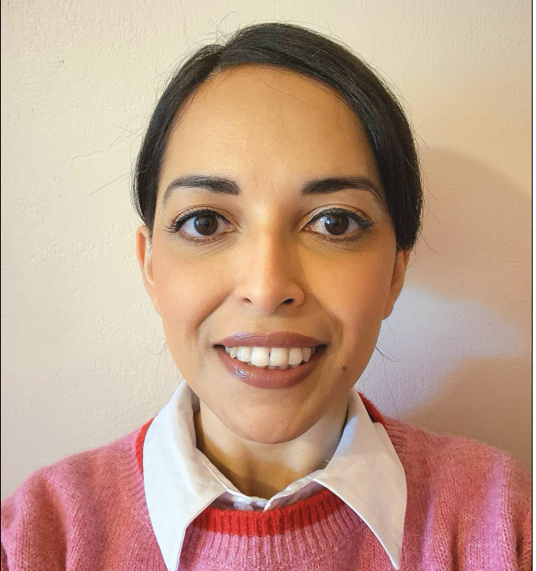
1c: Peer Support Worker
COMPLETE
Recruit a Peer Support Worker (via one-year fixed external funding) to set-up a variety of sustainable Autism Peer Support Resources and Groups.
In August 2024, the Worker post was advertised. 70 applications were received and seven shortlisted. Aisha, a local autistic resident was successful and started in October.
Aisha’s focus is supporting autistic residents through the development of a structured autism network that fosters connection and engagement. Central to this is the production of a monthly newsletter, facilitating access to information and support for subscribers, while also providing valuable insights into the needs of the autistic community through surveys and direct engagement. Equally important is her coordination of, and participation in, autism-focused events and activities (e.g. healthy eating sessions, wellbeing workshops, and peer support groups). Her role also involves sharing relevant resources to meet evolving community needs.
If you would like to be part of a support group or would like to set one up, please contact Aisha on aisha.ahmed58@nhs.net
Aisha shares… “I am autistic and very passionate about helping and empowering people. I am very empathetic, caring and a great listener, all of which drew me to this role. My work involves building support for the autistic community through connecting people with our newsletters, WhatsApp and various events including cooking classes, World Autism Acceptance Week events and various support groups. My lived experience has helped me build meaningful connections and enabled me to support autistic people in their unique journeys. Creating a safe place is so important for people, to have a voice and feel really listened to and seen. I have gained so much confidence in my role and developed new skills. By helping and supporting others. I am also learning along the way. I am so proud to be a Newham resident and to see all the hard work going on to create a more inclusive community. I am so pleased to be part of the great work the Action Plan is achieving and am excited for the future."

Slide 9
2. Improve autistic children and young people's access to education and support positive transition into adulthood

Slide 10
2a: SCERTS
COMPLETE
Deliver Social Communication, Emotional Regulation, Transactional Support (SCERTS) training in Newham Schools.
A two-day conference took place in 2024, led by Emily Rubin, an internationally respected and renowned trainer and practitioner and co-author of the SCERTS framework. 150 people attended, including representatives from Education, Children’s Social Care, East London Foundation Trust, Mencap and the Newham Parent Carer Forum. Feedback included:
‘It was so great seeing Emily speak again, and the information on mentoring was very useful as that has always been the main difficulty with embedding SCERTS’
‘It was a very supporting conference, that gave more insights in understanding some of the behavioural characteristics of children with autism. The conference also shared evidence of helpful support that leads to wonderful outcomes.
‘Thank you very much for a fantastic training. I learned so much and am excited to implement SCERTS a bit more in the schools I work in. Exciting! Emily was fantastic and she transferred so much passion and motivation onto us all!’
Since the conference, the Council has:
updated its ‘SCERTS in Newham’ training for schools - due to be launched in Autumn 2025;
developed materials for implementing the ‘Appreciative Inquiry’ coaching methods in schools;
continued to run its ‘SCERTS in Newham’ Network meetings as a space for sharing new developments, best practice and facilitate ongoing support implementing SCERTS;
continued to run its flagship ‘SCERTS for Newham Parents / Carers’ training. To find out more or book, visit: www.newham.gov.uk/LCIS.

Slide 11
2b: Home Care
IN PROGRESS
Procure an all-age Independent Living Support Service (Home Care) for residents whose primary need is Autism, Mental Health and / or Learning Disabilities.
The Service specification has been refreshed based on feedback from the residents who use it, and Social Care professionals.
The new Framework Agreement is in the process of being re-procured – and is currently at evaluation stage, with a planned start date of the 06.10.2025.

Slide 12
2c: School Provision
IN PROGRESS
Ensure robust data analysis and forecasting is implemented to ensure there is suitable school age, post 16 and adult educational provision and support for autistic residents in borough.
In 2024, the Council secured additional capital funding from the Department for Education to further strengthen its provision for autistic children and young people. This investment is part of our programme to expand specialist support across all age ranges, including post-16 education. A key development in this programme is the opening of Connaught Special Free School, which is currently operating from temporary accommodation. Its permanent site, in the Royal Docks, is scheduled for completion in autumn 2026, ensuring high-quality, purpose-built facilities for learners with complex needs.
In addition, the Council’s Cabinet has also approved funding for capital investment for schools and settings to further create high-quality, inclusive learning environments for autistic children (and others) to thrive in their local settings.

Slide 13
3. Supporting more autistic people into employment

Slide 14
3b: Post 16 Further Education Information
COMPLETE
Co-design an annual summary / flowchart of post-16 further education offers and application closing dates to support autistic residents and their families to plan.
Flowchart co-designed with resident workstream lead and placed on the Council’s Preparing for Adulthood webpage under downloads.

Slide 15
3b: Local Employer Resource
IN PROGRESS
Co-design a suite of online and paper-based resources and training for local employers to build their confidence in supporting autistic residents in the workplace.
An employers guide to support autistic employees has been co-designed with resident workstream lead and a flowchart outlining the range of supported employment programmes available for autistic adults aged 18-25 with an EHCP will be shared on Newham webpages.

Slide 16
3c: Employment - Care Act Eligible Residents
COMPLETE
Explore establishing a variety of Social Enterprises to employ autistic Care Act eligible residents - shifting the focus to employment rather than a Community Opportunity for those who are working-age.
The Council has five in-house Community Opportunities for Care Act Eligible residents. In December 2024, the Adults and Health Directorate agreed a new vision for Community Opportunities, to:
have co-designed outcomes for each resident cohort (with Individual Support Plans that work towards these); ​
reduce the number of working-age residents in receipt of a Community Opportunity by fostering resident ambition, community connection and employment opportunities; and
provide safe, high-quality, value for money provision that provides residents who need a Community Opportunity with meaningful activities and sense of purpose - promoting independence and positive relationships, close to their home and within their local community.
To this end one of these five Services, Active Support, has been re-purposed to provide volunteering and employment opportunities - working with local businesses / Social Value and Access to Work to support residents into employment – negating the need for a Community Opportunity.
The Service is currently reviewing the residents in receipt of this Service to identify those who are ‘employment ready’ and have ‘employment potential’, and those who have ‘no employment potential’. Alternative provision will be found for those who have no employment potential.

Slide 17
4.Tackle health and care inequalities for autistic people

Slide 18
4a: Diagnosis Assessment Process Resource
COMPLETE
Co-design an online and paper-based resource to raise awareness of the autism diagnosis assessment process to provide residents and their families when referred (e.g. how long an assessment will last, the types of questions that will be asked, where possible images of the environment and professionals involved, etc).
There are two diagnostic services in Newham, one for adults and one for children and young people.
The adult service has co-designed an online resource that provides information to residents on the assessment process. To view this resource, visit: Newham Adult Autism Diagnostic Service
Similarly, the children and young people’s diagnostic service co-designed an online resource, including a video providing information on their assessment process. To view this resource, visit: CHAND

Slide 19
4b: Awareness - Hospital Staff
COMPLETE
Raise awareness of autism with health staff in Newham Hospital including co-design of new resources, training, promotional materials, and holding a World Café event at the hospital with staff, residents, patients and professionals.
Area | Activity/Initiative | Details & Impact
Training Content developed and co-facilitated with autistic residents, where possible. | National Autism Training Programme (NATP) | Nurses trained. Monthly Community of Practice meetings established. Developing half-day training for broad access and 3-day in-house Autism Champion course.
 | Autism Awareness – Crisis Team Induction | Quarterly half-day sessions for new staff - focus on mental health, suicide risk, adjustments, and communication to reduce admissions.
 | Ad-hoc Training for Services | Delivered to Safeguarding and Pharmacy where specific needs were identified.
Clinical Advice | Specialist Consultations | Case-specific advice provided to teams supporting autistic patients.
Resource Development | Trust-wide ELA Page | Final stages of co-produced electronic Continuous Professional Development resource on autism.
 | SPACE Model Posters | Posters on reasonable adjustments displayed on wards during World Autism Acceptance Week.
Patient Engagement | World Café – Newham Hospital | Patient-led event involving autistic residents, carers, staff, and professionals. Gathered insight on improving hospital services for autistic patients. Over 30 participants.
LDA Practice Education | Oliver McGowan Training – Part 1 | 63% of staff have completed the online module; part of the Trust-wide learning approach.
 | Simulated Learning – Act Up! Theatre | Scenarios led by local actors across nursing, medical and AHPs to build autism understanding and staff confidence.
Ward-Based Learning | 10-Minute Bitesize Sessions | Focused, ward-level teaching on Mental Capacity, communication, behaviour support, and adjustments.
 | Tailored 1–2 Hour Training | Delivered to specific teams (e.g. end-of-life, cancer, renal, outpatients) with focused autism content.
 | Autism Training | Delivered to Opal Ward by the Autism Diagnostic Service; roll-out to other wards planned. 20 participants

Slide 20
4c: Awareness - Faith Groups
IN PROGRESS
Develop an awareness campaign / training for local Faith Groups.
There has been several conversations with different community and faith groups about their understanding of autism, challenges in relation to intersectionality, and support needed for both autistic residents, their families and wider communities.
On the 08.04.2025, a Community Leaders event took place to ‘talk autism’ with targeted invitations including faith communities. This was followed up with a dedicated session on NU Sound radio on the 30.04.2025 (whose audience is predominately South Asian).
A dedicated session is planned at the Interfaith Forum in June.

Slide 21
5. Build the right support in the community and support people in inpatient care

Slide 22
5a: Autism Dynamic Support Register
COMPLETE
Develop and maintain an Autism Dynamic Support Register - identifying autistic residents who display, or are at risk of developing, behaviour that challenges or mental health conditions that are likely to lead to admission to inpatient care. Residents on the Dynamic Support Register are offered a Community Care and Treatment Review to see whether they are safe, in the right place, and to understand their plans for the future.
In April 2024, the North East London Integrated Care Board introduced an Autism Dynamic Support Register. This is a system used to identify and support autistic residents who are at risk of needing inpatient mental health services. Its main purpose is to prevent unnecessary admissions to hospitals by ensuring timely access to appropriate support and care in the community.
If a resident is identified at being at risk of being admitted to, or is currently detained in inpatient care, a Care and Treatment Review (CTR) will take place. The aim of a CTR is to avoid admission wherever possible, or to plan discharge. The review looks at four areas:
is the person safe?
are they getting good care now?
what are their care plans for the future?
can care and treatment be provided in the community?
As of the 30.04.2025, 12 residents are on the Register / being supported through the CTR process.

Slide 23
5b: Autism Protocol - Inpatient Care
COMPLETE
Agree an Autism Protocol (and flowchart with contacts) with and for the Inpatient Mental Health Service based on the patient’s journey from admission to discharge.
The Centre for Mental Health has been provided with a list of community-based teams / organisations from across Health and Social Care, with details of what they do and their contact numbers.
A Therapeutic Environmental Checklist has been co-designed with resident workstream lead and is now in use at the Centre. This covers the five senses, plus balance, communication and space.

Slide 24
5c: Welcome Pack - Inpatient Care
IN PROGRESS
Refresh the Inpatient Mental Health Service’s Welcome Pack in partnership with autistic residents recently discharged to support other autistic patients to manage predictability and expectations. Within this, consider agreeing a ‘Welcome Kit’ comprising flash cards, fidget toys, etc; and age-group and ability.
The Welcome Pack has been refreshed in partnership with residents who have experience of Newham Centre for Mental Health. The Pack covers a resident’s journey from admission to discharge, and includes what to expect on arrival, the building, what is and isn’t allowed, treatment and support, visitors and communicating with family and friends, and discharge.
The Pack is a dynamic document, meaning it will change and develop on a regular basis in line with new legislation and patient feedback.
For this action to be approved and published, it needs to be approved by the Autism Resident Advisory Group. The workstream leads intend to take the Pack to the next session.

Slide 25
6. Improve support within the criminal and youth justice systems

Slide 26
6a: Resident Awareness - Staying Safe
IN PROGRESS
Co-design an awareness programme for autistic residents (broken down by age: under 18 and 18+) advising them how to stay safe; and reduce the risk of them coming into contact with people planning to break the law
The Metropolitan Police are working with the Pupil Referral Unit to support children and young people how to stay safe and what their rights are when in contact with the Police.
A pilot of using peers with lived experience as a more credible way of communicating with young people is taking place in custody suites.
The Youth Justice Service is working with autistic young people and local businesses to create ‘safe spaces’ in shops where children and young people can go if they feel threatened.

Slide 27
6b: School Exclusion - Staying Safe
IN PROGRESS
Identify Autistic residents excluded from school (prior to or at the point of exclusion) and support them to stay safe and reduce the risk of them coming into contact with those planning to break the law / offending. Within this, provide support to families and / or Social Care Service Providers to work with, not against the resident - encouraging employment and activities that provide a sense of purpose and enjoyment
The Youth Justice Service is working with the Special Educational Needs Coordinators at local schools to gauge the level of autism diagnoses at their school to develop tailored support.

Slide 28
6c: Crown Prosecution Service Resource
IN PROGRESS
Co-design an online and paper-based resource on the Crown Prosecution Service process and support available to autistic residents who will face prosecution.
Support is in place for autistic residents facing prosecution including:
the use of Social Communication Passports;
resources made visual and court materials simplified;
learning from neurodiversity training now applied across interventions;
embedded CAMHS support is routinely offered;
neurodiversity-Informed practice adapted to support autistic and neurodivergent children and young people.

Slide 29
Other achievements

Slide 30
P1: Peer Support Groups
Four peer support groups have been established, providing welcoming and supportive spaces for autistic residents to connect, share experiences, and access valuable information. The Open Peer Support Group, scheduled for one hour, often continues for up to five hours due to the strong sense of support and engagement among members.
Group | Location | Frequency | Attendance | Duration (Hours) | Facilitator
Open Peer Support Group | In-person AutismOutreachNewham@gmail.com | Quarterly | 8 – 12 | 5 | Volunteer
Autistic, Work and Anxiety Group | Online aisha.ahmed58@nhs.net | Monthly | 3 – 6 | 1 | Peer Support Worker
Autistic Men’s Group | Online Adam.Webb@newham.gov.uk | Monthly | 3 – 6 | 1.5 | Volunteer
Carers of Autistic People | In-person carersautisticadultsnewham@gmail.com | Monthly | 3 – 6 | 1 | Volunteer

Slide 31
P3:Employment Video
An autism employment video was co-produced and premiered at the Autism Action Plan soft launch. Since then, it has been viewed over 5,000 times across multiple platforms, helping to raise awareness and champion inclusive employment practices. To watch the video, visit: https://youtu.be/19vkO10H0YY

Slide 32
P4: Data Recording
Primary Care
The Autism Diagnostic Service now advises Primary Care of the code to use on their Primary Care database, ELMS when a resident is diagnosed autistic. This goes someway to better capture prevalence in the borough; and should also better support clinicians to ask if any reasonable adjustments are required regarding attending appointments / providing treatment.
In addition, East London Foundation Trust has added a “significant” alert on their database, RIO, so when a clinician opens the page, they can see it in demographics. This is to act as an aide memoire to ask if any reasonable adjustments are required regarding attending appointments / providing treatment.
Homelessness
In partnership with the homelessness services, a Homelessness / Autism Pathway has been developed and a streamlined referral process (easy read) agreed. This includes a fast-track ‘referral to assessment process’ for individuals with complex needs and long histories of rough sleeping from frontline homelessness services (i.e. London Navigator Team), into Newham’s Autism Diagnostic Service.

Slide 33
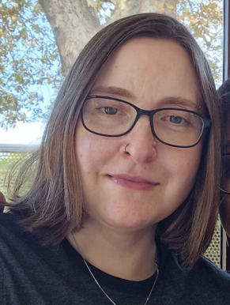
P4: Self-Referral
Following feedback from the ARAG, the Autism Diagnostic Service opened referrals from residents and their families (self-referrals).
In 2024/25, 13% of referrals were via self-referral, with the Service advising that the quality of information provided in the self-referrals is much better than that coming from other routes, and requests for additional information is often quicker.
Jay Gee is one of the resident working group leads, and put the idea forward. Jay shares…
“I made it clear to the ARAG and Autism Diagnostic Service how vital self-referrals are. I was surprised to be listened to and believed -but the change will literally save lives. My life has been shaped by being refused NHS referrals, leaving me severely disabled with complex PTSD. Many believe referrals can’t be refused, but they can, and often are. As an undiagnosed autistic person with untreated multiple sclerosis, I was denied assessments and only got diagnosed after going private. This is why self-referrals are essential - referrals from strangers after 10 minutes can’t compare. I credit the ARAG and Newham’s Diagnostic Service for recognising autistic people as experts in their own lives. Self-referral is a major step towards a solid foundation for the meaningful progress still to come."

Slide 34
P4: London Ambulance Service
The London Ambulance Service have coproduced three new resources to support autistic people when using the service. These resources are designed to help autistic people to know what to expect when an ambulance arrives, including assessments that may need to be competed, the inside of an ambulance and demystifying common concerns. To access these resources, visit: London Ambulance – Calling Us.

Slide 35
P4:London Fire Brigade
On the 13th of July 2024, the London Fire Brigade (LFB) attended a house fire in Newham where three autistic children tragically lost their lives. From this date the Station Commander and Station Officer began to identify a trend between the incidents the LFB attend and those that involve autistic people, as well as those with complex needs. From this an Autism and Complex Needs Initiative was piloted in Newham.
Following the creation of the Initiative, the LFB has worked with Altmore and Sheringham Children's Centres, the Shipman Youth Centre, Ranelagh, Tollgate and Upton Cross primary schools, JFK and Hopeful Futures raising awareness of the dangers of fire, heights, traffic, water, etc - delivering adapted versions of their Local Intervention Fire Education (LIFE) programme, and providing individual advice and support (e.g. alternative smoke alarms to avoid sensory overload).
The LFB, alongside East Sussex Fire and Rescue, the Council, and others, has created resources catered to the needs of parents / Carers of autistic children and those with complex needs.
There is a Home Fire Safety Checker and guidance on how to #ChargeSafe campaign for safer use of e-bikes and e-scooters.

Slide 36
P4:Cancer
A one-hour mini health event was held following the January ARAG meeting to help address the health inequalities experienced by autistic people.
15 members attended and accessed essential health information. The event featured a FREE NHS Health Check station offering blood pressure, BMI, cholesterol, diabetes testing, and Qrisk assessments, alongside tailored advice and signposting. A Bowel Cancer Screening stall provided guidance on gut health, tips for maintaining a healthy biome, and free take-home kits. A Breast Cancer Screening stall offered information on breast health. The event provided a safe, supportive space for autistic individuals to engage with healthcare services.
For more information on health checks, visit: Health Checks and Screenings

Slide 37
P4:Healthy Eating
14 autistic residents took part in a four-week cooking and health programme, where they learned to prepare vegetarian meals from scratch and gained knowledge about food groups and maintaining a healthy gut. Facilitators described the sessions as a "successful first run" with "great turnout." Participants expressed enthusiasm throughout, looking forward to each week. Many have since started cooking at home and have shown interest in starting other group activities together, reflecting the programme’s positive impact on both skills and community connection.
For more information on healthy eating, visit Food

