Slide 1

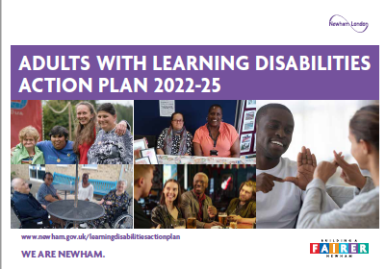
ADULT LEARNING DISABILITY ACTION PLAN
You Said, Together We Did
Year 2 Report - August 2024

Slide 2



Overview
COMPLETE
At the top of each page there is a box to say if the Action has been done. There are 5 choices:
CLOSED – The action has been completed. The action will become an everyday activity. Also known as ‘business as usual’ activity;
COMPLETE - The action has been done;
IN PROGRESS - The action has been started yet. We will work on it in Year 3.
NOT STARTED - The action has not started due to employee capacity or resource;
REMOVED – The action has been removed following discussion with the action owner and Resident Advisory Group.

Slide 3


More information
There is a Jargon Buster at the end to explain some of the words that we have used in this document.
There is a full version of this report. This is not in plain English.
There is a separate report for Year 3 Priorities.
These reports can be found on the webpage Learning Disability Action Plan Updates – Learning Disabilities – Newham Council

Slide 4

OUTCOME 1: HEARD AND VALUED

Slide 5
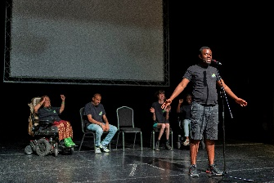
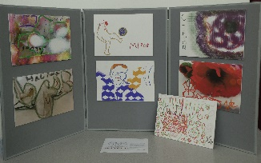
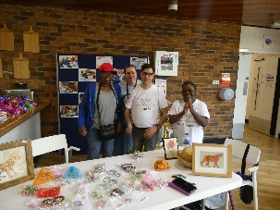
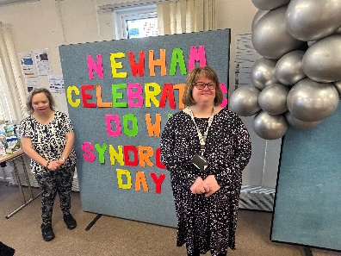
ACTION 1.1 - Raise Awareness
CLOSED
What we did:
Learning Disability Week - June 2023
There were 297 attendees over the week
28 people went to the Art Exhibition opening at Beckton Library
99 people went to the Variety Show
163 people went to the ‘Get Together’ BBQ
World Down Syndrome Day
The Council held its second all-age observation of World Down Syndrome Day.
Four adult residents with Down Syndrome gave speeches. They told children with Down Syndrome, their parents and professions about their successes and skills.
Other events
There was also Learning Disability representation at the Carers Festival 2023 and the Aging Well Festival 2023.

Slide 6

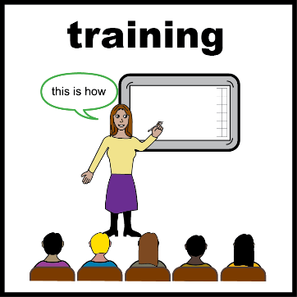
ACTION 1.2 - Training
COMPLETE
What we did:
The Council has a Making Research Count membership. This helps tell Health and Social Care professionals what good practice looks like.
The Council has commissioned Grey Matter Learning (now called Flourish) training across Health and Social Care. This is free and accessible to all Newham Providers who have registered with Care Providers Voice, as well as Adult Social Care Staff.
We paid I-Support Behaviour to run a training course for family Carers. 23 people attended this.
Residents supported by the Community Health Team had personalised training for their Carers/ Famillies.

Slide 7
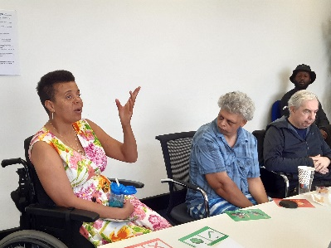
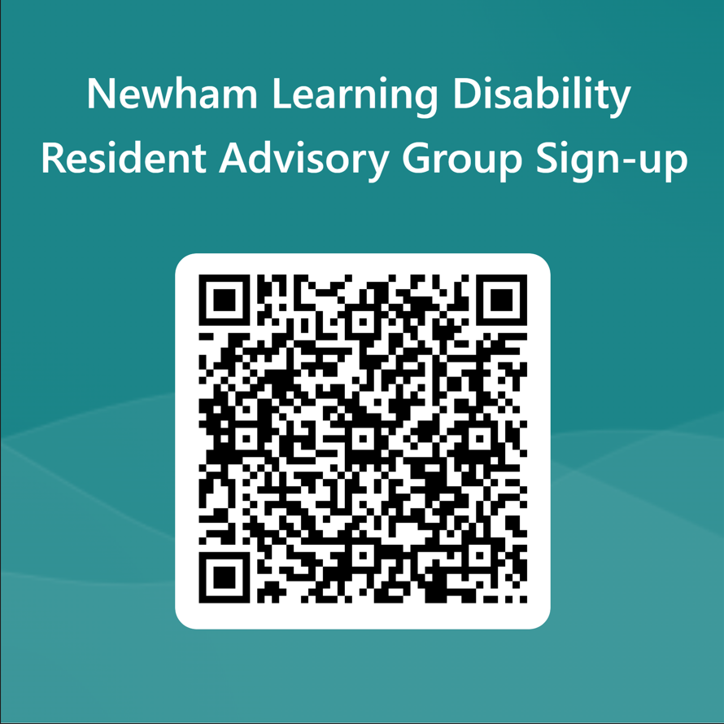
ACTION 1.4 - Resident Forums
CLOSED
What we did:
The Learning Disability Resident Advisory Group.
This Group met four times. The meetings are face-to-face.
It is Co-chaired by a resident with a Learning Disability.
To join the Group online click here. Or email: LearningDisability.Commissioning@newham.gov.uk.
What we said in the meetings was shared with the Action Plan Delivery Board and the Learning Disability and Autism Joint Planning Group.
The Learning Disabilities Action Plan Delivery Board
This group met four times.
The purpose of the Board is to meet the Outcomes in the Action Plan.
There are two residents with lived experience sharing the Co-chair role for the Delivery Board. What was said in the meetings was shared with the Resident Advisory Groups and the Learning Disability and Autism Joint Planning Group.

Slide 8
ACTION 1.4 - Resident Forums
CLOSED
What we did:
East London Foundation Trust (ELFT) has a dedicated People Participation Lead in their Learning Disability Service
They have regular resident engagement sessions around Health needs. To join the sessions email: simon.bedeau@nhs.net.

Slide 9


ACTION 1.5 - Advocacy Service
CLOSED
What we did:
The Council has a Contract with VoiceAbility for the Advocacy Service110 residents with a Learning Disability used the Advocacy Services in Year 2.
.
Monthly Learning Disability self-advocacy drop-in sessions began from the 9th October 2023 at Chargeable Lane Resource Centre. These now run monthly on the second Monday of the month. The Learning Disability drop-in runs from 1-2pm, there is a session from 2-3 where those with learning disabilities and/or autism can attend.
To find out more or access the Service visit: VoiceAbility Newham or ring: 0300 303 1660.
Newham Council renewed the contract in September 2024. Changes were made to the new contract to improve access to Independent Mental Capacity Advocacy for residents placed in accommodation outside of Newham. These will be reported in Year 3.

Slide 10
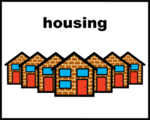
OUTCOME 2: ACCOMMODATION AND HOUSING

Slide 11


ACTION 2.1 - General Housing Tenancies
IN PROGRESS
What we did
We shared information and guidance with Housing Services and Temporary Accommodation Services to help them support people with learning disabilities..
Newham’s Planning Department commissioned research into Housing Design
The researchers talked to the Learning Disability Resident Advisory Group, the Learning Disability and Autism Provider Forum, and held two workshops with residents with Learning Disabilities and/or Neurodivergent needs.
The outcomes of the research will inform the implementation of the new Local Plan policies.

Slide 12
ACTION 2.3 – Shared Lives
COMPLETE
What we did:
A Review of Shared Lives was completed in year 2.
The Review suggested that 1-2 Residents who live in Shared Lives are supported to join the Learning Disability Resident Advisory Group

Slide 13
ACTION 2.2 Floating Support
NOT STARTED
What we did:
A review of how the Council buys how it buys housing support/ floating support services for residents still needs to be done.
This will start in Year 3.

Slide 14
ACTION 2.4 - Care Homes
CLOSED
What we did:
A Needs, Capacity and Opportunities Assessment was completed. There is an Action Plan to address the issues and opportunities identified.
There is a Market Position Statements for Older Adults (65+) Care Homes. It can found at:: www.newham.gov.uk/health-adult-social-care/market-position-statements/1

Slide 15
ACTIONS 2.5 and 2.7 - New Housing
IN PROGRESS
What we did:
The Council is developing Supported Living schemes for specific need-groups including Learning Disabilities.
This was identified in the Needs, Capacity and Opportunities Assessment, as part of the Council’s Supported Living Transformation Programme.

Slide 16
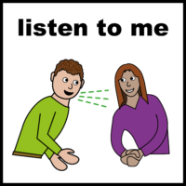

OUTCOME 3: CONNECTED AND INVOLVED

Slide 17

ACTION 3.2 - Support Worker
REMOVED
What we did:
This project shifted in focus in Year 1 to meet Operational demands in Adult Social Care.
The Peer Support Worker role focussed on supporting Autistic residents, though some also have Learning Disabilities.

Slide 18

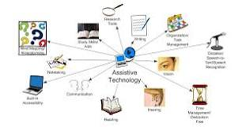
ACTION 3.4 – Assistive Technology
IN PROGRESS
What we did:
Newham Council is looking at its Assistive Technology offer.
It looking at how this is part of the Independent Living Support Services and Enablement offers.

Slide 19

ACTION 3.5 Non-Exploitation Policy
CLOSED
What we did:
In October 2022, the Council published a Hate Crime Strategy. This Strategy addresses a number of issues raised by residents aged 50+.
Training started in February and to date 60 frontline staff members have been trained.
A new Hate Crime reporting service has been established. To report a hate crime visit: stophateuk.org/report-hate-crime or call 0800 138 1625 (24hrs a day).

Slide 20


ACTION 3.6 and 3.7 - Sex and Relationships
IN PROGRESS
What we did:
A Sex and Relationships Charter and Sex and Relationships Policy for in-borough accommodation-based Providers has been drafted.
This has been shared with Newham’s Learning Disability Teams and the Neighbourhood Teams as well externally to three Care Homes and Care Providers Voice.
We are looking for NEL ICB, Care England and other Local Partners to give feedback.

Slide 21
OUTCOME 4: WORK AND PURPOSE

Slide 22

ACTION 4.1 – Pathways from Education to Further Education
COMPLETE
What we did:
227 learners attended Special Educational Needs and Disability classes from Our Newham Learning and Skills in 2023/24.
There are other activities in Outcome 2 that feed into this outcome.

Slide 23

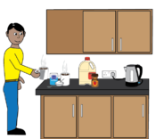
ACTION 4.2 - Social Value
IN PROGRESS
What we did:
The Council has been working with Housing Developers (Construction) to target projects for residents accessing Adult Social Care Services and specific groups. This includes residents with Learning Disabilities.
The Council’s Adults, Health and Communities Commissioning Team uses CommuniTeas and Coffees (a Learning Disability Social Enterprise) for meetings, as and when required.

Slide 24

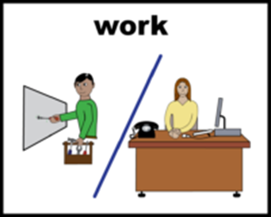
ACTION 4.3 - Supported Employment
IN PROGRESS
What we did:
In Summer 2023, one new resident was trained to take part on the East London Foundation Trust interview panels.
The Council now has a dedicated Commissioning lead on Supported Employment.

Slide 25
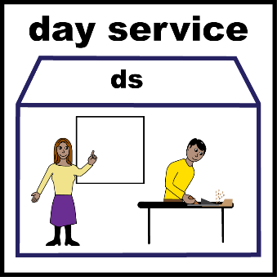

ACTION 4.4 - Day Opportunities
IN PROGRESS
What we did:
The Council worked with the London Boroughs of Havering, Redbridge and Waltham Forest to develop Minimum Quality Standards for Adult Day Opportunities.
Once agreed, these will be used in conjunction with local Quality Assurance processes to improve Day Opportunities.
Newham’s In-House PMLD (Profound and Moderate Learning Disability) Day Opportunity moved from Mariner Road to Chargeable Lane.
A number of new projects started in year 2 as part of the Loneliness Action Plan, including Chatty Cafes, Men in Sheds and Talking Benches.

Slide 26
OUTCOME 5: HEALTH AND SOCIAL CARE

Slide 27
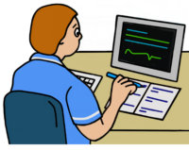
ACTION 5.1 - Improve Recording
IN PROGRESS
What we did:
There was work being done with Social Care Practitioners to add if residents have a Learning Disability on the Council’s Social Care database (Azeus Care). Social Care Practitioners to also add the other protected characteristics of those with a Learning Disability.
The Community Health Team Peripatetic Nurses are working with GP surgeries to ensure all residents (aged 14+) with a Learning Disability have the correct diagnosis recorded on Health databases.
There are different terms used by Health and Social Care (Children’s and Adults). Work is being done to address differences in the words we use across services in order to improve shared understanding and data collection.
An Adults Power BI dashboard has been set up that can pull out information about residents with Learning Disabilities / those open to the Adults 18-24 and 25+ Learning Disabilities Teams. This has helped the Council look at trends and gaps.

Slide 28

ACTION 5.2 – Develop an Adult Diagnostic Service
CLOSED
Year 2 Update:
The Learning Disability Action Plan had this as a Year 2 Action to develop and implement a Learning Disability Diagnostic pathway /service.
Due to the shortage of funding options available we have not been able to progress this action in year 2 delivery.

Slide 29
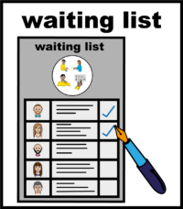


ACTION 5.3 - Equal Health Access
IN PROGRESS
What we did:
Barts Health
Newham Hospital will be aiming to reduce waiting times for patients with Learning Disabilities for elective care to the same as other people and hopefully to less than this.
The Council
The Council’s Public Health Team are developing a Healthy Weight offer for residents with Learning Disabilities. They have developed this following consultation with residents. The project group involves NEL ICB and ELFT partners.
50 Steps for a Healthy Newham 2024-29. This now contains a specific step regarding Equity – Step 19 Make Newham a neurodiversity- and disability-friendly borough.

Slide 30
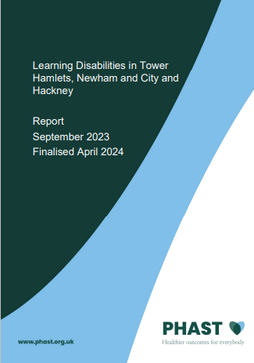
ACTION 5.3 - Equal Health Access
IN PROGRESS
What we did:
The East London Foundation Trust
From April 2023, the Community Health Team for Adults with Learning Disabilities transferred to the Adult Mental Health Directorate.
Commissioned a Health Needs Assessment which was finalised in April 2024. Learning Disabilities in Tower Hamlets, Newham and City and Hackney Health Needs assessment report.
The North East London Integrated Care Board
Looked at the Mild to Moderate Health Offer in Newham against the offer to residents in other North East London boroughs.

Slide 31
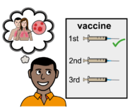
ACTION 5.5 - Annual Vaccination
COMPLETE
What we did:
Flu Vaccination (from February 2022 to 2023)
929 people (49% on the Learning Disability Register) received their Primary Course Flu Shot;
934 people (47%) received their Autumn booster;
Covid-19 Vaccination
1,266 people (79.4% on the Learning Disability Register) received their Primary Course Covid Shot;
644 people (52%) received their Autumn booster

Slide 32

ACTION 5.6 - Reduce Hospital Admissions
COMPLETE
What we did:
The Learning Disability and Autism Joint Planning Group added this as a priority.
NEL ICB has a Learning Disability Nurse goes to Mental Health Hospitals to be part of meetings for patients with Learning Disabilities. This includes Ward Rounds and Care and Treatment Reviews.
NHS England asked all areas to make some changes to their Dynamic Support Registers. This has been done in Newham. There are now separate Autism and Learning Disability Registers.
Safe and Wellbeing Reviews were completed for all hospital admissions in 2022/23.

Slide 33
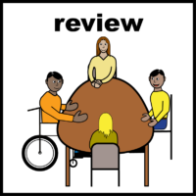
ACTION 5.7 - Strengthen Care Education and
Treatment Reviews [C(E)TRs]
COMPLETE
  We did:
  There is a new and Care Education and Treatment Review [C(E)TR] process in place.
  It has more patient-focussed outcomes.
  12 Adults had Reviews.
  5 Adults refused
  6 Children (or young person) had reviews
*Note a Care Education and Treatment Review is held for residents under 25 who have education needs. All others will be offered a Care and Treatment Review.

Slide 34
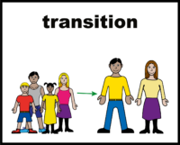
ACTION 5.9 - Improve the Transition Offer
COMPLETE
What we did:
Post-16 Commissioning work will continue with Children’s and Adult’s Commissioners. This will look at the offer for young people moving into Adult services.
A Transition Panel has been set up between SEND and Adult Operations. This is to improve pathways.
Transition-aged young people have been included in the Down Syndrome Day Celebration. The celebration focussed on adults telling young people and their families about their successes in adulthood.
A member of CAMHS (Child and Adolescent Mental Health Services) is spending a day a week with the Newham Community Health Team for Adults with Learning Disabilities.

Slide 35
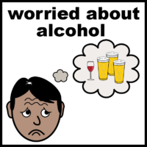

ACTION 5.10 – Substance Misuse
IN PROGRESS
What we did:
The Council has a new lead Commissioner for Substance Misuse. They will:
Work with Change Grow Live (CGL) / Rise Newham regarding data collection.
Improve pathways for residents who have a with dual diagnoses (Learning Disability and Substance Misuse) to both Substance Misuse Services and Adult Social Care.
Change Grow Live are working on improving pathways for residents with Learning Disabilities.

Slide 36
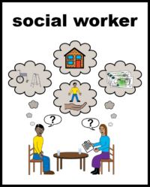
ACTION 5.11 – Improve the Social Work Offer
IN PROGRESS
What we did:
The Council is continuing to work toward ensuring sufficient Social Work capacity. This has been difficult due to a national Social Worker recruitment crisis.
Autism has been separated from the Learning Disability Social Work Teams in order to target resources and specialise expertise.

Slide 37

ACTION 5.12 - Support for Parents who have
Learning Disabilities
IN PROGRESS
What we did:
Support currently falls under universal services.
People with learning disabilities who are going to be parents are eligible for additional support via the Learning Disability Hospital Liaison Nurses, Adult Social Care and Health Community Team for Adults with Learning Disabilities.
More work to be done in Year 3.

Slide 38
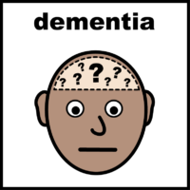
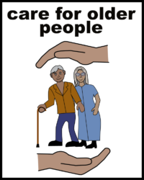
ACTION 5.13 - Access for Older People
IN PROGRESS
What we did:
The Community Health Team for Adults with Learning Disabilities has an early-onset Dementia provision for residents with Down Syndrome.
The Dementia Pathway will be reviewed against the NICE guidelines.
The Aging Well Festival 23/24 included a table for aging well with a Learning Disability.

Slide 39
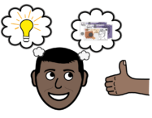
ACTION 5.14 Review Joint Funding
Arrangements
NOT STARTED
We need to start this in year three.
This will include Health and Social Care:
Talking about current arrangements;
Having the right tools and agreements for Continuing Health Care, Joint-Funding and Section 117.

Slide 40

ACTION 5.15 - Map Commissioned Services
IN PROGRESS
What we did:
For Children and young people
Newham Family Information Service and our Local Offer for children and young people with Special Educational Needs and Disability (SEND) and their families can be found on Newham Families Advice and Support. This is updated on a regular basis.
For Adults
The Newham Health and Care Partnership developed Well Newham. There are Well Newham Hubs and online on Helping everyone in Newham to live well | Well Newham
The Council has also commissioned the Joy Platform for residents.

Slide 41

ACTION 5.19 – Personal Health Budgets
IN PROGRESS
We are going to:
Increase the number of Personal Health Budgets for those who are eligible.

Slide 42

ACTION 5.20 - PBS Training
CLOSED
What we did:
The Community Health Team for Adults with Learning Disabilities provide person-specific support to Carers and Providers.
I-Support Behaviour provided PBS Support Training for Carers in Year 2.
The Supported Living Dynamic Purchasing Vehicle includes the requirement for Learning Disability Providers to be Positive Behaviour Support trained.

Slide 43

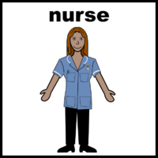
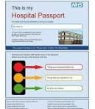
ACTION 5.21 - Community Nursing
COMPLETE
What we did:
Learning Disabilities assessment pathways for breast and bowel cancer screening were developed and implemented.
The Primary Care Liaison Nurses have had to continue with clinical caseloads. This is due to gaps in service provision for residents with Mild to Moderate Learning Disabilities.
There are new 14-25 Hospital Passports. These need to be promoted to strengthen links between Children’s and Adults with a focus on transition.

Slide 44
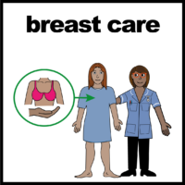
ACTION 5.22 – Increased understanding of Epilepsy, Mental Health and Suicide
IN PROGRESS
What we did:
We added increased understanding of the benefits of Cancer screening in Year 2.
The Newham Health Team for Adults with Learning Disabilities have been working closely with the North London and Central and East London Breast Screening Service to support all women aged 50+ to attend their breast screening appointment.
Where women with Learning Disabilities cannot attend the screening appointment, breast check awareness information shared with parents/carers.
The effectiveness of this piece of work is being captured in a Quality Improvement Project.

Slide 45
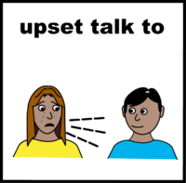

ACTION 5.23 Bereavement Service
CLOSED
What we did:
The Community Bereavement Service was decommissioned in Year 2.
Residents can get Bereavement support from Newham Talking Therapies or the Community Team for Adults with Learning Disabilities (if they cannot access Talking Therapies).

Slide 46
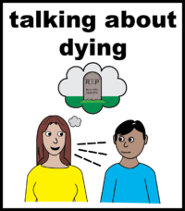
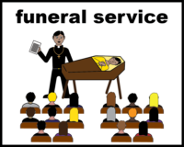
ACTION 5.24 End of Life Planning
IN PROGRESS
What we did:
St Joseph’s Hospice have developed a number of Easy Read Resources around Palliative Care. They can be found here.
Improve End of Life planning awareness
Increase use of Advanced Planning documents

Slide 47

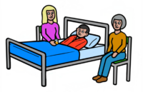
ACTION 5.25 - LeDeR
COMPLETE
What we did:
A group has now been set up between the Council and Health to discuss the learning from LeDeR to try and avoid similar issues arising for other Newham residents.
Common themes found in reviews (April 2022 to March 2023) were:
Recognising deterioration and making referrals in a timely manner (Significant 7+);
Absence of individual discussions about Advanced Care Planning and lack of confidence amongst staff to have these discussions;
Absence of Independent Mental Capacity Advocates for those who may lack capacity to support these discussions;
Last minute referrals for Learning Disability Nursing or End of Life support (during last hospital admission).

Slide 48
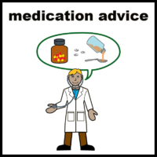

ACTION 5.26 - STOMP / STAMP
CLOSED
What we did:
ELFT has an Adults Pharmacist and a CAMHs Pharmacist working on reducing antipsychotic medication. This is a type of Mental Health medication. Adults on this medication are part of the STOMP programme.
The number of STOMP patients has reduced from 153 to 80.
Of the 80, 44 (55%) are on a STOMP medication reduction plan - and the other 45% are regularly reviewed with a plan to reduce in the future. Nine patients have completely stopped antipsychotics.
GP training sessions to be arranged to raise awareness of STOMP*, STAMP*; and the importance of Mental Health medication reviews.
*See Jargon Buster for more information about STOMP and STAMP

Slide 49
OUTCOME 6: CARERS

Slide 50
ACTION 6.2 - Emergency Care and Support
IN PROGRESS
What we did:
Work has started to map emergency care and support services currently being used.

Slide 51
ACTION 6.3 - Carers Respite
NOT STARTED
We need to:
Start work to look at residents with PMLD (*Profound and Multiple Learning Disabilities) who have Carers who are over 50 years old.
This will help identify service needs and long-term planning

Slide 52
ACTION 6.4 - Long-Term Planning
IN PROGRESS
What we did:
A Learning Disability Carers Representative joined the Learning Disability Action Plan Delivery Board.
Work has started to identify those Carers aged 50+ in order to anticipate demand for services for their cared for person, particularly those who are providing care in the family home

Slide 53
DASHBOARD - Carers
OUTCOME | INDICATOR | BASELINE | YEAR 1 | YEAR 2 | YEAR 3
Proportion of residents with a Learning Disability who receive practical support (from an unpaid carer). | Yes, from someone living in my household; Yes, from someone living in another household; No Source: Adult Social Care Survey (Learning Disability) | 75.8% 25.3% 7.7% |  | 78% 27% 7%

Slide 54
Information from Surveys and Data

Slide 55
information from Surveys and Data
Information from Surveys and Data showed that some things have gotten worse, or feel like a problem.
We need to find out why in Year 3, and try to make things better. We have put a
next to these.
Some of the information showed that things have gotten better.
We want to find out why these are better and keep doing what works. We have
put a next to these.

Slide 56





Information from the Adult Social Care Survey
This is a survey sent to everyone who receives Social Care. It is sent every year.
In year 2:
69.7% said it was easy to find information about support. It was 92% in year 1.
82% said their home is designed to meet their needs. It was 92% in Year 1.
71% said their home was clean and comfortable. This was 99% in Year 1.
42% said they are able to get around their community. This was 70% in Year 1.
88% said they have as much social contact as they would like. It was 89% in Year 1.

Slide 57
More Information from the Adult Social Care Survey
86% feel they have control over their daily life. This was 88% in year 1.
95% thought that care and support services helps them to have a better life. This was not available in year 1.
81% said that their Social Care Service helps them to have control over daily life. This was 88% in year 1.
98% who use services thought that those services have made them feel safe and secure. This was not available Year 1.

Slide 58
Information from Azeus Care
(Social Care)
In Year 2:
86% of residents with a Learning Disability in receipt of Long Term Services who live in their own home or with family. The target is 80%. In Year 1 it was 87%.
80% of residents with a Learning Disability who live in an in-borough Supported Living scheme. In Year 1 it was 85%.
28% of residents with a Learning Disability who live in an in-borough Care Home. In Year 1 it was 26%.
79 Safeguarding Concerns were raised for adults with Learning Disabilities. It was 96 in Year 1. Of these concerns:
  53 became Section 42 Enquiries. This was 54 in Year 1.
  80% of cases had the risk reduced or removed. It was 83% in year 1.

Slide 59
More information from the Adult Social Care
2.8% of working-age residents with a Learning Disability are in paid work. It was 3.2% in Year 1.
1.3% of residents with a Learning Disability who are Care Act eligible are in work. This was 2.9% in Year 1.

Slide 60

Information about Co-Production
In Year 2, 19 people took part in the Learning Disability Resident Advisory Group, this was up from 11 in Year 1.
We could not get information about the number of people who took part in the ELFT’s People Participation Group for Year 2.

Slide 61
Information about Our Newham
Our Newham Learning and Skills:
There were 227 Students with Learning Disabilities. This was 178 in year 1.
Our Newham Work
15 residents were getting support from the Enterprise Scheme (Support into work). This was the same as Year 1.
61 residents with a Learning Disability were getting support from Our Newham Work’s Supported Employment Team. This was 42 in Year 1.

Slide 62


Information from the NHS
There were 1681 people on the Primary Care Learning Disability Register. There were 1635 in year 1.
86% of residents on the Learning Disability Register have had a GP Health check. This was 89% in Year 1.
5 residents have been an inpatient in a Mental Health Hospital
19 residents have been on the Dynamic Support Register. This was the same in Year 1.

Slide 63
Jargon Buster
Term | Full name or meaning
ASC | Adult Social Care
AzeusCare | AzeusCare is a digital recording system used by Newham’s Social Care Services to support delivery of services.
Barts Health NHS | Barts Health NHS Trust is a group of hospitals provide a huge range of clinical services to people in east London and beyond. Hospitals include: Newham University, St Bartholomew’s, Mile End, Royal London and Whipps Cross Hospitals.
CAMHS | Child and Adolescent Mental Health Services
C(E)TR | Care, (Education) and Treatment Reviews are for children or adults with a learning disability (or autistic) admitted, or at risk of admission to a Mental Health hospital. The NEL ICB or NHS England leads meetings. The meetings aim to reduce or avoid hospital stays. Education if the resident is under 25 and have education needs.
CGL Change Grow Live | Local Provider of Substance Misuse Services also known as Rise Newham.

Slide 64
Jargon Buster
Term | Full name or meaning
CYPS | Children and Young People’s Services.
Dual Diagnosis | In this report it means that you have a Learning Disability plus another need or condition, such as Substance Misuse.
Dynamic Purchasing Vehicle | It is an electronic system for the Council to buy services. The Council sets standards that the providers/suppliers must demonstrate when they apply to join. Providers /supplier must be approved before the Council will use them.
Dynamic Support Register DSR | The DSR is a register of people with learning disabilities and/or autism who are at risk of being admitted to a specialist or mental health hospital. It helps local support teams to identify those who would benefit from a Care (Education) and Treatment Review. Each local borough holds a registers for adults and one for children's and young people.
ELFT | East London NHS Foundation Trust provides mental health, community health, and inpatient services to young people, working age adults, older adults and forensic services to Newham; it also provides a range of services outside of Newham.
Elective Care | Non-emergency and planned care

Slide 65
Jargon Buster
Term | Full name or meaning
Learning Disability Resident Advisory Group. | The main purpose of this group is to Advise the Learning Disability Action Plan Delivery Board and make sure that residents voices are part of the delivery of the Adult Learning Disability Action Plan.
Learning Disability Action Plan Delivery Board | The main purpose of the Delivery Board is to oversee the successful delivery of the action plan. It will monitor delivery of all of the actions within the plan to time and quality for reporting and sign off by the Learning Disability and Autism Joint Planning Group.
Learning Disability and Autism Joint Planning Group | This Group brings together statutory health and social care services, voluntary and community sector organisations, service users, and carers, to work collaboratively to test and deliver improvement and transformation initiatives.
LeDeR Learning Disabilities Mortality Review | Started in 2017 by NHS England and NHS Improvement, LeDeR is a service improvement programme that improve care, reduce care inequalities, and prevent people with a learning disability and autistic people from early deaths
NEL ICB North East London Integrated Care Board | NEL ICB is the Integrated Care Board responsible for Newham and the seven neighbouring local authorities (Barking and Dagenham, City and Hackney, Havering, Redbridge, Tower Hamlets, Waltham Forest) in North East London.

Slide 66
Jargon Buster
Term | Full name or meaning
NHS | National Health Service
NHSE | National Health Service England
People Participation Group | ELFT People Participation has a group for Newham residents open to the Community Health Team for Adults with Learning Disabilities. The aim is working together with service users and carers to make sure people with a learning disability and/ or their carers can say what they think about the services, and how they can be improved.
Positive Behaviour Support PBS | PBS is research based model of intervention used to build understanding of the behaviour from the person’s point of view and their lifestyle, and developing an intervention based upon this interpretation. It aims to increase the quality of life and decrease ‘problem’ behaviour by teaching new skills and making changes to a person’s environment.
PMLD | This term can be used to describe people who have Profound and Multiple Learning Disabilities.

Slide 67
Jargon Buster
Term | Full name or meaning
S117, S7, S17, S37/41, S47, | These are sections in the Mental Health Act. They help decide financial arrangement between Health and Social Care.
S75 | This is a financial arrangement between Health and Social Care for jointly funded care
SEND | Special Education Need and Disabilities
Social Prescribing | Social prescribing refers to when health professionals refer patients to non-clinical support services in the local community to help their health and wellbeing where appropriate.
STAMP | Supporting Treatment and Appropriate Medication in Paediatrics is a national programme that aims to make sure that children and families can access other treatment and support when children display behaviours that challenge (including accessing medication if they need it).
STOMP | Stopping over medication of people with learning disabilities, autism or both is a national programme aims to stop the overuse of psychotropic medications for children and young people with a learning disability, autism or both.
Well Newham | Well Newham is the Social Prescribing site to find information and support for Newham residents to look after their Health and Wellbeing.

